Slide 1
Ethernet System Controller
WV-CU980
Ver. 1.10

Slide 2
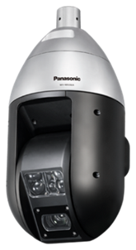
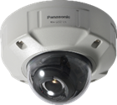
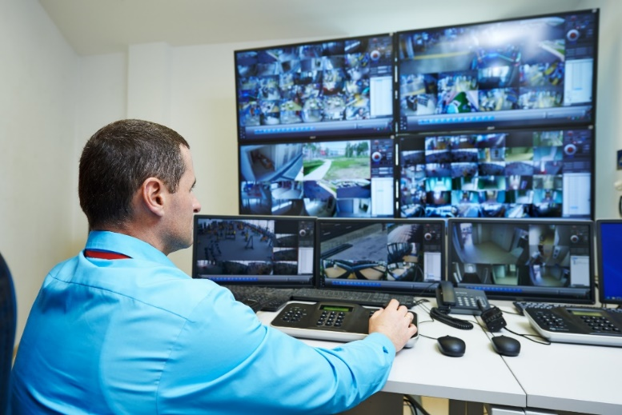


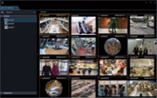
Even a small monitoring room with limited space
can easily manage a complex surveillance system.
Monitoring Center
Introducing a new controller with superior operability and comfort

Slide 3
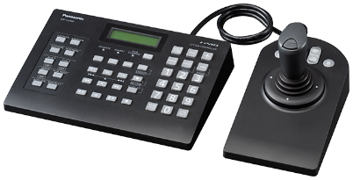
Concept & key points
Accurate and intuitive camera control at your fingertips !
Reduces user fatigue through an ergonomic design that simultaneously improves the quality of work while providing better overall system management.
User-friendly design
Compact body
Compatibility with VMS
Ethernet System Controller
WV-CU980

Slide 4
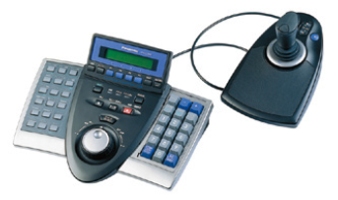
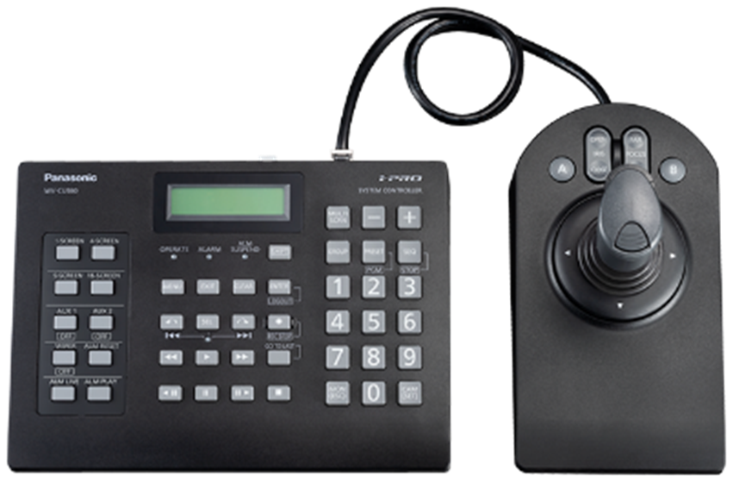
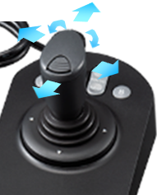
User-friendly design
Accurate and intuitive camera control at your fingertips !
The user-friendly design reduces operational strain during prolonged use.
The detachable 3D joystick can change the pan & tilt direction of a camera, while the calibration of the lever’s position controls the camera’s pan & tilt zoom functions, making tracking seamless.
WV-CU980
Conventional model
WV-CU950
3D Joystick
Redesigned button layout provides smoother camera and recorder control.

Slide 5
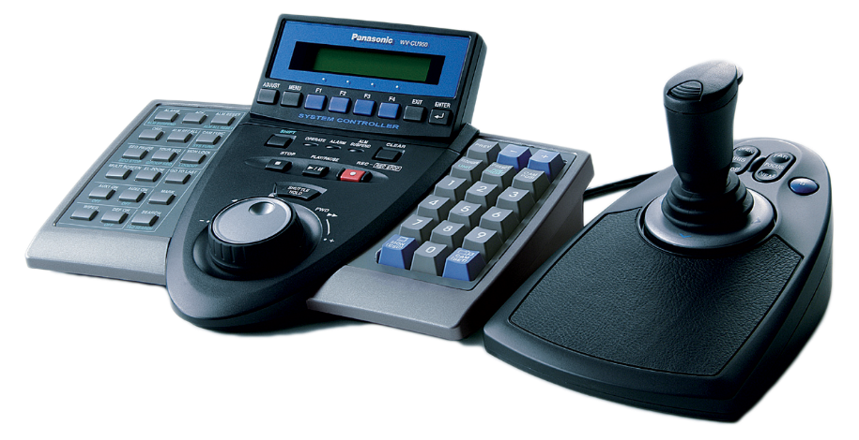
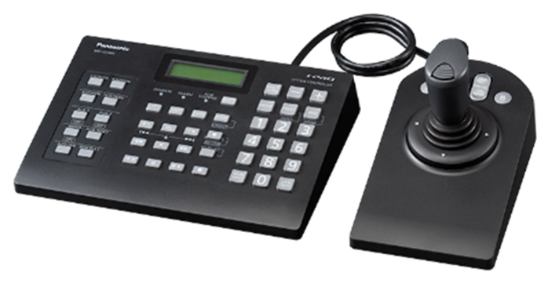
Compact body
With its separated joystick and compact main body design,
the WV-CU980 is perfect in areas where space is limited.
WV-CU950
WV-CU980
Main body : 290 (W) x 221 (D) mm
Main body : 237 (W) x 173 (D) mm
Joystick body : 134 (W) x 222 (D) mm
Joystick body : 113 (W) x 206 (D) mm
Reduces space requirements by 30%

Slide 6

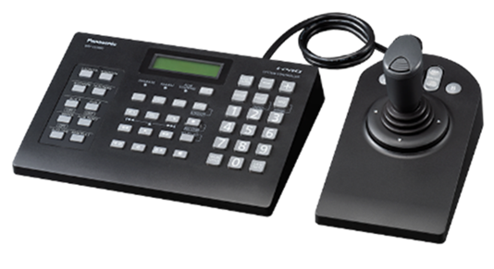
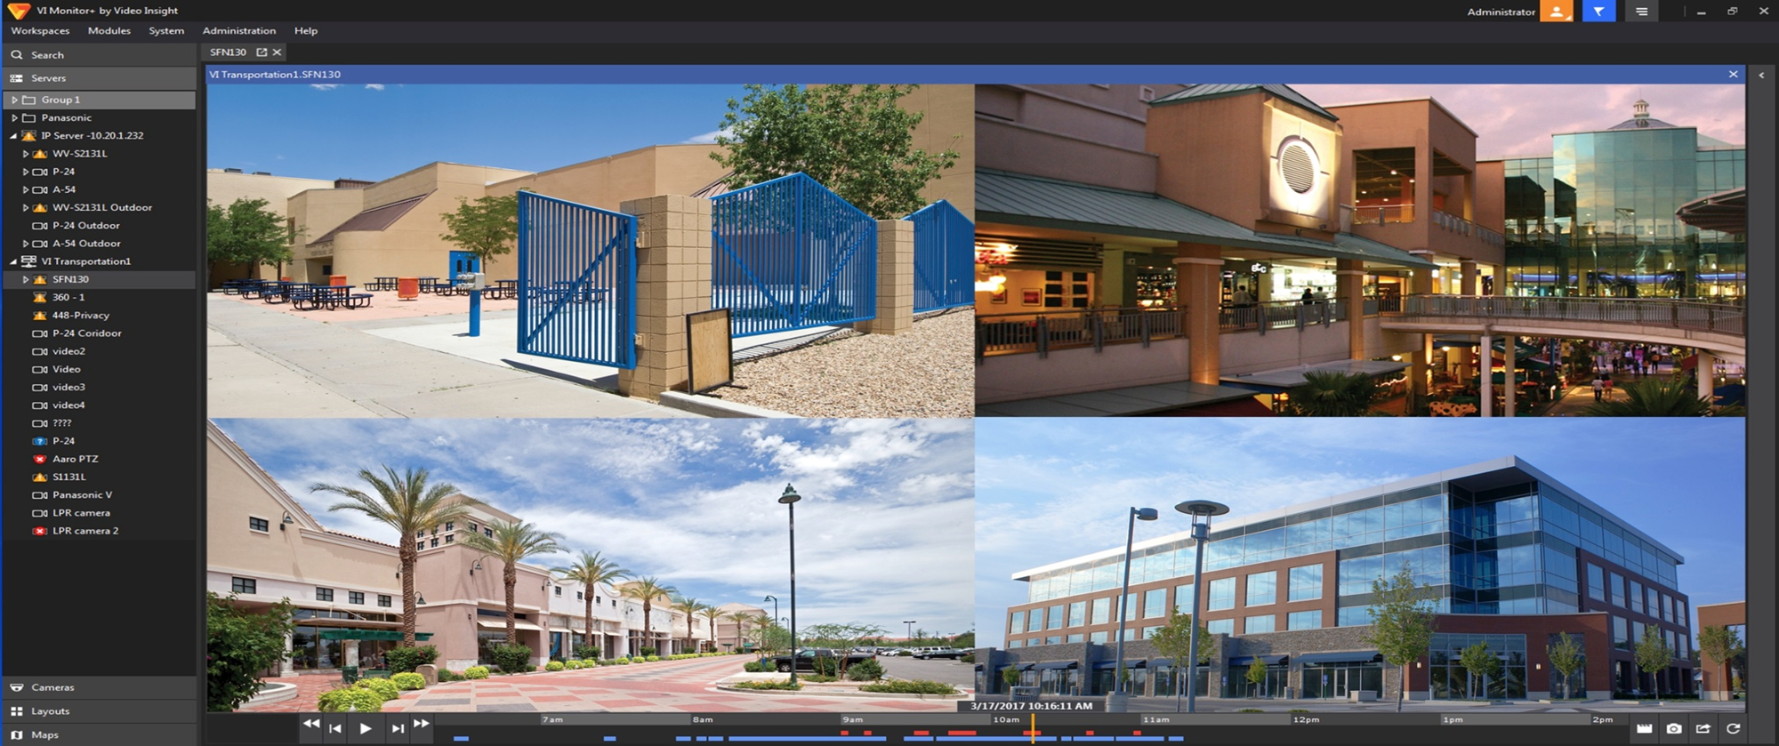
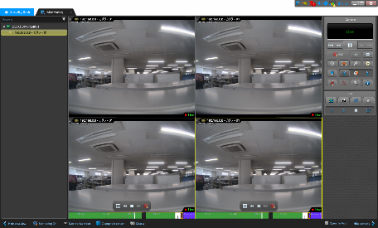

Compatibility with VMS
Provide improved efficiency and intuitive operational controls
to any compatible VMS platform via network
Video Insight
WV-CU980

Slide 7


Specifications
 |  | WV-CU980 | WV-CU950
Connected Software ＆ Device | Software & VMS | ASM300 / Video Insight | ASM200 / ASM300 / Video Insight/ASC970
 | Analog devices | -- | Yes (PS-Data/Terminal) (RS485)
Structure | Joystick | PTZ, TOP button, A/B button
 | Button | For selecting devices (18 buttons) ,function (10 buttons) | For selecting devices (18 buttons), function (22 buttons)
 | Recorder control | Operation by buttons | Operation by jog dial / Jog shuttle / buttons
 | LCD display | 2 lines × 16 characters | 2 lines x 20 characters
 | Indicator (LED) | Power / Alarm / Alarm suspend / SEL | Power / Alarm / Alarm suspend / Holed
Functions | PC Display Control | 1/4/9/16 images, Sequence, Group
 | Camera Control | Pan / Tilt / Zoom / Focus / Iris / Preset / AUX / Wiper / Auto tracking
 | Recorder Control | Play / Fast Play / Step / Skip / Jump / GoToLast / Manual REC
 | Alarm Control | Reset / Select / Ack
 | Joystick Adjustment | Change moving direction (PAN/TILT) Calibration of lever position (By user) | --
 | Update Firmware | Available by user (with PSSCT) | Not available by user
 | Communication | Secure mode / Compatible mode | CU950 protocol (Compatible mode)
Dimensions | Main Unit | 237 x 45 x 173 mm({9-11/32 x 1-25/32 x 6-13/16 inches) | 290 x 111 x 221 mm(11-13/32 x 4-3/8 x 8-11/16 inches)
 | Joystick Unit | 113 x 121 x 206 mm(4-7/16 x 4-25/32 x 8-1/8 inches) | 134 x 131 x 222 mm(5-9/32 x 5-5/32 x 8-3/4 inches)
Weight (without the AC adaptor) |  | Main : 0.84 kg {1.85 lbs}, Joystick : 0.64 kg {1.41 lbs} | Main : 1.3 kg {2.87 lbs}, Joystick : 0.8 kg {1.77 lbs}
Power Source, Operating Temperature |  | DC 12 V 250 mA, 0 °C to +50 °C {32 °F to +122 °F} | 9 V DC, 600 mA, -10 °C to +50 °C {14 °F to +122 °F}

