Slide 1
Fiber Optic Media Converter Unit
WV-X65F1 (For IR PTZ and outdoor PTZ cameras)
WV-S25F1 (For outdoor Dome and 360-degree cameras)
Ver. 1.01
Panasonic i-PRO Sensing Solutions Co., Ltd.

Slide 2



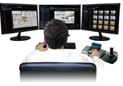
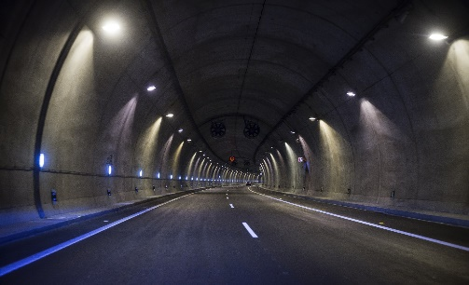
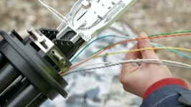
Why is fiber optic cable used?
Oil pipe line
Bridge
Monitoring center
LAN twisted pair cable
To use fiber optic cable
Benefit
Tunnel
Long distance data transmission with lower data loss
Long-distance surveillance applications
High-speed data communication with wider bandwidth
Higher reliability and lower total cost
2

Slide 3
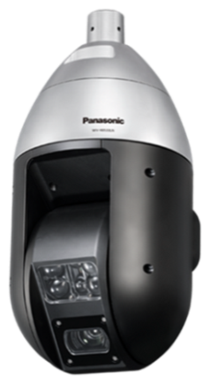
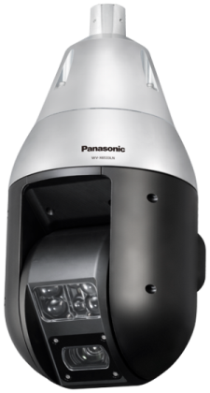
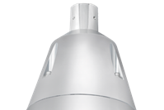

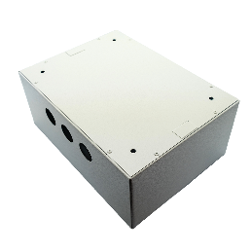
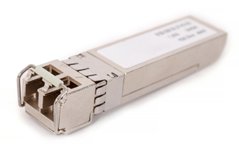
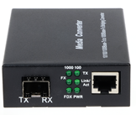

Concept & key point
The optional Fiber Optic Media Convertor Unit enables to reduce the installation time and construction of a long distance monitoring system without spending time on selecting and evaluating the optical media converter.
Current
New solution
Sold separately
Junction box
Fiber Optic Media Converter Unit
SPF module
Built-in
optical media converter
＋
Sold separately
Optical media converter
Incorporate an SFP module into mounting bracket
Selecting and evaluating the optical media converter
To protects against static electricity and dust and maintains high reliability
Installation takes time
Easy installation for waterproofing
3

Slide 4
Specifications
 | WV-X65F1//S25F1
Waterproof | IP66 (IEC 60529)
Shock resistance | IK10 (IEC 62262)
Power source | 24 V AC (50 Hz/60 Hz)
Input power consumption | 24 V AC: 4.8 A / 77 W
Output power consumption | 24 V AC: 4.5 A / 72 W 12 V DC: 1.1 A / 13 W
Operating Temperature | –40 °C to +60 °C {–40 °F to +140 °F} (Power On range: –30 °C to +60 °C {–22 °F to +140 °F})
Humidity | 10 % to 100 % (no condensation)
Dimensions | ø174 mm × 186 mm (H) {ø6-27/32 inches × 7-5/16 inches (H)}
Weight | Approx. 1.6 kg {3.53 lbs} (Including attachment ring (Approx. 200 g {0.44 lbs})
Support specifications for SFP module
SFP Port Type | LC type
Ethernet Speed | 100/1000 Mbps
Supply voltage, current | 3.3 V typical, Max. 300 mA
SFP Cage | Standard mini-SFP cage (For 6.5 mm pitch SFP)
Required SFP’s Bit Error Rate | Max. 10-12
Compatible SFP module
1000Mbps support Model No. (Brand) | Cable type | TX wavelength | Reach | Operating Temperature
GLC-SX-MM-RGD(CISCO) | MMF | 850nm | 500m | 40-85℃ (Industrial type)
GLC-LX-MM-RGD(CISCO) | SMF / MMF | 1310nm | 10km(SMF)
J4859D(HP) |  |  |  | -40-85℃
100Mbps support Model No. (Brand) | Cable type | TX wavelength | Reach | Operating Temperature
GLC-FE-100FX-GD(CISCO) | MMF | 1310nm | 2km | 40-85℃ (Industrial type)
GLC-FE-100LX-GD(CISCO) | SMF |  | 10km
*For latest information about compatible SFP modules, refer to the https://security.panasonic.com/support/info/ <Control No.: C0504>.
4

Slide 5
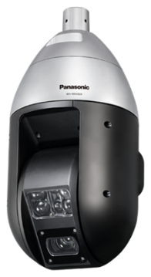
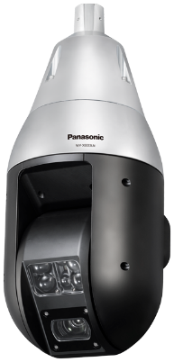
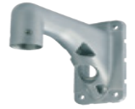
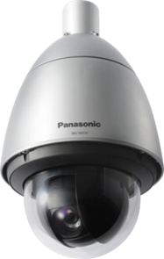
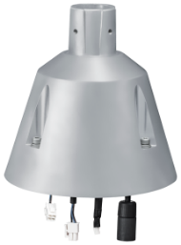
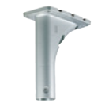
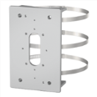
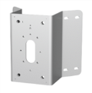
Support models and optional brackets (1)
IR PTZ camera
WV-X6533LN
WV-S6522LN
Wall mount
WV-Q122A
(Light Silver)
WV-X65F1
(Fine silver)
Ceiling mount
WV-Q185
(Light gray)
WV-Q121B
(Light silver)
Pole mount
Corner mount
WV-Q188
(Light Silver)
WV-Q189
(Light Silver)
Fiber Optic Media Convertor Unit
Outdoor PTZ camera
WV-X6531N/X6511N
WV-S6530N
WV-Q182
(Light gray)
WV-Q183
(Light gray)
5

Slide 6
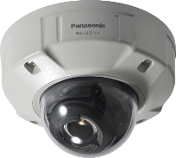
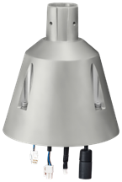
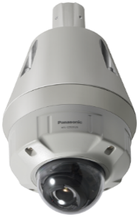
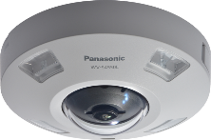
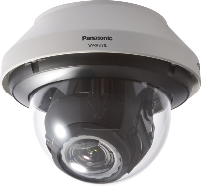
Support models and optional brackets(2)
H.265 Outdoor
Dome camera
WV-S2570L(4K)
WV-S2550L(5M)
WV-S2531LTN/S2531LN(FHD)
WV-S2511LN(HD)
Wall mount
WV-Q185
(Light gray)
WV-S25F1
(Light gray)
Ceiling mount
WV-Q122A
(Light silver)
WV-Q121B
(Light silver)
H.265 Outdoor
360-degree camera
WV-X4571L(9M)
WV-S4550L(5M)
Pole mount
Corner mount
WV-Q182
(Light gray)
WV-Q183
(Light gray)
Fiber Optic Media Convertor Unit
H.264 Outdoor camera
WV-SFV781L
WV-Q188
(Light silver)
WV-Q189
(Light silver)
6

Slide 7
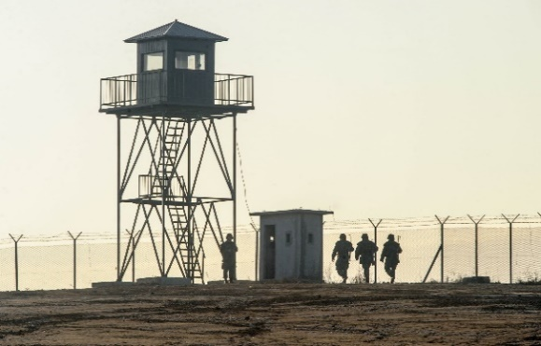

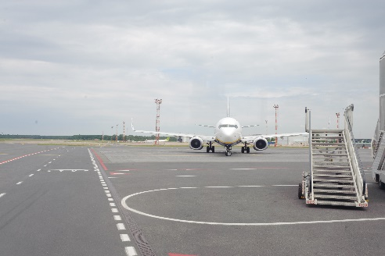



Industry examples
Fiber Optic Media Convertor Unit are suitable in use several long distance surveillance applications
Airport
Boarder
City surveillance
Oil plant
Railway
Shipyard
and more……
7

Slide 8


