Slide 1



Vehicle Search Server Software
New Deep Learning Vehicle Search Solution
WV-ASV100W
Ver. 1.02
Panasonic i-PRO Sensing Solutions Co., Ltd.

Slide 2





Typical law enforcement investigation workflow
Spend hours, days or even weeks to narrow down a suspect vehicle
Witness
There was a robbery! The man drove out eastwards.
Operator
Emergency call
Do you remember the License Plate?
No. I only remember that it was a grey sedan.
Emergency call
All right. We will check candidate vehicles on video footage and dispatch an officer to confirm with you.
Finding the suspect vehicle takes tremendous
time searching video footage manually.
Identify and arrest
2

Slide 3


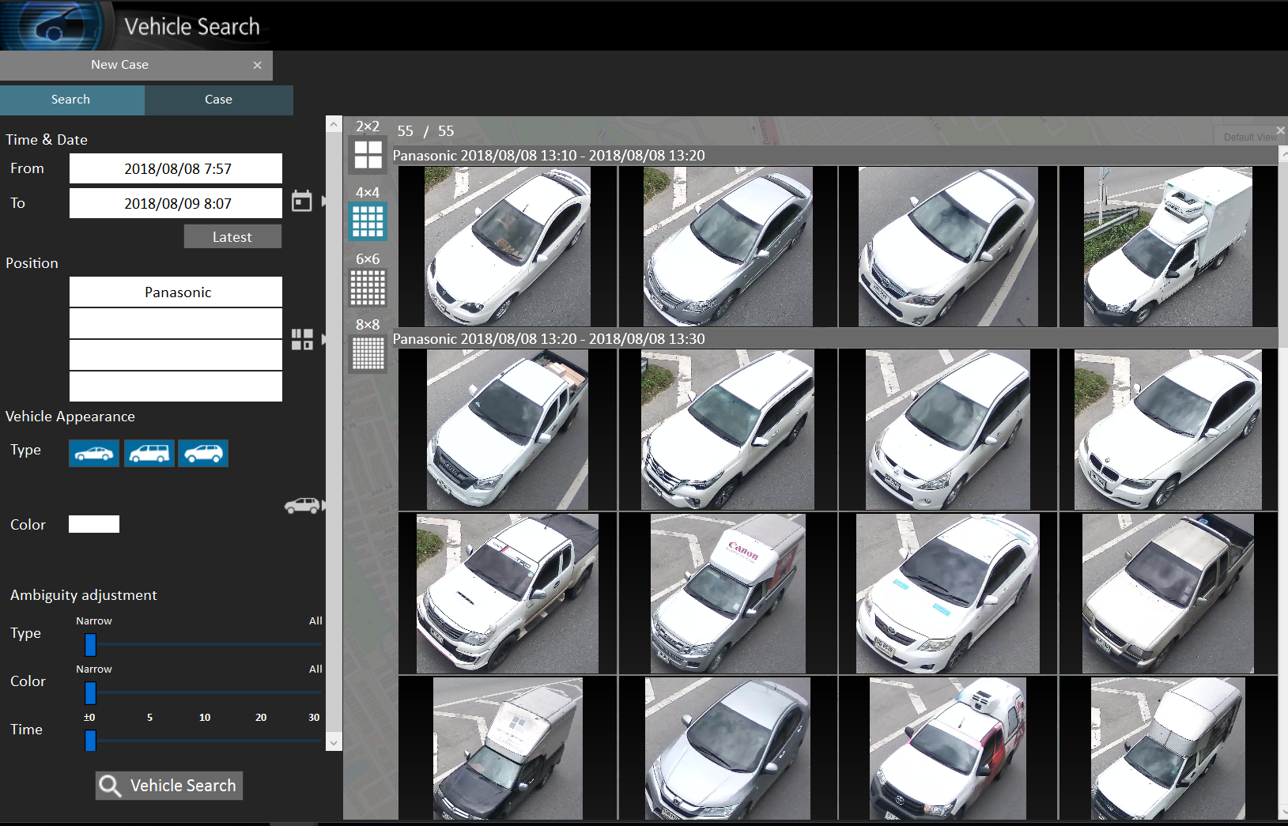
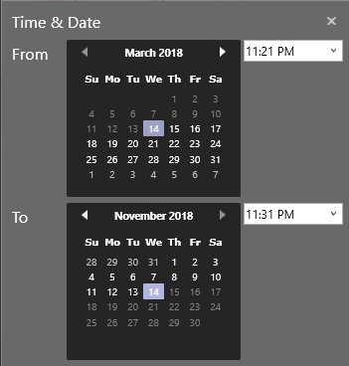
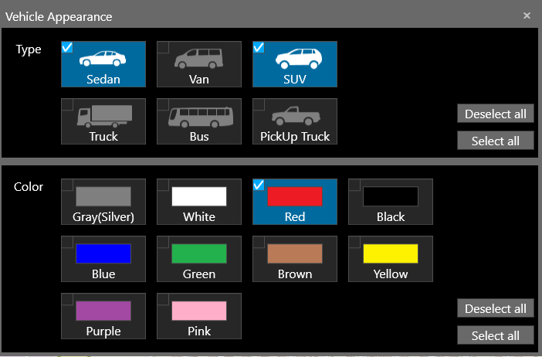
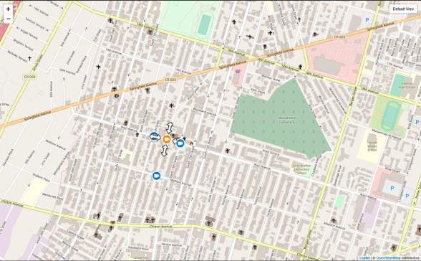


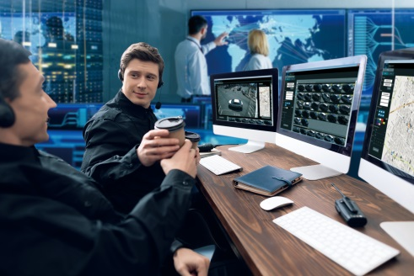

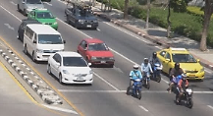
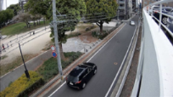
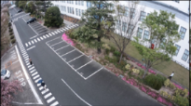
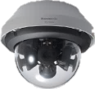
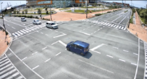

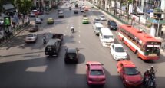



New Solution with Panasonic Vehicle Search System
Enables law enforcement to find the candidate of suspicious vehicle efficiently
even by the incomplete information from witness such as lack of license plate,
then helps to accelerate time of investigation
Current Process
New Solution with Panasonic Vehicle Search System
Review all footage
frame by frame
for hours …
Enter When,
When, Where,
!
When, Where, What
？
Immediate
Search result
8 hours per day*
*Based on multiple surveys in 2017
15 min. per day*
*estimated by simulation
3

Slide 4
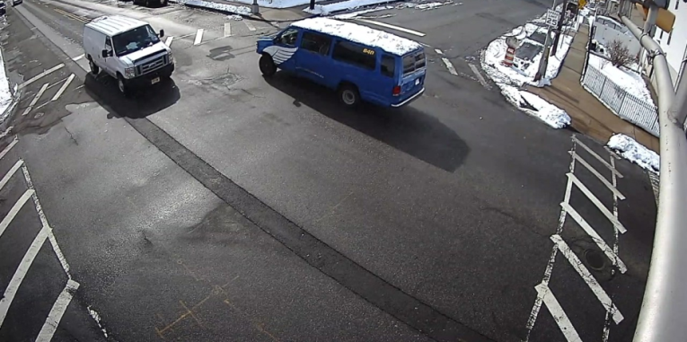
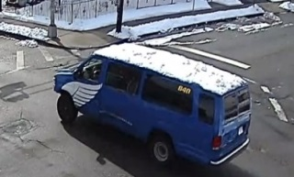
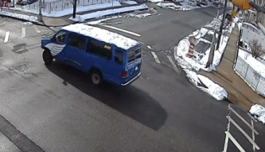
Highly accurate vehicle detection under challenging scenes : sunlight reflection, shadows, overlapping objects, dynamic traffic situation
Panasonic Deep Learning Technology
Vehicle search solution powered by Panasonic deep learning technology
Color
Type
Direction
1st : Blue
2nd : Black
3rd : Brown
1st : Van
2nd : Sedan
3rd : SUV
Recognize vehicle by classifying “color” and “type” at various camera view angles
Supports “ various directions” by tracking vehicle position
"Top 3 candidates" of “color" and “type" are extracted to enable a flexible search
4

Slide 5
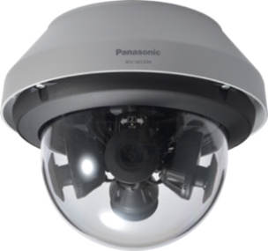
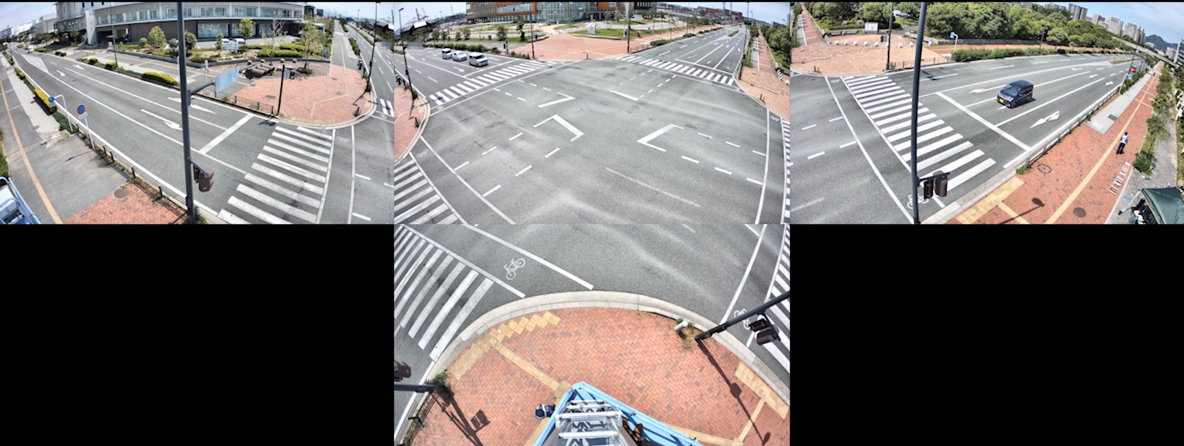
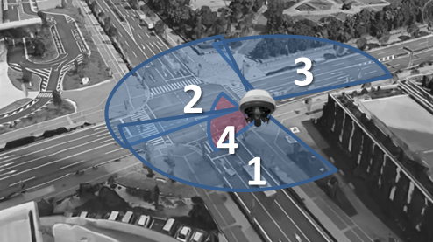
Multi-sensor camera at intersection
One Multi-sensor camera can cover the whole intersection
Cam2 and Cam4 can be used for vehicle search
1
2
3
4
5

Slide 6
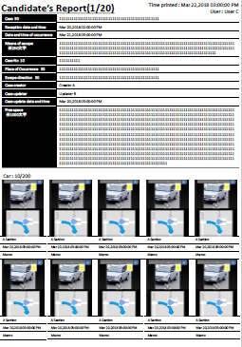
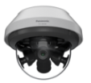
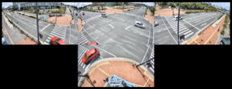

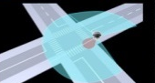
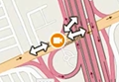

Panasonic Vehicle Search System
Vehicle monitoring
in the intersection
Vehicle search server provides analytics
Vehicle search on VMS
i-PRO Extreme Cameras
Deep learning engine
Share search result with
field officer
Thumbnails
Color
PDF
Panasonic multi-sensor camera enables monitoring of vehicles by minimizing blind spots in intersection.
Type
Direction
Panasonic Video Insight and Genetec VMS Integration . Coming Soon.
Benefit
Panasonic Vehicle Search Solution searches for suspicious vehicles approximately 30 times faster* than manual search
*Estimation by original calculation
Free your operators from repetitive tasks and enable them to focus on investigation
Improve initial response time and increase arrest rate leading to a safer community
6

Slide 7



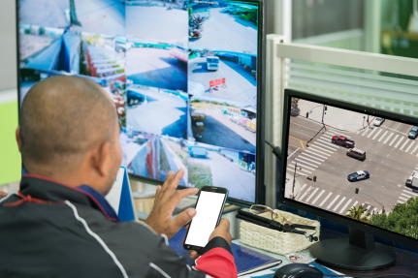
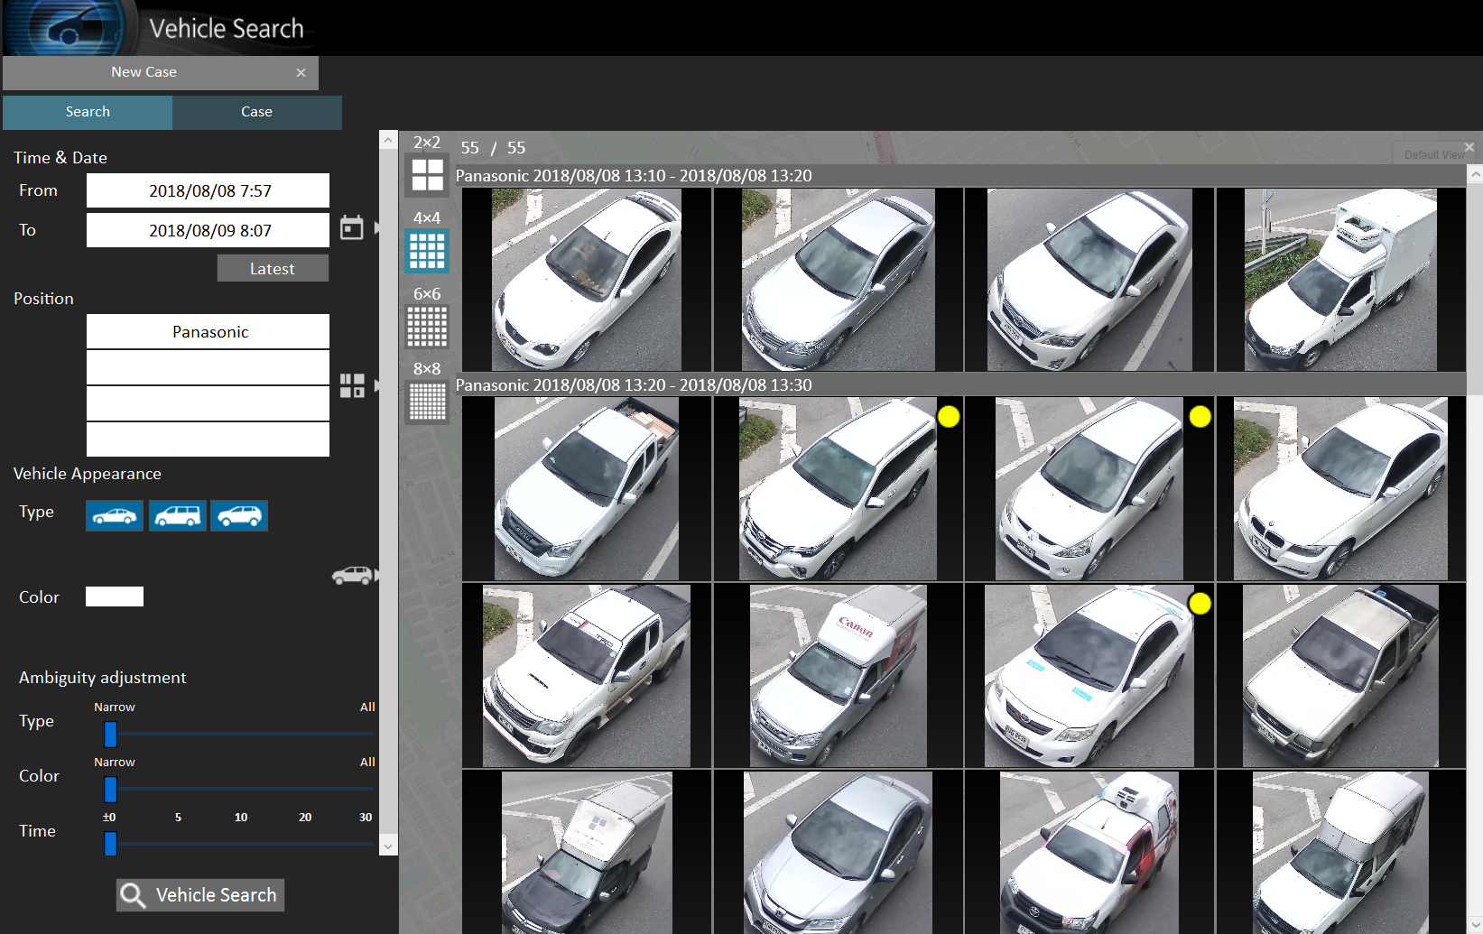
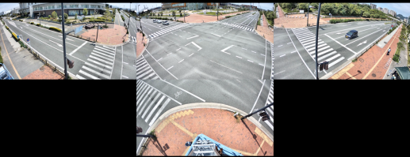
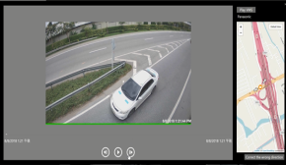

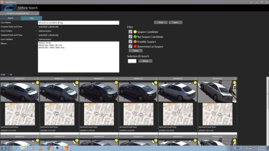
Operation example
1: Information from witness
2: Search/Narrow down/Report
3: Pursue
Search for white sedan by thumbnail
White sedan drove east
Playback
Narrow down candidate
Dispatch pursue
team to area
Multi sensor camera WV-X8570N
Using two channels per multi-sensor camera enables the capture of all vehicles inbound and outbound in an intersection.
7

Slide 8
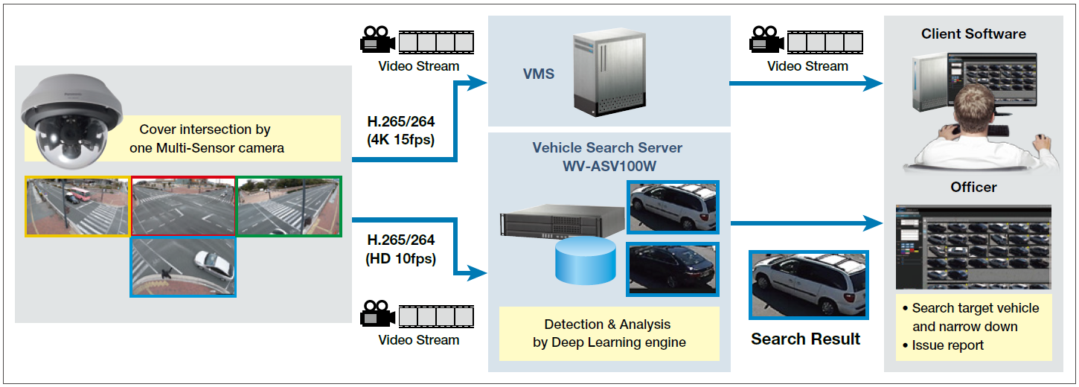
System application
8

Slide 9

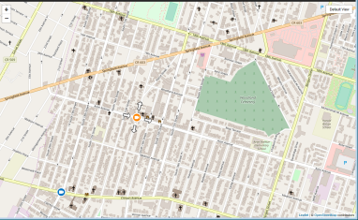


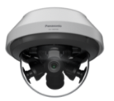


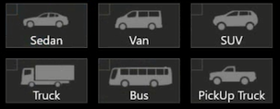
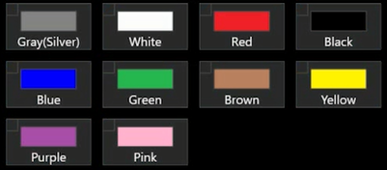
Main features
Real-Time analytics
For immediate response
in crime investigation
20 cameras per server
minimizing system cost
i-PRO Extreme
cameras are supported
High image quality images under
low-light and harsh environments
6 vehicle types
10 vehicle colors
8 x 2 directions
8 inbound
8 Outbound
9

Slide 10













System Expandability
Expanding system
Basic system
Client
Clients
Camera
VI/Genetec
Video
Video
Up to 10 clients
Vehicle search server
Can monitor up to
10 intersections with
10 multi-sensor camera or
20 single camera units
Vehicle search server
Can monitor up to
100 intersections with
100 multi-sensor camera or
200 single camera units
Search Result
Can search data across
20 camera channels among
1 server
Can search data across
200 camera channels among
10 servers
10

Slide 11
Specification
Analytic Method |  |  | Real time analytic using deep learning engine on server
Object | Vehicle detection |  | Yes
 | Search key | Type | 6 (Pickup Truck, Sedan, Van, SUV, Truck, Bus)
 |  | Color | 10 (Green, Blue, Brown, Purple, Yellow, Red, Pink, Black, Silver/Gray, White)
 |  | Direction | 8 inbound/ 8 outbound direction (enable to filter on map window)
 |  | Map | Yes (Select camera icon on map)
Search | Multiple camera |  | Yes (Up to 4 position)
 | Accuracy adjustment |  | Yes (increase or decrease result by slide bar)
 | Result view |  | Thumbnail (max. 64 at same page)
 | Map integration |  | Search and result with direction on the map *Google Map and Open Street Map are supported, Offline map (JPEG)
 | Retention period |  | 31days as default (14 to 92 days, configurable)
Integration | VMS |  | Security Center 5.7 / VideoInsight 7.3.2.5 *As of April 2019
 | Camera |  | i-PRO Extreme Camera *Multi-sensor/Fixed/PTZ camera(Except 360-degree camera)
Management Result | Case reporting |  | Save up to 100/load
 | Log |  | Save Operation log
 | Report |  | Print to paper and PDF (depend on Windows environment), enable to share by email
System | Max CH per server |  | 20ch (When using 2 ch per unit with 10 multi-sensor camera, 10 intersections)
 | Max server per system |  | 10 server
 | Max CH per system |  | 200ch (When using 2 ch per unit with 100 multi-sensor camera, 100 intersections)
11

Slide 12
Specification (system requirements)
Server Specification
CPU | Intel® Xeon® Gold 5118 2.3 GHz (12-core 24-thread) or faster CoreTM i7-8700K 3.70 GHz (6-core 12-thread) or faster
Memory | 32 GB (16GB x 2) or more
HDD | 3 TB or more (in the case of 31days)
Graphic | NVIDIA Quadro P4000 x 2
OS | Microsoft® Windows® 10 Pro (64 bit) Release Ver.1709 and later Microsoft® Windows Server® 2016 Standard Edition
Network I/F | 1000 Mbps
Client Specification
 | Security Center 5.7 client + WV-ASVC101W | VI Monitor Plus 7.4 + WV-ASVC101W
CPU | IIntel® CoreTM i7-4770 or better | Intel® CoreTM i7-6700 or better
Memory | 8 GB or more | 8GB or more
HDD | 120 GB for OS and Security Center applications | 120 GB for OS and Video Insight IP Server applications
Graphic | NVIDIA® QUADRO® K620 2 GB video card | 1600 x 900 or higNVIDIA® QUADRO® K620 2 GB video cardher screen resolution
OS | Microsoft® Windows® 8.1 Professional (64bit), Microsoft® Windows® 10 Professional RS4(64bit) English/French | Microsoft® Windows® 10 Professional (64bit)
Network I/F | 1000 Mbps | 1000 Mbps
12

Slide 13
Supported Camera
 | Model | Note
i-PRO Extreme series except Fisheye cam | WV-X8570N | 4x 4K, 33MP Multi-sensor camera
 | WV-S8530N | 4x FHD, 8MP Multi-sensor camera
 | WV-X6531NS, X6531N, WV-X6511N, S6530N, WV-S6131, S6130, S6111 | Extreme PTZ camera *Direction detection is only available at home position.
 | WV-S2550L, S2250L, WV-S2531LTN, S2531LN, WV-S2511LN, S2231L, WV-S2211L, S2131L, S2131, S2130, WV-S2111L, S2110, WV-S1550L, S1531LTN, WV-S1531LNS, S1531LN, WV-S1511LN, S1132, WV-S1131, S1112, S1111
Recommended
model
13

Slide 14
Products Line-up
Line up |  | Model number
Vehicle Search Server Software (4ch is attached) |  | WV-ASV100W
Client Plug-in Software | VI | WV-ASVC101W
 | Genetec
Additional camera Kit | 4CH | WV-ASVE104W
 | 1CH | WV-ASVE101W
Update Software (per 1 year, per server) |  | WV-ASVM111W
Example:
10 Multi-sensor camera are installed in 10 intersections. Two channel per one multi-sensor are registered to server. (20ch are required 10 intersection)
-> WV-ASV100W x 1 + WV-ASVE104W x 4 + WV-ASVC101W + WV-ASVM111W are required.
14

Slide 15


