Slide 1



Facial Recognition Server Software
Deep Learning Facial Recognition Solution
WV-ASF950
New Version
Ver. 2.01
Panasonic i-PRO Sensing Solutions Co., Ltd.

Slide 2


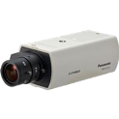

Concept & Main Features
Recognizes those who don't want to be recognized !
New deep learning facial recognition technology has recognized the faces that difficulties
by conventional technologies and will propose a personal recognition solution for
the monitoring of public facilities and entry management.
High precision
New deep learning facial recognition engine
Image optimization for facial recognition
(Intelligent Auto / Super Dynamic)
Face best shot technology
Cost reduction
System costs (Distributed computing)
Installation costs (Easy setting)
System expandability
Additional face registration
Integrated into video surveillance system
UNREGISTERED face detection
New
2

Slide 3
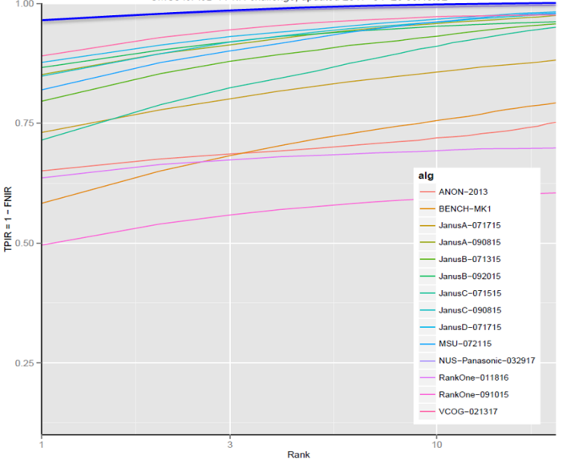
High precision
New deep learning facial recognition engine
Equipped with a world's highest level (as of April 2017) facial recognition
engine as evaluated by NIST. *Development cooperated with NUS (National University of Singapore)
Highest rank
Panasonic
NIST (IJB-A) competition
100%
NIST : National Institute of Standards and Technology
Accuracy
75%
・Competition between corporate and universities to
compete latest technology. (unlike FRVT or FIVE)
・By using data set disclosed by NIST, daily verification
is possible. Results are disclosed in a timely manner
by NIST
50%
Rank ≒ Difficulty
25%
3

Slide 4
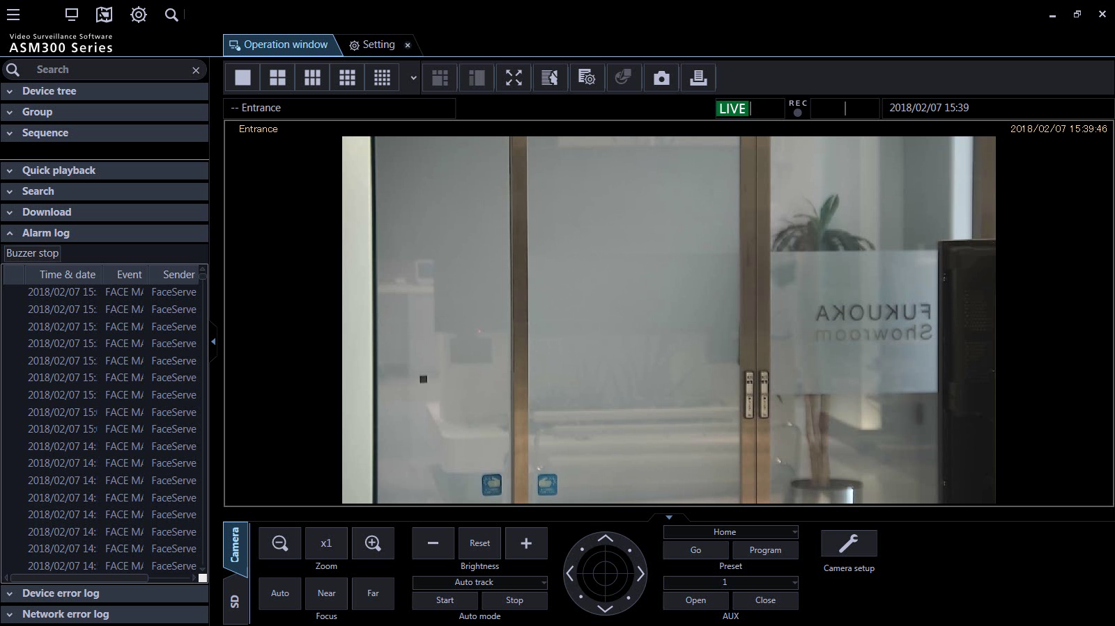


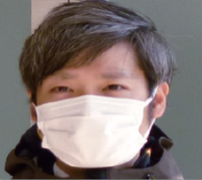

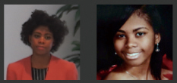
High precision
Our world leading deep learning facial recognition technology triggers
even when the subject is wearing sunglasses or surgical mask*.
Angled face
Left/Right ±45°
Up/down ±30°
Sunglass
surgical mask
*Scheduled for launch by the end of 2018
Changed by aging
4

Slide 5

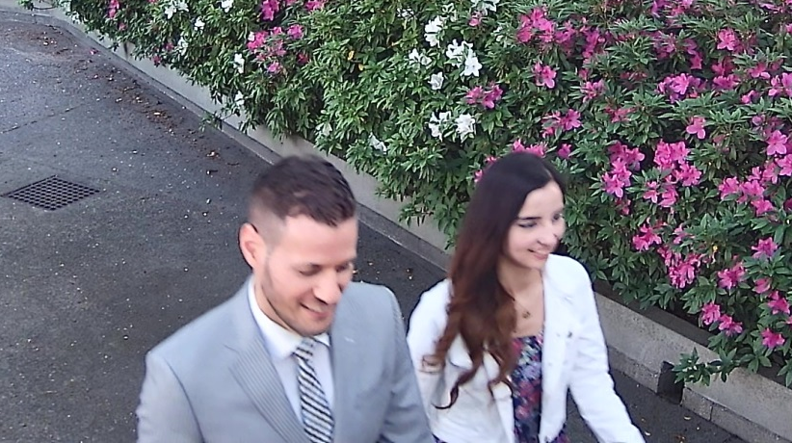

High precision
Image optimization for facial recognition - Intelligent Auto
iA function in i-PRO extreme camera enables to capture facial images that reduces blur by adjusting shutter speed in accordance to actual movement under low light conditions.
Conventional
i-PRO Extreme camera iA ON
Improvement of verification accuracy approx.10% under challenging video capturing situation
5

Slide 6

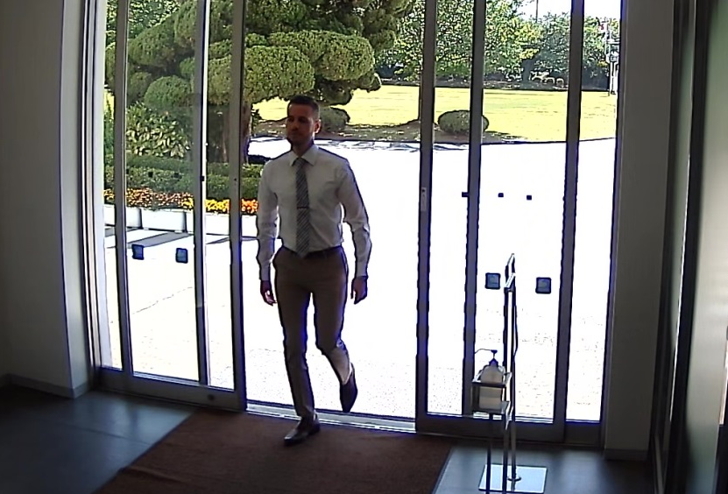
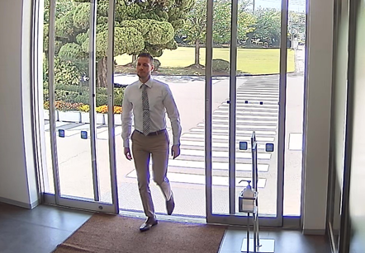
High precision
Image optimization for facial recognition - Super Dynamic
Super Dynamic function in i-PRO extreme camera enables to capture facial images that visible the face at dark area.
OFF
6

Slide 7




High precision
Face best shot technology
Best shot technology in i-PRO extreme camera enables to transmit only best facial images to facial recognition server.
Facial Recognition Server
Improve face match
processing speed
7

Slide 8
Cost reduction
System costs (Distributed computing)
Distributed computing by best shot technology enables to reduce to data transmission costs and server costs by reduce network load.
Network load approx. 1/10
Recognition server workload approx. 1/5
Max.20 cameras can be connected per server
(only 4 cameras if no best shot mode)
8

Slide 9
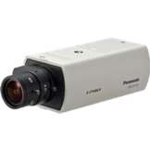
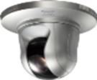
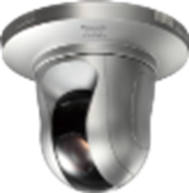
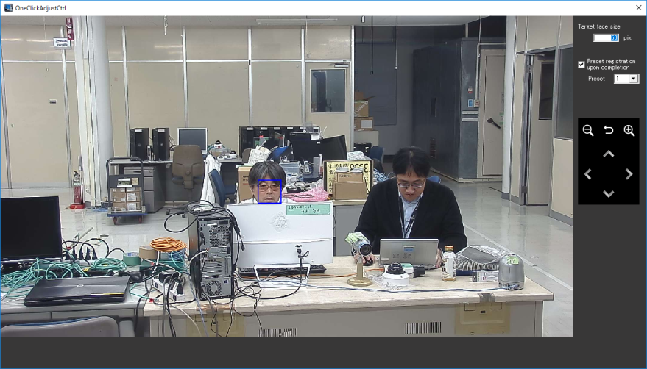
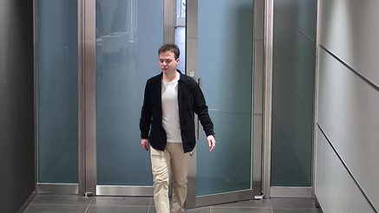
Cost reduction
Installation costs (Easy setting)
New deep learning facial recognition engine and i-PRO extreme camera
thus easy camera set up without any expert and it enables to reduce installation costs.
New : Extreme PTZ cameras enable one click camera set up setting with adjustment tool.
Easy camera set up setting
for facial recognition
9

Slide 10

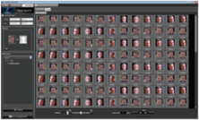
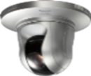


Cost reduction
Installation costs (Easy setting)
Facial Recognition Sever Software
Reduce camera setting time
for facial Recognition
Necessary captured face images : 30 pixel or more
Before
After
vs. conventional facial recognition : 1/2
To be recognized face angle :
Left/Right 45 degree, Up/Down 30 degree
1/6
15 minutes / 1 Camera
x 2 times
5 minutes / 1 Camera
vs. conventional facial recognition : x2
+
+
1/2
→ Quick and easy installation
Travel Expenses
X 2 times
Travel Expenses
10

Slide 11

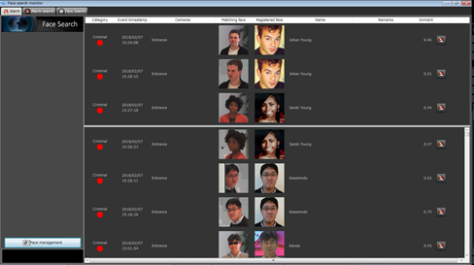

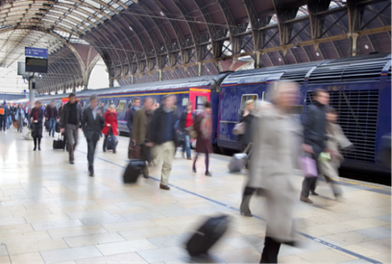
System expandability
Additional face registration
Improved accuracy through deep learning technology, it realized a significant increase in the maximum number, enables up to 30,000 faces registrations at large scale applications with optional software.
Large scale applications
Facial Recognition Server Software
WV-ASF950W / ASF950
Up to 30,000 faces can be registered
with
Additional Face Registration Kit
WV-ASFE951W / ASFE951
Up to 10,000 faces
can be registered
11

Slide 12
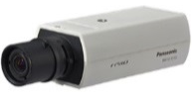
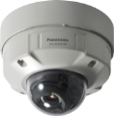
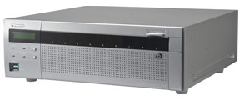
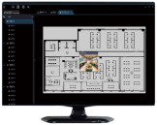
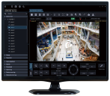
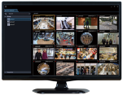
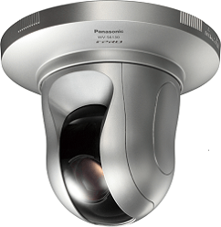

System expandability
Integrated into video surveillance system
i-PRO security system which dose not include facial recognition system
Camera
Recorder
Monitoring software
12

Slide 13
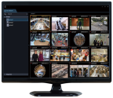




System expandability
Integrated into video surveillance system
Integrated with i-PRO security system
Camera
Recorder
Monitoring software
Facial Recognition
GUI
Facial Recognition Server
Extension software
WV-ASE231W / ASE231
Facial Recognition Server Software WV-ASF950Ｗ /ASF950
10,000 faces registration + 4ch camera license）
13

Slide 14

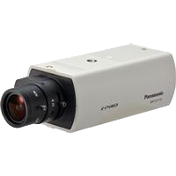
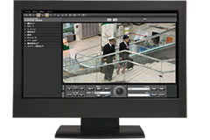
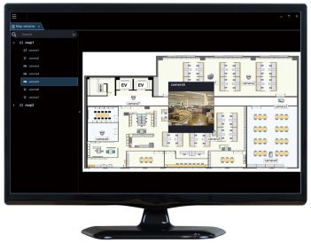
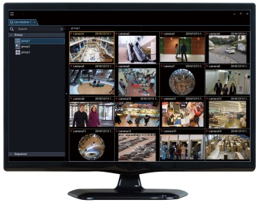
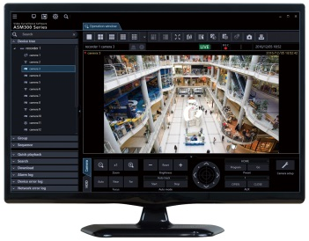
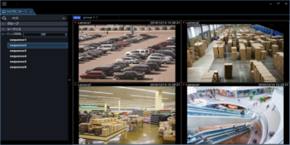
System expandability
Integrated into video surveillance system
Integrated
with i-PRO security system
Normal
operation
Main monitor
Map
Live multi-screen
Facial recognition system screen
14

Slide 15

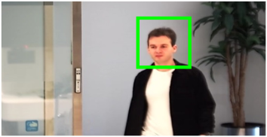
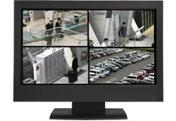
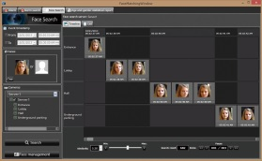

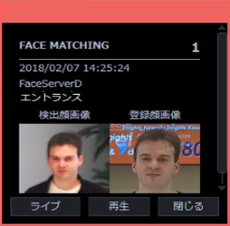
System expandability
Integrated into video surveillance system
Integrated
with i-PRO security system
Face Match
Alarm
TIME
location
Playback
button
Main monitor
Map
Live multi-screen
Facial recognition system screen
① Notification
Select face, search and show
time-line per camera
② Map confirmation
③ Capture by other security cameras
④ Pursue and locate
15

Slide 16









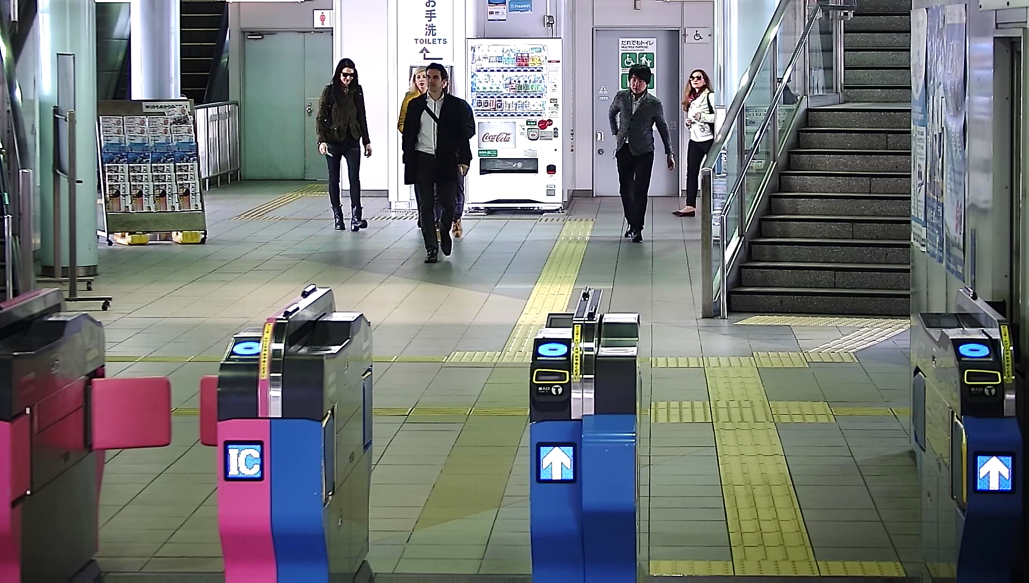
System expandability
Support Max. 2,000 cameras for large scale multi-site systems
【Station A】
【HQ・Security Center】
router
Surveillance video
Video surveillance software
・・・・・・
IP-VPN
recorder
Facial recognition server
・・・
【Station N】
・・・
router
・・・・・・
recorder
【Station A】
16

Slide 17
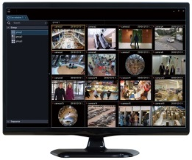

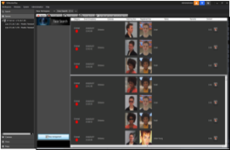
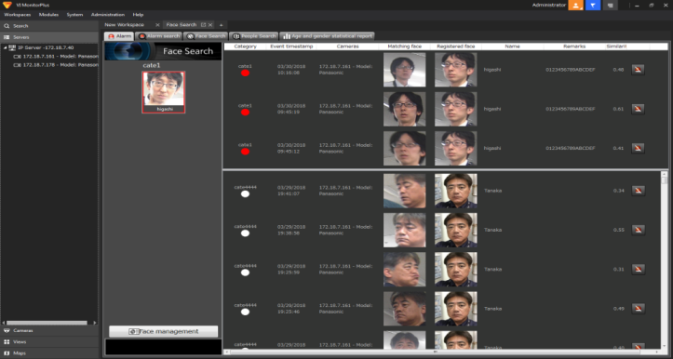

System expandability
Integrated into video surveillance system
Integrated with Panasonic Video Insight video management system
Camera
Video Insight video management system
Facial Recognition GUI
17

Slide 18
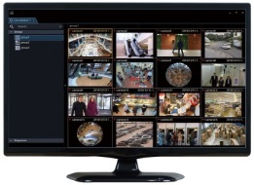
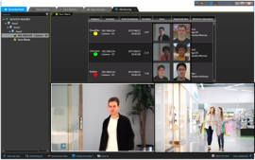



System expandability
Integrated into video surveillance system
Integrated with GENETEC video management system
Camera
GENETEC video management system
Facial Recognition GUI
18

Slide 19
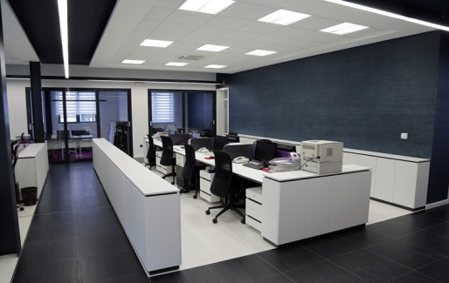
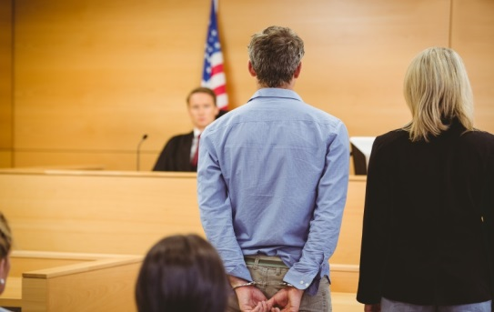

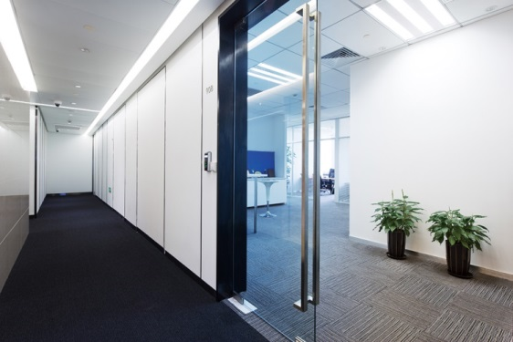



System expandability
New
UNREGISTERED Face Detection
Real-time detection of people who are NOT registered.
Important area
Office/R&D labs
Public facility
Detect people who are
not allowed in specific areas
Unregistered person
School
19

Slide 20
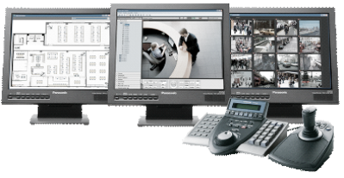
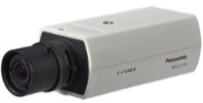
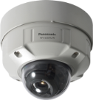

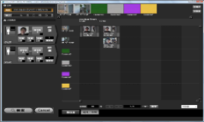

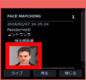



System expandability
New
UNREGISTERED Face Detection
Enables the detection of unregistered faces in the same facial recognition system
Camera
Recorder
Monitoring software
Facial Recognition Server
Facial Recognition GUI
NEW
Detects
unregistered faces
Max.10 cameras can be connected per server
Max.100 servers can be expanded(Total 1,000 cameras)
20

Slide 21
Specifications
 | Registered Face Detection | Unregistered Face Detection
Face matching speed | At 1 second in 30,000 registered faces *¹ | At 3 second in 30,000 registered faces*¹
Max. number of face in matching list | Up to 30,000 faces*²
Face searching speed in database | 3 seconds per 5 million faces*³
Max. number of face history | Up to 10 million items
Range of angles | Horizontal range : -45° to +45°, Vertical range : -30° to +30°
Minimum size of the face image | 30 pixel (Eye Distance : 15 pixel)
Face with sunglass / surgical mask | Yes / Yes
Registered face matching | Yes | Yes *⁴
Unregistered face matching | No | Yes
Max. number of connected camera | 10 cameras is suitable, up to 20 cameras per 1 face matching server*⁵ | Up to 10 cameras per 1 face matching server*⁵
Max. number of servers | 100 servers (10 primary + 90 secondary)
Max. number of client PC that can be linked with the alarm | WV-ASM300 : 16
*¹ From receiving the face thumbnail to matching in face matching server.
*² Two Additional Face Registration Kits WV-ASFE951 are necessary.
*³The best case when the time range is narrowed down and the number of search result is 100 faces. Depending on the search conditions,
the search time may take several minutes.
*⁴ Depending on settings, Unregistered Face Detection and Registered Face Detection can be used simultaneously.
*⁵ Deploying plural face servers in a system is acceptable.
21

Slide 22

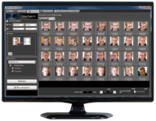
System requirement
Server/Hardware
CPU Intel® Xeon® or CoreTM i7 series 3.40 GHz
or faster (4-core 8-thread or better)32 GB
2. Memory 32 GB or more
3. HDD 1 TB or more
4. Graphic NVIDIA® QUADRO® P5000
5. Power supply 550 W or more
6. OS Microsoft® Windows® 10 Professional RS4 (64 bit),
Microsoft® Windows Server® 2016 Standard Edition
22

Slide 23
System requirement
Network Camera for face detection
WV-SPN631* ¹/ WV-SPN611*¹/ WV-SPN531A / WV-SPN311A / WV-SPN310A /
WV-SP305 / WV-SFV631LT *²/ WV-SC385 *³ / WV-S1132 / WV-S1131 / WV-
S1112 / WV-S1111 / WV-S2531LTN *² / WV-S6130
*¹ The Optional IR-LED(WV-SPN6FRL1) cannot be installed with any of the tested Lenses*⁴
*² Although this is the outdoor model, it can be used as face matching camera for indoor only.
*³ After fixing the angle of view, if you control the camera with PTZ operation, the face
Matching function will not work properly. In this case, set the view.
*⁴Tested lenses : Panasonic do not guarantee the quality, performance, operation of the following
third-party products.
FUJINON : YV3.3x15SA-SA2, YV3.3x15SR4A-SA2, DV10x8SR4A-SA1,YV10x5HR4A-SA2
TAMRON : M13VG550, M13VG850IR
23

Slide 24
System requirement
Network Disk Recorder
WJ-NV300 Series, WJ-NV200 Series, WJ-ND400 Series, WJ-ND300 Series,
WJ-NX400 Series, WJ-NX300 Series, WJ-NX200 Series
Management Software
1. i-PRO Central Management software + Extension software :
WV-ASM300 + WV-ASE231
2. The unified security platform from Genetec Inc. :
Genetec Security Center/Security Desk V5.6 SR4, V5.7 SR1 + WV-ASE231
3. Video Insight VMS Software :
Video Insight IP Server/VI MonitorPlus V7.2 + WV-ASE231
24

Slide 25



Industry examples
Those cameras are suitable under the extreme conditions
Retails / Shopping mall
Transportation (Airport / Train / Subway)
Education / Hospital / Building
and more.
25

