Slide 1
5MP H.265 Fixed Network Camera
WV-S2550L (Outdoor Vandal Resistant Dome model)
WV-S2250L (Indoor Vandal Resistant Dome model)
WV-S1550L (Outdoor Vandal Resistant Box model)
Ver. 1.02
Panasonic i-PRO Sensing Solutions Co., Ltd.

Slide 2



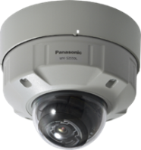
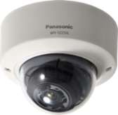
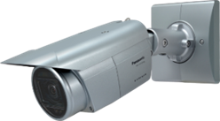
Concept & Main Features
New i-PRO extreme camera with high quality image capturing allows 5MP images to be obtained for evidence even under extreme conditions.
Extreme Visibility
5MP high quality resolution
High sensitivity with color night vision
Intelligent Auto / Super dynamic 120dB
ClearSight coating (Option)
WV-S2550L
Extreme Compression
H.265 compression with new smart coding technology
Extreme Data Security
Secure communication with Symantec certification
WV-S2250L
Extreme Reliability
Vandal resistant / IP66 compliant / Anti-correction
WV-S1550L
2

Slide 3
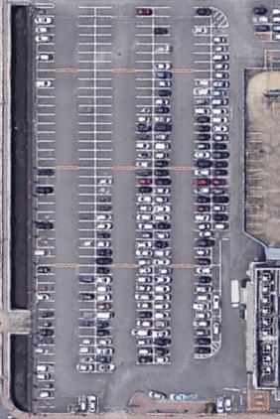
Extreme Visibility
5MP High resolution
The i-PRO Extreme 5MP camera can be monitored by 1.3 times in distance and width and 1.8 times in area than FHD.
193 ft
Angle of view
30-degree
130 ft
97 ft
360 ft
240 ft
180 ft
FHD
5MP
4K
3

Slide 4
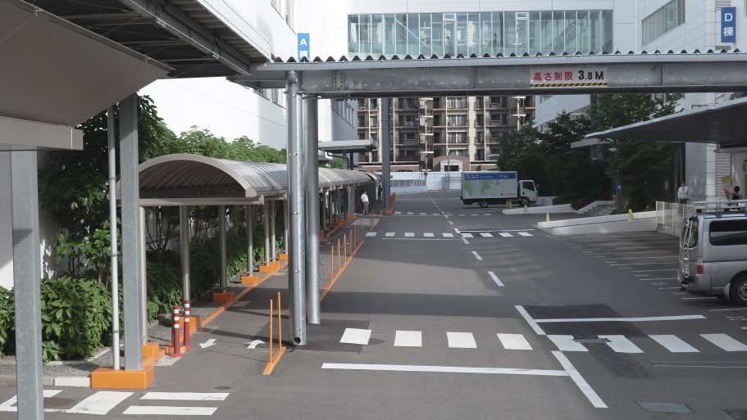

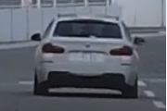
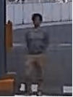
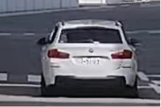
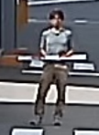
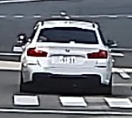
Extreme Visibility
5MP High resolution
The i-PRO Extreme 5MP camera can be monitored by 1.3 times in distance and width and 1.8 times in area than FHD.
Can visible the people and vehicles
Object size
20 ppf
4K model
WV-SFV781
360 ft
240 ft
180 ft
5MP model
WV-S2550L
FHD model
WV-S2531
4

Slide 5
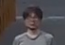
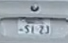
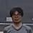
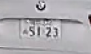
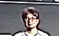
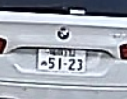
Extreme Visibility
5MP High resolution
The i-PRO Extreme 5MP camera can be monitored by 1.3 times in distance and width and 1.8 times in area than FHD.
Object size
40 ppf
Can visible the faces and license plates
4K model
WV-SFV781
180 ft
90 ft
120 ft
FHD model
WV-S2531
5MP model
WV-S2550L
5

Slide 6
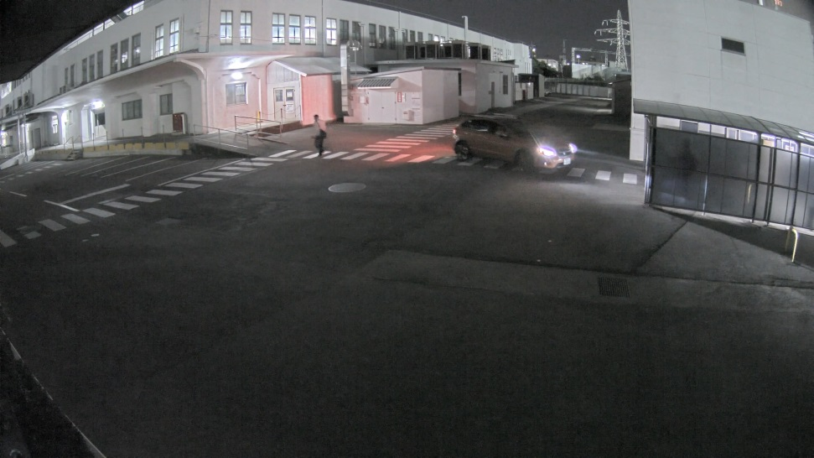
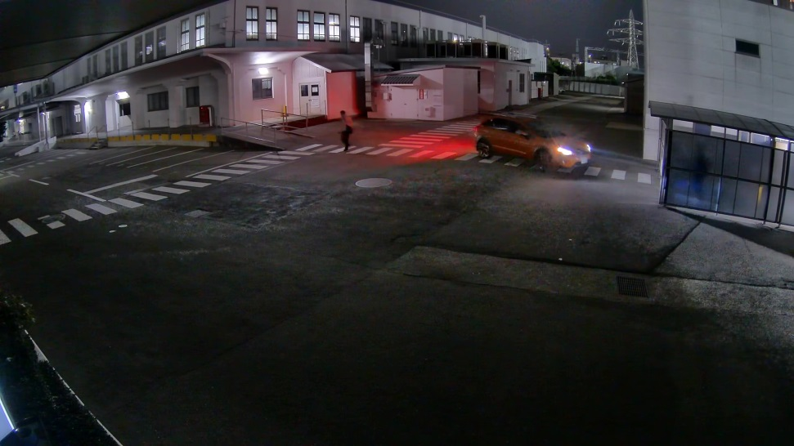
Extreme Visibility
High sensitivity with color night vision
It shows clear color images in low light condition at night time
Leading brand camera
i-PRO Extreme camera WV-S2550L
Under 2-5 lux lighting environment
6

Slide 7

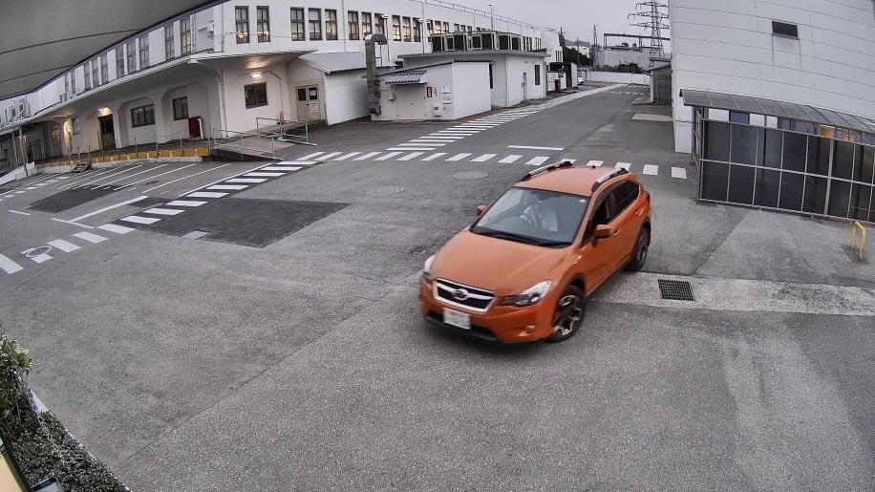
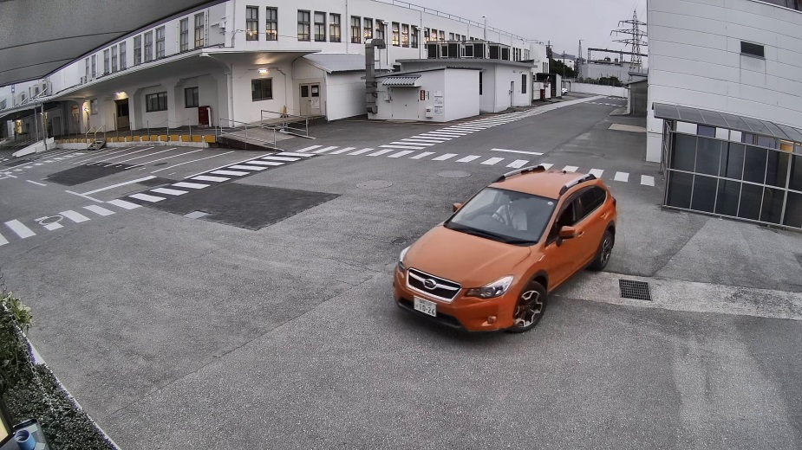
Extreme Visibility
Intelligent Auto
iA-Intelligent Auto monitors scene dynamics and motion to adjust key camera settings automatically in real-time reducing distortion such as motion blur
on moving objects.
i-PRO Extreme camera WV-S2550L
iA OFF
i-PRO Extreme camera WV-S2550L
iA ON
7

Slide 8
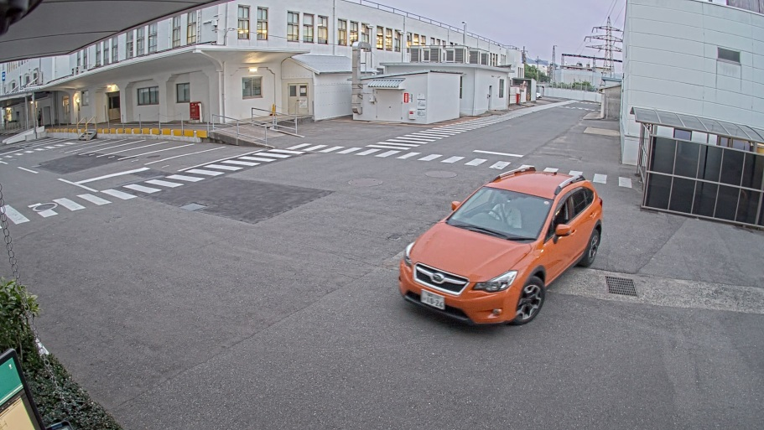
Extreme Visibility
Intelligent Auto
iA-Intelligent Auto monitors scene dynamics and motion to adjust key camera settings automatically in real-time reducing distortion such as motion blur
on moving objects.
Leading brand camera
i-PRO Extreme camera WV-S2550L
iA ON
8

Slide 9
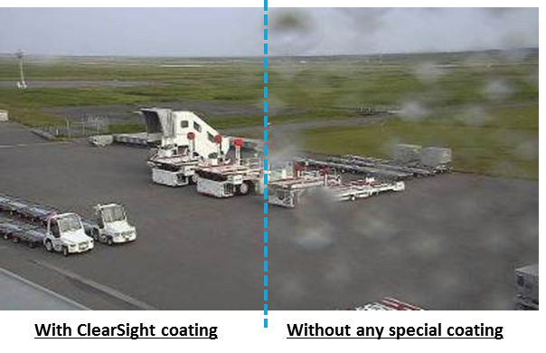
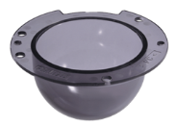
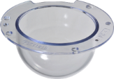
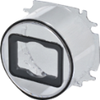
Extreme Visibility
ClearSight coating (Option)
The specially coated (ClearSight) cover surface resists water stains and dust accumulation, reducing the need for periodic maintenance
Optional cover
WV-CW7SN
WV-CW7CN
WV-S2550L
Optional cover
WV-CW8CN
WV-S1550L
9

Slide 10

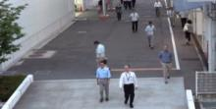
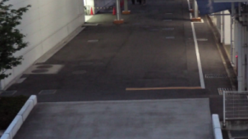
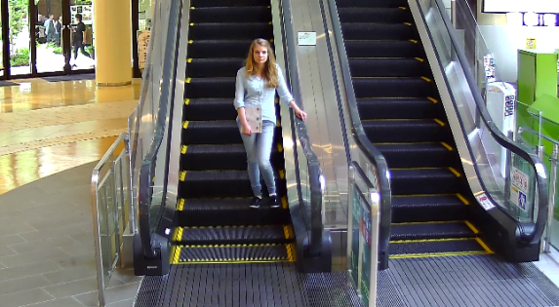









Extreme Compression
H.265 compression with new smart coding technology
GOP control
Auto-VIQS
Reduces encoding data
by using p-frame in
place of i-frame when
no motion is detected.
WITH MOTION
WITHOUT MOTION
Automatically determine areas with and without motion and reduce the data volume of those without motion.
Low Bit rate
(Higher
Compression)
I-frames are thinned down
to reduce the amount of data.
With
Motion
Without
motion
With
Motion
New
frame rate control
30
fps
15
fps
7.5
fps
3ps
1ps
1ps
*Simulated
image
4
sec
16
sec
32
sec
64
sec
160
sec
480
sec
480
sec
4
sec
Mid. Bitrate (Original compression)
Bit rate reduction
i-PRO extreme
H.265 + Smart coding
H.264
Max.95%
10

Slide 11
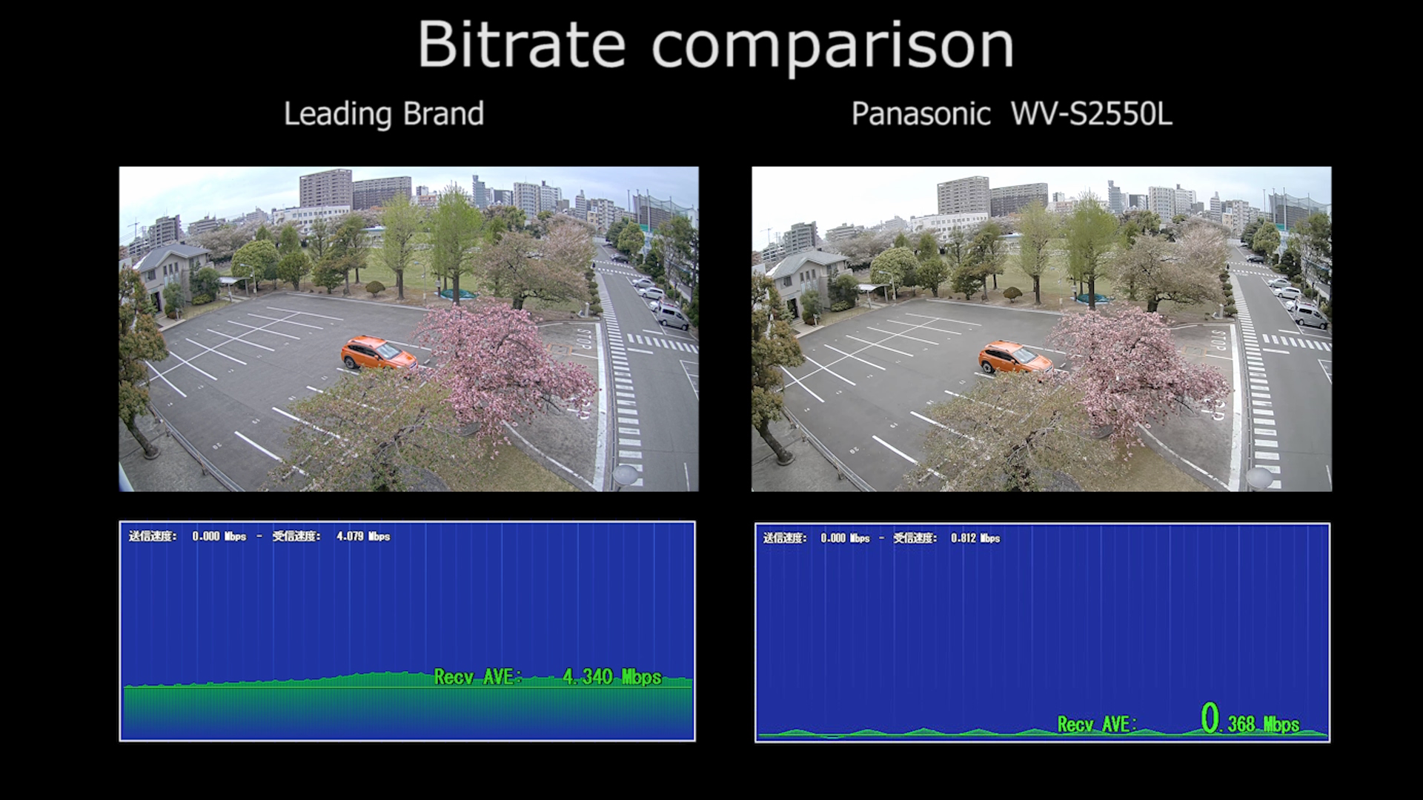




Extreme Compression
H.265 compression with new smart coding technology
Extreme compression allows higher image quality monitoring in the same
network environment.
i-PRO Extreme camera WV-S2550L
with smart coding
Leading brand camera
H.264
Max.
95%
11

Slide 12
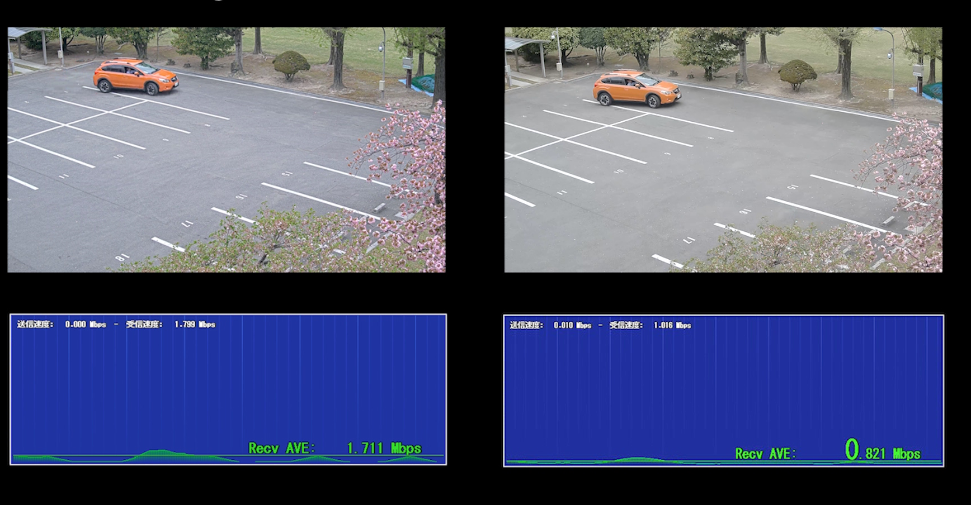


Extreme Compression
H.265 compression with new smart coding technology
Leading brand camera
with bit rate control
i-PRO Extreme camera WV-S2550L
with smart coding
H.264
Max.50%
12

Slide 13


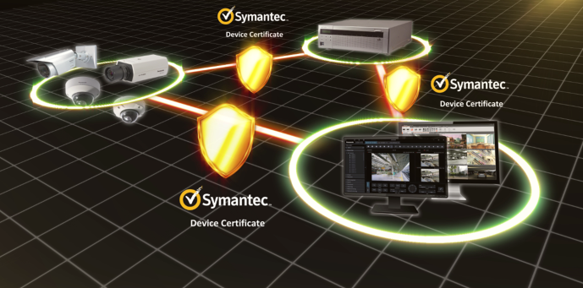






Extreme Data Security
Secure communication with Symantec certification
Vulnerability Assessment
- 3rd party assessment and penetration tests
made to achieve higher security standards
Symantec Device Certification
- Pre-installed Symantec Certification
- Video tampering detection
End-to-End Data Encryption
- Support full encryption communication
- Camera encryption recording on-the-edge
FIPS140-2 Level 1 CAVC compliant
(Federal Information Processing Standardization)
- For federal/public safety usage
13

Slide 14

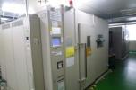
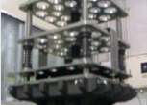
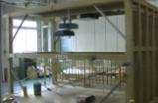


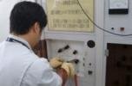



Extreme Reliability
Achieve high endurance and long life usage under extreme conditions
Dustproof Test
High-Temperature Test
Pressure Test
Earthquake Test
Waterproof Test
Lifetime Test
Thunder Test
Static Electricity Test
Drop Test
Box Shaking Test
14

Slide 15
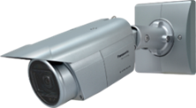
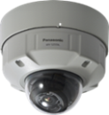
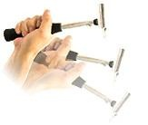
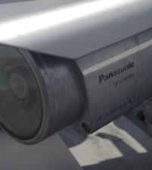
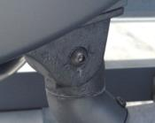
Extreme Reliability
Achieves high endurance under extreme condition
Vandal Resistant
Anti-corrosion screw
Highly impact resistant.
Compliant with 50J IEC60068-2-75
test Eh, (WV-S2550L)
IEC 62262 IK10
Adoption of Anti-corrosion screws prevents to corrosion and improves maintainability.
Adopt
anti-corrosion
of screws
Water & Dust Resistant *Except WV-S2250L
Corrosion of screws
IP66
IEC60529 measuring standard compatible
Type 4X(UL50)
NEMA 4X compliant
15
Notes:
Vandal Resistant
Pan angle up to 100 degree for outdoor box model.
Salt (Corrosion)-resistant screw

Slide 16
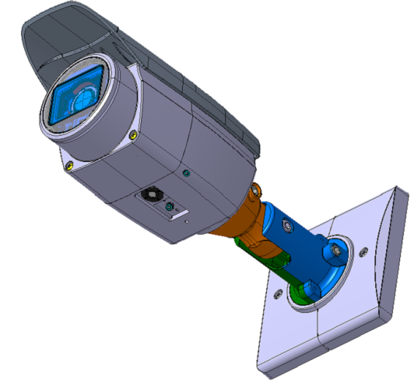
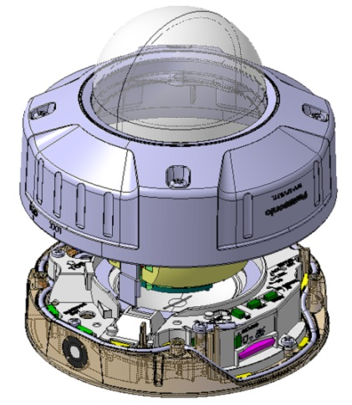
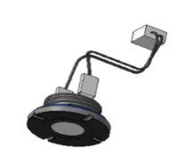
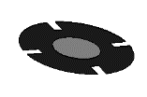
Extreme Reliability
Anti-humidity with the new dehumidifier method
By controlling the heater, IR-LED heat and FAN blowing against temperature drop inside the camera, the temperature inside the camera is kept properly to prevent dew condensation.
Dehumidifier
Ｃｕｒｒｅｎｔ
Ｎｅｗ
Waterproof
breathable
material
Condensation prevention control of “heater” + “FAN”
16
Notes:
Vandal Resistant
Pan angle up to 100 degree for outdoor box model.
Salt (Corrosion)-resistant screw

Slide 17
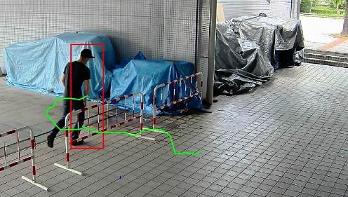
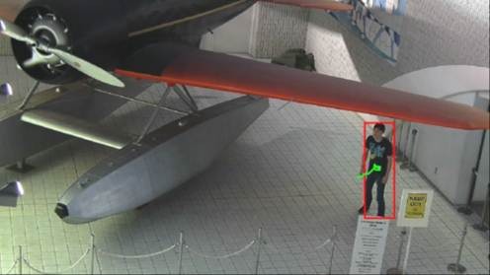
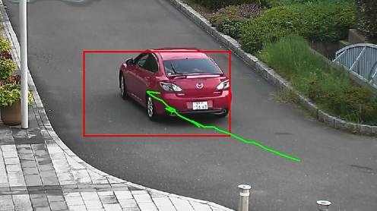
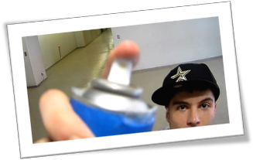
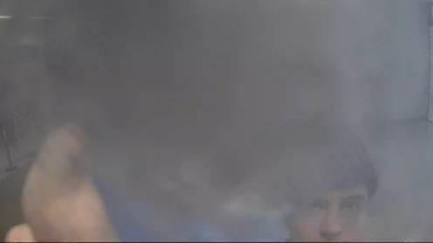
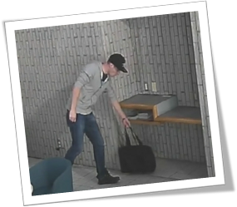




Optional Intelligent VMD
Detect various abnormal behavior of person by Optional intelligent VMD (i-VMD) software WV- SAE200
Intruder detection
detects people or cars trespassing in restricted areas.
Loitering detection
detects people who has loitered for too long in the area.
Direction detection
detects people or cars that go the wrong direction.
Scene change detection detects tampering with the camera view.
Object detection (left)
detects something left behind that shouldn’t be there.
Object detection (removed)
detects objects disappearing that should be present.
Cross line detection
detects people or objects crossing the imaginary lines.
17

Slide 18



Specifications
 |  | WV-S2250L | WV-SS2550L | WV-S1550L
Image sensor |  | 1 / 2.8 type CMOS
Max. video resolution (pixel) |  | 16:9 mode : 3072 x 1728 (Super resolution), 4:3 mode : 3072 x 2304 (Super resolution)
Max. frame rate |  | 30 fps * 15fps (Super Dynamic: On, Level: 30 or more)
Minimum Illumination *Shutter speed 1/30s | Color | 0.07lx @F1.3, 0.0044 lx @ shutter speed 16/30
 | B/W | 0.04lx @F1.3, 0.003 lx @ shutter speed 16/30, 0 lx @ IR
Angular Field of View *16:9 mode | Horizontal | 16:9 mode : 33°(Tele) - 103°(Wide), 4:3 mode : 19°(Tele) - 55°(Wide) |  | 16:9 mode : 34°(Tele) - 106°(Wide) 4:3 mode : 19°(Tele) - 57°(Wide)
 | Vertical | 16:9 mode : 33°(Tele) - 103°(Wide), 4:3 mode : 25°(Tele) - 75°(Wide) |  | 16:9 mode : 34°(Tele) - 106°(Wide) 4:3 mode : 25°(Tele) - 77°(Wide)
Intelligent Auto / WDR / Smart coding |  | Yes / Super Dynamic (120dB) / Yes
Audio Interface / Compression |  | input (ø3.5 mm stereo mini jack x 1, Line x1), Output(ø3.5 mm stereo mini jack x 1) / G.726, G.711, AAC-LC
SD memory card slot |  | 1slot (SDXC/SDHC/SD)
Secure communication |  | FIPS 140-2 Level 1 compliant
External I/O Terminals |  | ALARM IN 1(Alarm input 1/ Black & white input/ Auto time adjustment input) (x1) ALARM IN 2 (Alarm input 2/ ALARM OUT) (x1) , ALARM IN 3 (Alarm input 3/ AUX OUT) (x1)
Environmental |  | IK10 | IP66, Type 4X(UL50), NEMA 4X compliant Compliant with 50J IEC60068-2-75, IK10 | IP66, Type 4X(UL50), NEMA 4X compliant IK10
Power Source / Ambient Operating Temperature |  | DC12V,PoE -10°C ~ +50°C (14 °F ~ +122 °F) | DC12V, PoE, -40 °C to +60 °C (-40 °F to 140 °F) / IR LED is off (Power On range : –30 °C to +60 °C {–22 °F to +140 °F})
Dimension (mm) |  | ø129.5 mm x 102.5 mm (H) | ø164 mm x 139 mm (H) *When using base bracket | 133 mm (W) x 133 mm (H) x 377 mm (L)
18

Slide 19















Optional Accessories
  ■ Optional dome covers and brackets for WV-S2550L
Embedded
ceiling mount
WV-Q124
(Fine silver)
WV-Q186
(Light gray)
WV-Q169A
Wall mount
Ceiling mount
Ceiling mount
Sun Shade
Dome Cover
WV-Q122A
(Light Silver)
WV-Q185
(Light gray)
WV-Q121B
(Light silver)
WV-Q105A
For indoor
With ClearSight coating
WV-Q7118
WV-CW7S
Smoke type
WV-CW7SN
Smoke type
Pole mount
Corner mount
WV-CW7CN
Clear type
WV-Q188
(Light Silver)
WV-Q182
(Light gray)
WV-Q189
(Light Silver)
WV-Q183
(Light gray)
19

Slide 20







Optional Accessories
  ■ Optional indoor dome covers and brackets for WV-S2250L/S1550L
Embedded
ceiling mount
Pole mount
WV-S2250L
WV-S1550L
WV-Q188
(Light Silver)
WV-Q182
(Light gray)
WV-Q174B
Corner mount
Ceiling mount
WV-Q189
(Light Silver)
WV-Q183
(Light gray)
Front panel
Dome Cover
WV-Q105A
WV-CW8CN
WV-CR1S
Smoke type
Clear type
with ClearSight coating
20

Slide 21





Industry examples
Those cameras are suitable under the extreme conditions
Retails / Shopping mall
Public safety (City / Highway toll / Parking gate)
Transportation (Airport / Train / Subway)
Retail / Bank / Logistics / Education
Hospital / Building
and more.
21

Slide 22


