Slide 1
H.265 Outdoor PTZ Camera
WV-S6530N
Ver. 1.01
Panasonic i-PRO Sensing Solutions Co., Ltd.

Slide 2

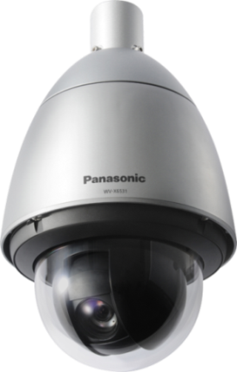


Concept & Main Features
New H.265 PTZ cameras are shown extreme performance under extreme condition.
Extreme Visibility
・High powered 21x optical zoom function
・Intelligent Auto
・High sensitivity with color night vision
・Extreme super dynamic 144dB
・CleraSight coating
Extreme Compression
・H.265 compression with new Smart coding technology
Extreme Data Security
・Secure communication with Symantec certification
Extreme Reliability
・Achieves high endurance under extreme condition
2

Slide 3
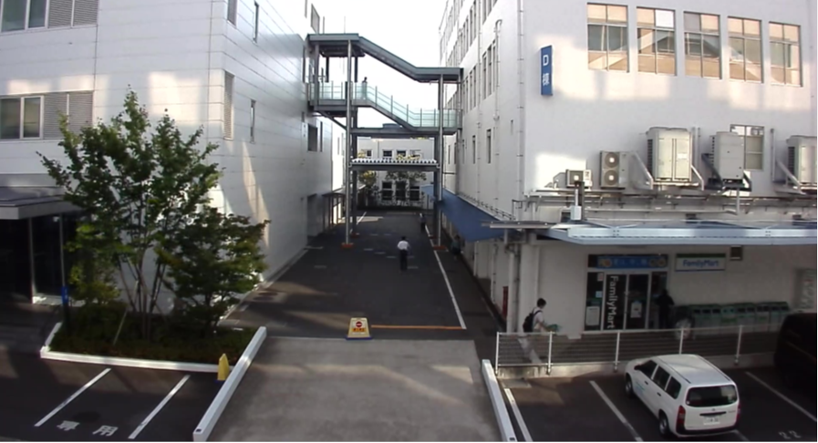
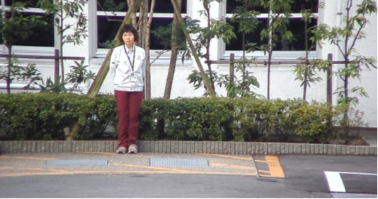

Extreme Visibility
21x optical zoom function can survey further long distance objects clearly
People can be recognized with
high powered zoom function
Appox.64m
21x zoom
3

Slide 4

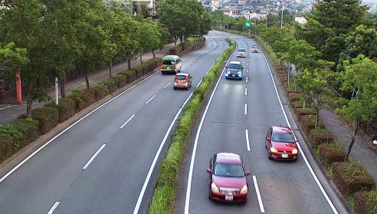

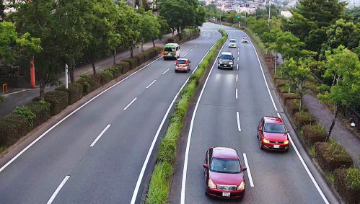

Extreme Visibility
Intelligent auto mode adapts to your application scene
Automatically optimizes camera parameters for best tuned image for various scenes, using techniques like Full Auto Shutter & Iris control, Backlit compensation , auto image stabilization.
Also can detect characteristics and movement within the scene to optimize camera settings to provide best fit picture quality.
Conventional model
iA mode : ON

Slide 5
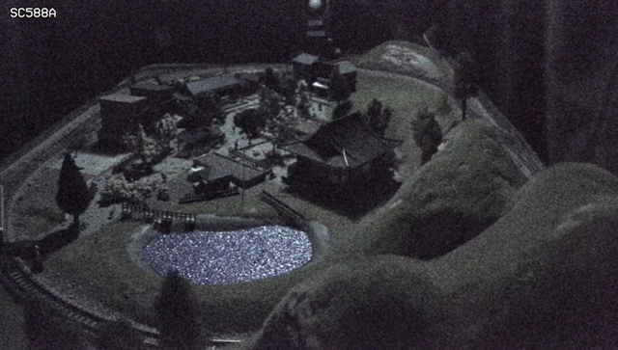
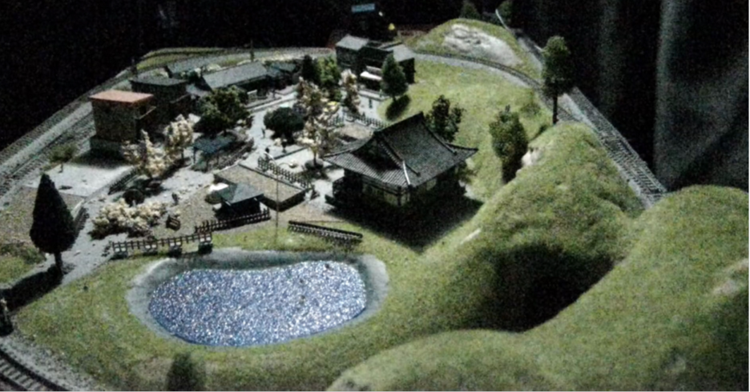
Extreme Visibility
High sensitivity with color night vision
It shows clear color images in low light condition at nigh time.
Panasonic new night view enhancer technology changes your 1/3 inch sensor camera into a outstanding low light performance camera to provide you TRUE color information under very low lighting conditions.
Illumination : 0.3 lx
5

Slide 6
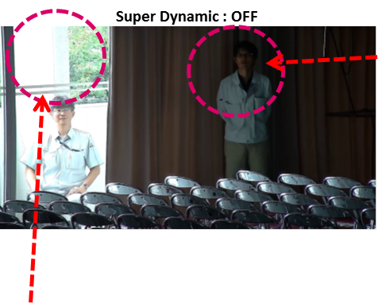
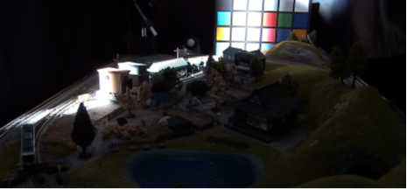
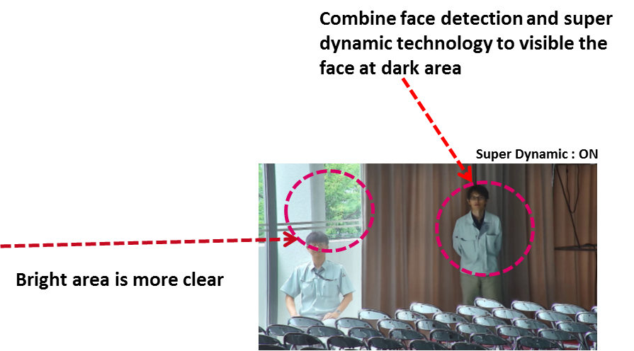
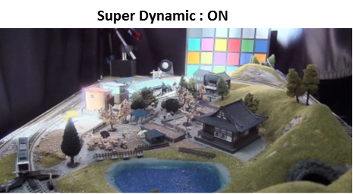
Extreme Visibility
Extreme super dynamic 144dB
Both bright and dark area are visible by extreme super dynamic function.
Super Dynamic : OFF

Slide 7
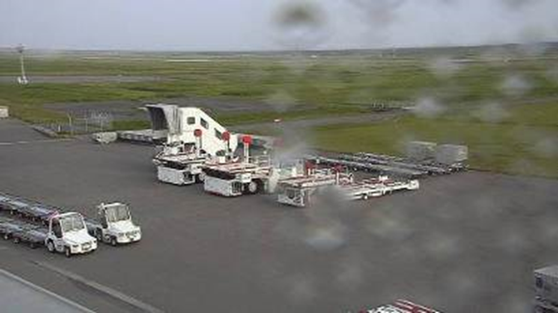
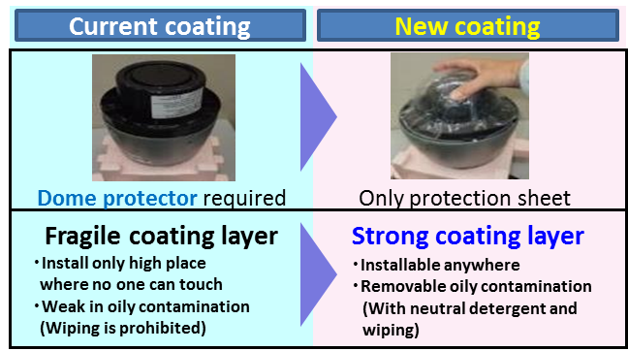
Extreme Visibility
ClearSight Coating
New ClearSight coating significantly increases the operational utility of outdoor cameras in rain weather. The specially coated surface resists water stains and dust accumulation, reducing the need for periodic maintenance.
ClearSight Coating can be wiped with a damp cloth or washed with a neutral detergent.
Improve ease of handling and maintenance
With ClearSight coating
Without any special coating
7

Slide 8
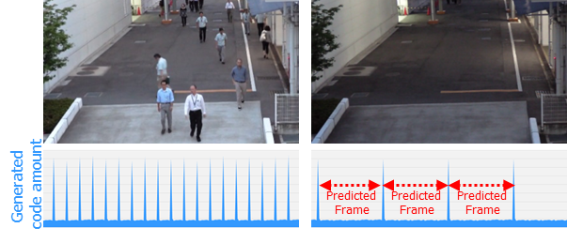
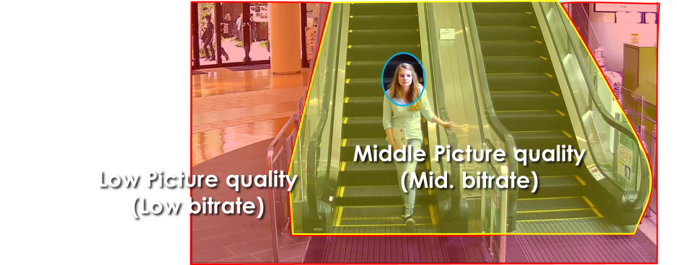
Extreme Compression
Smart coding Technology
With the latest bitrate reducing technology, GOP control, Auto-VIQS, Smart face coding, these cameras save the network bandwidth and the recorder disk space.
The cameras can reduce the amount of data by up to approx. 95% for still scene and up to approx. 80% for moving scene compared with the normal H.264 codec. When comparing with Panasonic H.264 camera (WV-SPN531, SPN631 etc) , the amount of data is reduced by up to approx. 70% for moving scene and up to approx. 90% for still scene.
When people are walking, I-frame is inserted at regular intervals as usual.
When there is no person walking,
I-frames are thinned down to reduce the amount of data.
GOP control reduces encoding data by using p-frame in place of i-frame when no motion is detected.
Scene | Without GOP | With GOP
Heavy traffic of people | 3 Mbps | 3 Mbps
Minimal traffic of people | 2 Mbps | 1 Mbps(-50 to - 60%)
Keep high
Picture quality
Auto - VIQS can automatically determine areas with and without motion and reduce the data volume of those without motion.
The camera can also detect faces and keep the area of the face at most highest picture quality to keep your most important evidence to be kept clear, Smart facial coding.
*Simulated image
8

Slide 9




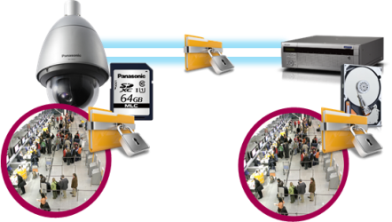








Extreme Data Security
Secure Communication
Protect the devices from cyber attacks
Prevention leakage of the video
Eliminated vulnerability with the latest CVE* support
*CVE : Common Vulnerabilities and Exposures. Common Vulnerabilities and Exposures is a dictionary of common names
(i.e., CVE Identifiers) for publicly known
Panasonic cameras deliver the encrypted video, and it‘s stored in WJ-NX200K (Panasonic recorder).
The data can be password-protected and alteration detection helps ensure credibility of data.
*When using this function, you need optional licenses.
The stream and video are encrypted by the module meet FIPS140-2 level 1 CAVP*. Panasonic fully protect the stream and the video on the End-to-End System.
*Evaluated by WV-TW370P
Prevention leakage of the data
on communication network
Realize secure communication between devices by using communication encryption (SSL/TLS communication).
By using hash value, can detect Video alteration.
9

Slide 10
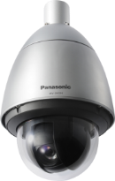
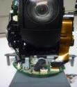



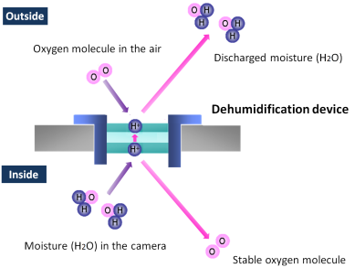
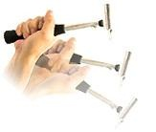
Extreme Reliability
Achieves high endurance under extreme condition
Durability
Salt (Corrosion)-resistant screw
(All the screws of the outer)
The gear-drive support exact internal standard
and longer life than belt-drive
Prevention from fixation at maintenance.
Note: Salt Resistant is applied
only to screws, not for whole body.
Pan/Tilt Gear Drive
（No backlash mechanism）
Anti-humidity
Connection cable is FPC
The built-in electrical dehumidification keeps the camera dry inside, using electrolysis
to remove any moisture from the camera.
This anti-humidity technology is
safe and green due to low power
consumption and no heaters or
mechanical fans being used.
Vandal Resistant
Highly impact resistant.
Compliant with IEC 60068-2-75 test Eh,
20 J / IEC 62262 IK10.
10
Notes:
Vandal Resistant
Pan angle up to 100 degree for outdoor box model.
Salt (Corrosion)-resistant screw

Slide 11
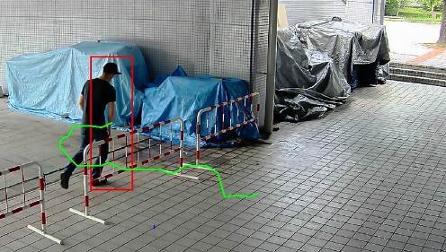
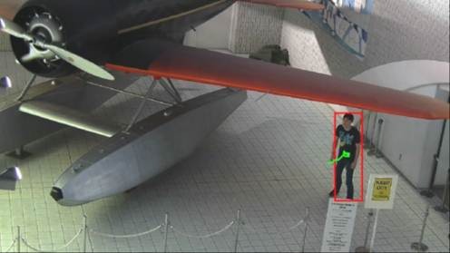
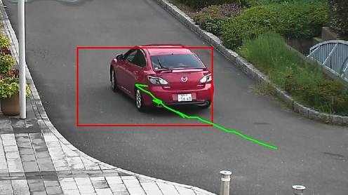
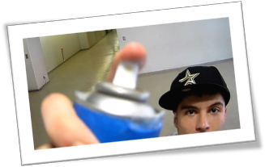
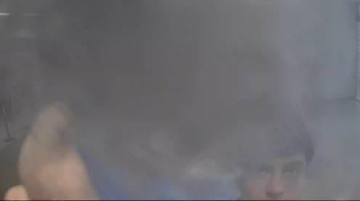
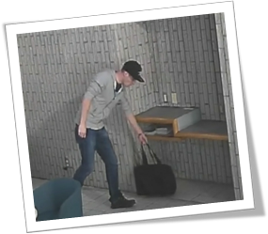
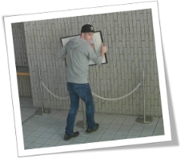
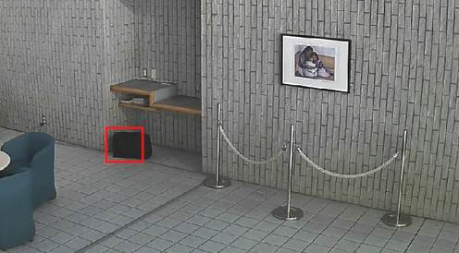
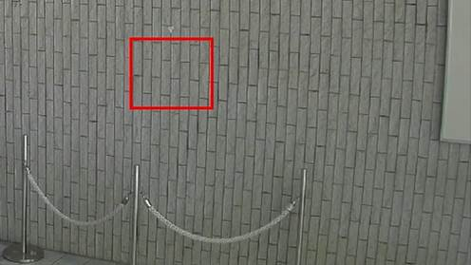
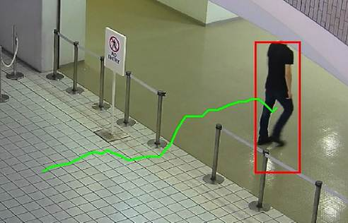
Optional Intelligent VMD
Detect various abnormal behavior of person by Optional intelligent VMD (i-VMD) software WV- SAE200
Intruder detection
detects people or cars trespassing in restricted areas.
Loitering detection
detects people who has loitered for too long in the area.
Direction detection
detects people or cars that go the wrong direction.
Scene change detection detects tampering with the camera view.
Object detection (left)
detects something left behind that shouldn’t be there.
Object detection (removed)
detects objects disappearing that should be present.
Cross line detection
detects people or objects crossing the imaginary lines.
11

Slide 12
Specifications
 |  | WV-S6530N
Image sensor |  | 1 / 2.9 type MOS
Max. video resolution (pixel) |  | 2048 x 1536 (Super resolution)
Max. frame rate |  | 60 fps
Day / Night |  | Yes (ICR)
Minimum Illumination *Shutter speed 1/30s | Color | 0.015lx @F1.6
 | B/W | 0.006lx @F1.6
Angular Field of View *16:9 mode | Horizontal | 3.4°(Tele) - 73°(Wide)
 | Vertical | 2.0°(Tele) - 34°(Wide)
Panning range |  | 0°~ 350°
Audio |  | Two-way
SD memory card slot |  | 1slot (SDXC/SDHC/SD)
Zoom Ratio |  | 21x Optical, 32x with HD Extra Optical Zoom(Resolution 1280x720)
Image stabilizer |  | Yes(Electric Image Stabilization)
Ambient Operating Temperature |  | -40°C ~ +60°C (-40 °F ~ +140 °F) , -30 °C to +60 °C {-22 °F to +140 °F} (PoE+ device)
Dimension (mm) |  | Φ229 x 393 (H)
12

Slide 13
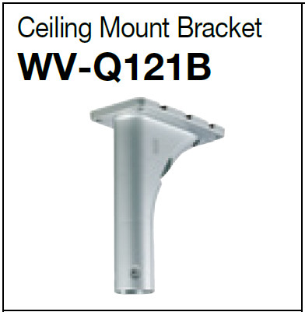
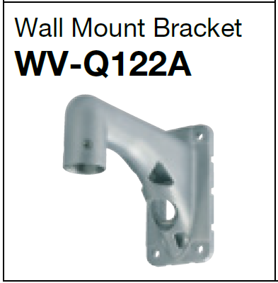
Optional Accessories
  Mount brackets
13

Slide 14

Applications
These cameras are suitable under the extreme conditions :
City Surveillance
Parking lot
Logistics
Building and more.
14

