Slide 1
Network Video Disk Recorder
WJ-NX200K
【NTSC】
Ver. 1.01
Panasonic i-PRO Sensing Solutions Co., Ltd.

Slide 2

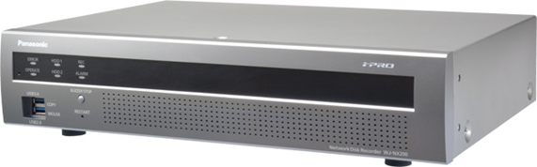
Concept & Main Features
H.265/H.264 high-throughput and scalable recorder featuring integrated GUI and
robust embedded IP security enabling a secure end-to-end PC-Less surveillance solution
Secure & High Compression Recording
PC-Less Surveillance Solution
Up to 16 cameras (H.264/H.265) support
384 Mbps Maximum Total throughput
Secure Communication between cameras and WJ-NX200K and between WJ-NX200K and applications
Dual Stream Recording for narrow band network playback
Easy installation & operation
Automatic Security System configuration wizard
Image search with thumbnail
High speed copy to the USB storage
Built-in GUI and Dual HDMI Outputs
High Reliability & Redundancy
Eco-writing : Acceleration of data access (reading/writing) by original filesystem
Momentary power failure resistance
Keep working & recording without UPS within 200ms

Slide 3
Secure & High Compression Recording
16 cameras (H.264/H.265)
WJ-NX200K supports up to 16 cameras. As basic recorder, WJ-NX200K support
9 cameras. When adding a additional license WJ-NXE20(W) in WJ-NX200,
WJ-NX200K supports up to 16 cameras.
In addition, WJ-NX200K can record both H.264 and H.265 stream.
It is easy to configure a coexisting system of i-PRO H.264 cameras and i-PRO H.265 cameras since WJ-NX200K can record both H.264 and H.265 stream.
Add one license (up to 16 cameras)
NXE20
Camera
Additional kit
384 Mbps Total throughput
WJ-NX200 is equipped with maximum 384 Mbps as total throughput. Maximum recording throughput is 192 Mbps, and it is possible to record the images of 16 cameras when connecting Full-HD H.265 camera (30ips, 2 Mbps). Maximum output throughput is 192 Mbps, and the video of 16 all cameras (Full-HD, 30ips, 2M bps) can be output to a monitoring software at one time.
Basic : up to 9 cameras
WJ-NX200K
Network Video Disk Recorder

Slide 4




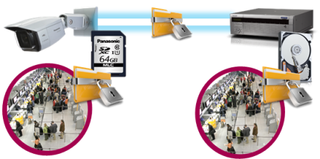







Secure & High Compression Recording
Secure Communication
Protect the devices from cyber attacks
Prevention leakage of the video
Eliminated vulnerability with the latest CVE* support
*CVE : Common Vulnerabilities and Exposures. Common Vulnerabilities and Exposures is a dictionary of common names
(i.e., CVE Identifiers) for publicly known
Panasonic cameras deliver the encrypted video, and it‘s stored in WJ-NX200K (Panasonic recorder).
The data can be password-protected and alteration detection helps ensure credibility of data.
*When using this function, you need optional licenses.
The stream and video are encrypted by the module meet FIPS140-2 level 1 CAVP*. Panasonic fully protect the stream and the video on the End-to-End System.
*Evaluated by WV-TW370P
Prevention leakage of the data
on communication network
Realize secure communication between devices by using communication encryption (SSL/TLS communication).
By using hash value, can detect Video alteration.

Slide 5








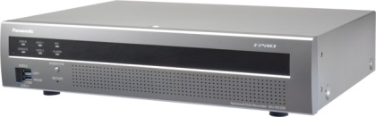

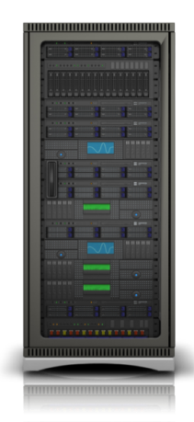
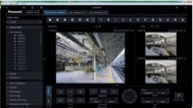

Secure & High Compression Recording
Dual Stream Recording for narrow band network playback
Video delay may be happened as playing a several cameras at one
time or playing on a narrow band. Therefore, WJ-NX200K has
the function which can record 2 stream per a camera.
When using this function, an operator can set the stream
depending on their playback environment.
i.e)
1st stream is recorded at Full-HD resolution and 2nd stream is
recorded at VGA resolution.
・When network band of an operating environment is narrow band.
・When playing the video on WV-ASM300, it plays a video of 1st stream.
・When an operator play a several cameras at one time.
It is possible to use 2nd stream when playing the video on
multiscreen on WV-ASM300.
i-PRO Extreme H.265
i-PRO H.264 cameras
1st stream
2nd stream
1st stream
2nd stream
Rec
Rec
WJ-NX200K
Playback
WV-ASM300 series

Slide 6
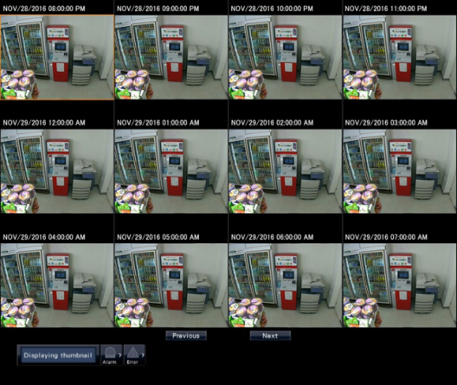
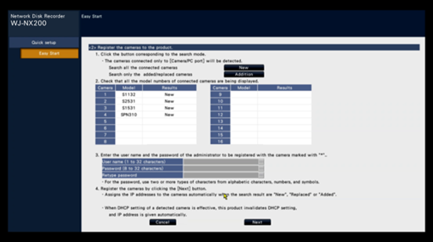
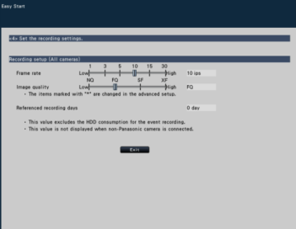
PC-Less Surveillance Solution
Easy installation & operation
・Automatic Security System configuration wizard
・Image search with thumbnail
With only 4-steps “Easy start” of WJ-NX200, the setting of the recorder and cameras is completed in a few minutes from main display (without PC).
Easy to find out image by thumbnail search
Time and date setting
Camera registration
Multi-screen layout setting
Recording image quality setting
[Note]
Multiple cameras are not supported
It is necessary to select start date and time and display interval
Camera registration GUI

Slide 7


PC-Less Surveillance Solution
High speed copy to the USB storage
Data copy speed will be 3 times higher than current NVR
Example
・2 cameras x 48 hours data copy
・ USB3.0
・Smart coding :efficiency of data compression
NV300
(Current)
Approximately 18.0 Hours
NX200
6.0 Hours
Built-in GUI and Dual HDMI Outputs
Main display (HDMI)
Equipped with two HDMI output, WJ-NX200 provides PC-less operation that enables users operate just about all features from the main display without running a PC. The main and sub displays support multi-screen viewing. The main display supports up to 4K resolution, and the sub display supports up to Full-HD resolution.
Display | Interface | Viewing live images | Playback videos | Operation and Setting
Main display | HDMI | P | P | P
Sub display | HDMI, BNC | P | - | -

Slide 8
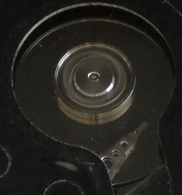
High Reliability and Redundancy
Eco-writing : Acceleration of data access (reading/writing) by original filesystem
Reduce the movement of a head to the utmost limit
Reduce the movement of a head to the utmost limit
WJ-NX200K can reduce the movement of a head to the utmost limit to access own HDD since it equips with Panasonic proprietary file system. Thus WJ-NX200K achieves the high efficiency of writing control, and can extend the life of HDDs.
Reduce fever of actuator motor
Reduce abrasion of motor
NX200

Slide 9
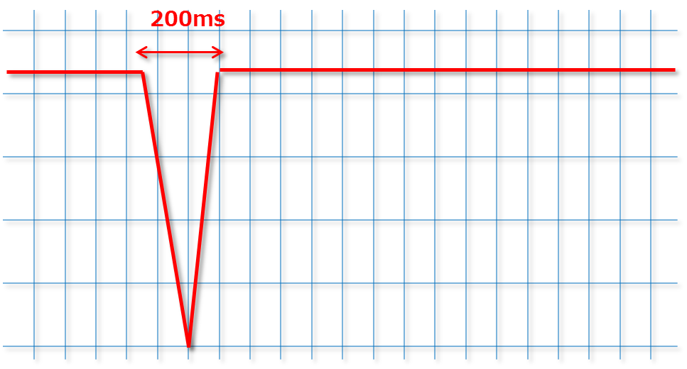
High Reliability and Redundancy
Momentary power failure resistance
“Keep working & recording” without UPS
95%* of momentary power failure is a power failure within 200ms. WJ-NX200K doesn’t have UPS, but it doesn’t stop and doesn’t reboot even when occur a instantaneous voltage drop within 200ms.
When a power failure time is longer than 200ms, WJ-NX200K detects a power interruption and shuts safe down by itself.
WJ-NX200K provide a stable recording and a stable operation for you.
*The case of power source conditions in Japan

Slide 10














System Configuration
ASM300
Monitor output
(up to 16 cameras)
Mobile
NX200K
Software license
NXE20
Camera
additional
kit
NW
Basic up to 9 cameras
NXSxx
Secure
Comm.
kit
NW camera
Key-board
Mouse
Coax-Lan convertor
Analog camera
Encoder
Decoder
Monitor

Slide 11
WJ-NX200 Specifications
Supported Cameras | Supported Cameras | Panasonic i-PRO series Network camera
 | Supported Image Format | H.265,H.264,JPEG,
 | Supported Audio Format | G.726 32kbps, AAC-LC 128kbps, G.711 64kbps for Onvif
 | Maximum Number of Cameras | MAX.16
Recording | Recording Mode | Event, Schedule, Emergency
 | Frame Rate/Camera | Up to 60 ips
 | Others | Pre-Event Recording, 2 stream recording
Playback | Main Unit Function | PLAY, Rev PLAY, Pause, Stop, FF, FR, Prev Record, Next Record, Prev Image, Next Image, Go to Date, Go to Last (30 s), Time-saving playback
 | Viewer Software | PLAY, Rev PLAY, Pause, FF, FR, Prev Record, Next Record, Prev Image, Next Image
Data Format/Copy |  | N3R/MP4 *Copy to USB
HDD | Type | 3.5 inch Serial ATA HDD, Up to 2x HDDs can be installed
 | Maximum Capacity | 2 HDD slots Up to 12TB(2x 6TB) will be supported
 | RAID(Software RAID) | RAID 1 supported
Network | Interface | 2x 10BASE-T / 100BASE-TX / 1000BASE-T (RJ45)
 | Maximum Band Width | Total throughput : Max. 384Mbps Recording throughput : Max. 192Mbps, Output throughput : Max. 192Mbps

Slide 12
WJ-NX200 Specifications
Viewer Software (Additional Functions) | NX Viewer | Alteration detection, Save as JPEG, Two times zoom, Print, Copy, Aspect ratio switching, fish eye correction,
External Interface | Spot Output Connector | 1x 1 V [p-p] / 75 (BNC)
 | Monitor (HDMI) Connector | [Main monitor] HDMI 4K UHD(3840x2160p) /30Hz, 4K UHD(3840x2160p) /25Hz, 1920x1080p /60Hz, 1920x1080p /50Hz, 1920x1080i /60Hz, 1920x1080i /50Hz [Sub monitor] HDMI 1920x1080p /60Hz, 1920x1080p /50Hz, 1920x1080i /60Hz,1920x1080i /50Hz
 | Alarm Connector | Alarm input: 9 / output:1(1x -10 dBV, 600 ohm ,Unbalanced (RCA)
 | USB connector | Front x2: USB3.0 x1 (copy), USB2.0 x1(mouse, keyboard), Rear x2: USB3.0 x1 (copy), USB2.0 x1(mouse, keyboard)
General Specifications | Power Source/Power Consumption | WJ-NX200K/P : 120 V AC, 50 Hz/60 Hz , Approx.56 W
 | Ambient Operating Temperature | +5 °C to +45 °C (41 °F to 113 °F)
 | Ambient Operating Humidity | 5 % to 90 % (no condensation)
 | Dimensions (W x H x D) | 430 mm x 88 mm x 300 mm (16-9/16" x 3-7/16" x 11-13/16“, excluding rubber feet and projections)
 | Weight | Approx.5.2kg (11.5lbs) [without HDD] / Approx.6.6kg (14.5 lbs.) [with 2x HDDs]

Slide 13
WJ-NX200K optional line-up
Software
Additional Camera kit | WJ-NXE20(W) | Additional channel license(Up to 16 cameras)
Secure Communication license | WJ-NXS16(W) | Secure optional license for 16ch
 | WJ-NXS04(W) | Secure optional license for 4ch
 | WJ-NXS01(W) | Secure optional license for 1ch

Slide 14


Applications
This recorder is suitable under the extreme conditions :
Banks
Retails / Quick-Service Restaurants
Hospitals
Education
Factories
Gas Stations and more.

