Slide 1
5MP H.265 360-Degree Camera
WV-S4150 (Indoor model)
WV-S4550L (Outdoor Vandal Resistant model)
WV-S4550LM (Outdoor Vandal Resistant Transit model)
Ver. 1.02
Panasonic i-PRO Sensing Solutions Co., Ltd.

Slide 2


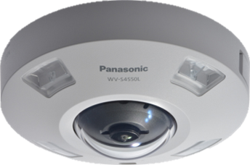
Concept & Main Features
New i-PRO extreme camera enables high performance 360-degree surveillance
Extreme Visibility
High resolution at 360-degree surveillance area
Intelligent Auto / High sensitivity with built-in IR LED
Super dynamic 108dB
Extreme Compression
H.265 compression with new Smart coding technology
Extreme Data Security
Secure communication with Symantec certification
Extreme Analytics
Intelligent VMD and video analytics
Extreme Reliability
Vandal resistant / IP66 compliant
2

Slide 3
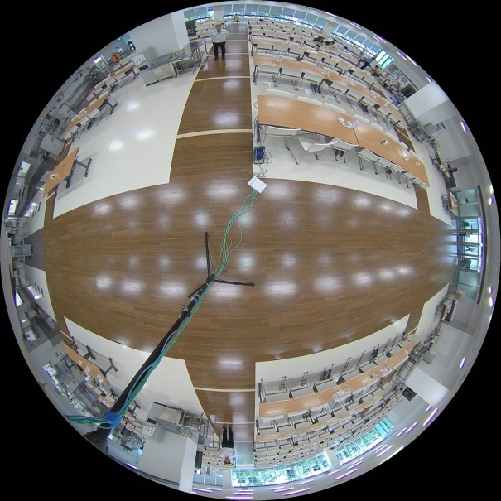
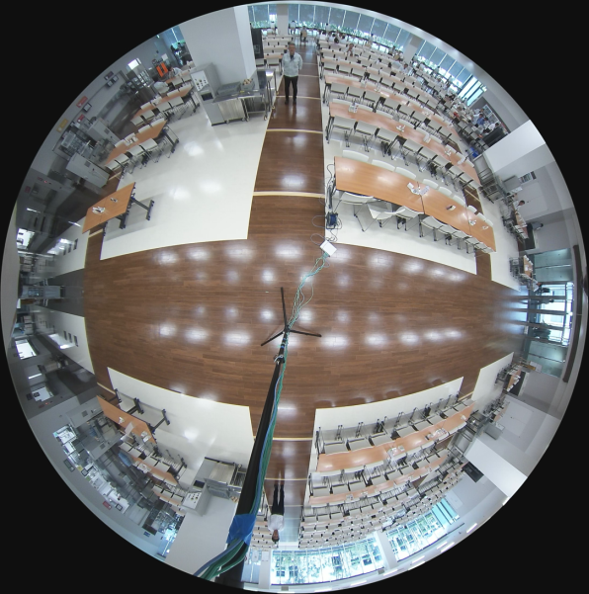

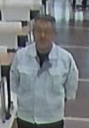
Extreme Visibility
5MP High resolution at 360-degree surveillance area
Enables sharp rendering image of objects and people’s face
Leading brand
New i-PRO extreme
6m
Less distortion
3

Slide 4

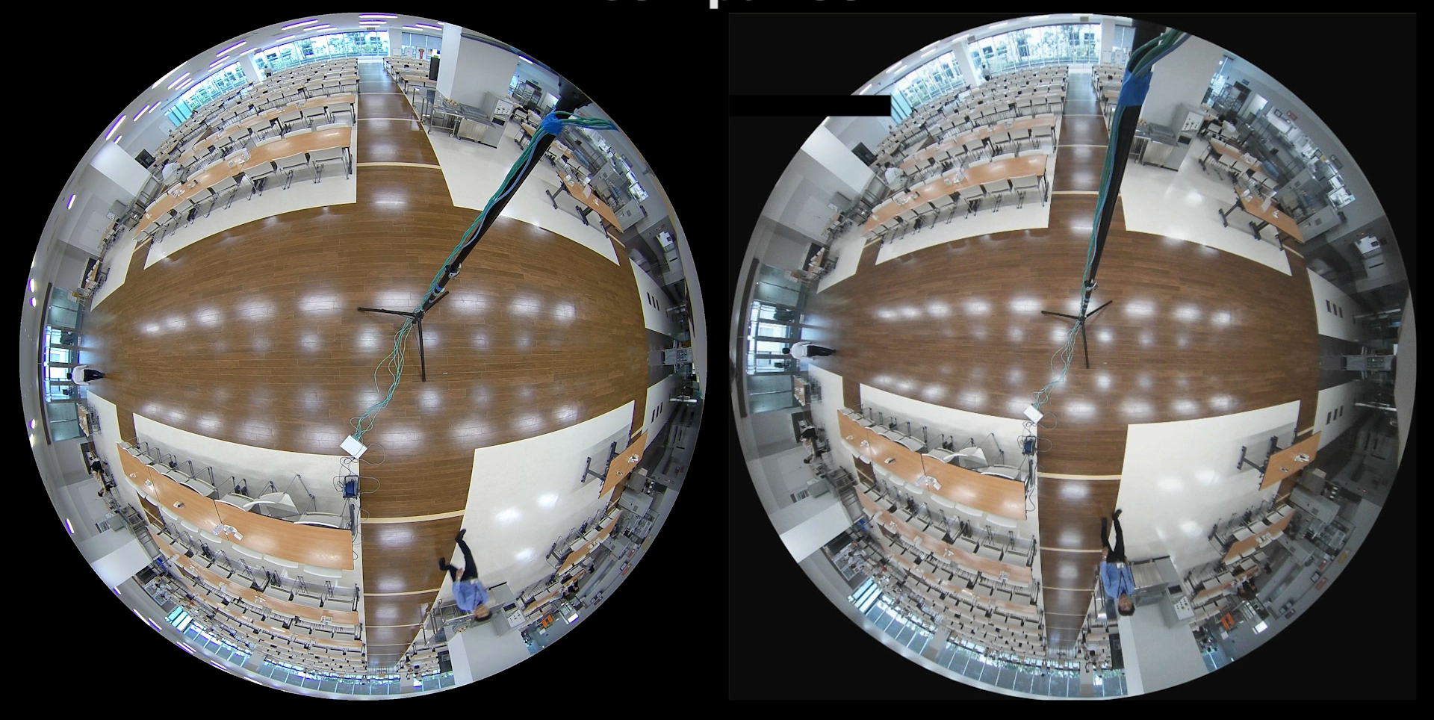
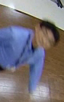

Extreme Visibility
Intelligent auto mode sharp images of moving objects
Automatically optimizes camera parameters for best tuned image for various scenes, using techniques like Full Auto Shutter & Iris control, Backlit compensation , auto image stabilization.
Also can detect characteristics and movement within the scene to optimize camera settings to provide best fit picture quality.
New i-PRO extreme
with iA
(5MP)
Leading brand
(5MP)
4

Slide 5
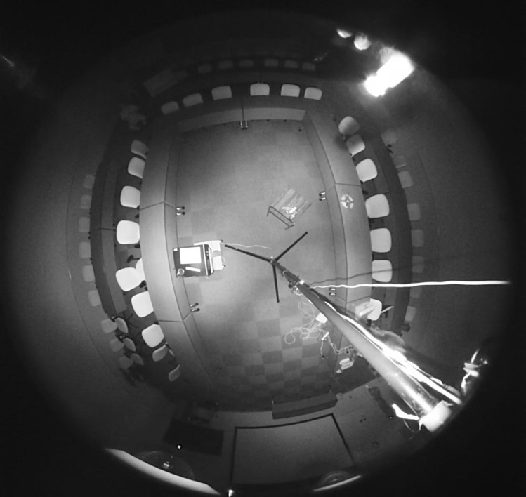
Extreme Visibility
High sensitivity with built-in IR LED ex. still picture image
Enables to visible objects with built-in IR light even 0 lux of dark condition
Leading brand
New i-PRO Extreme
10m
10m
6m
6m
5

Slide 6
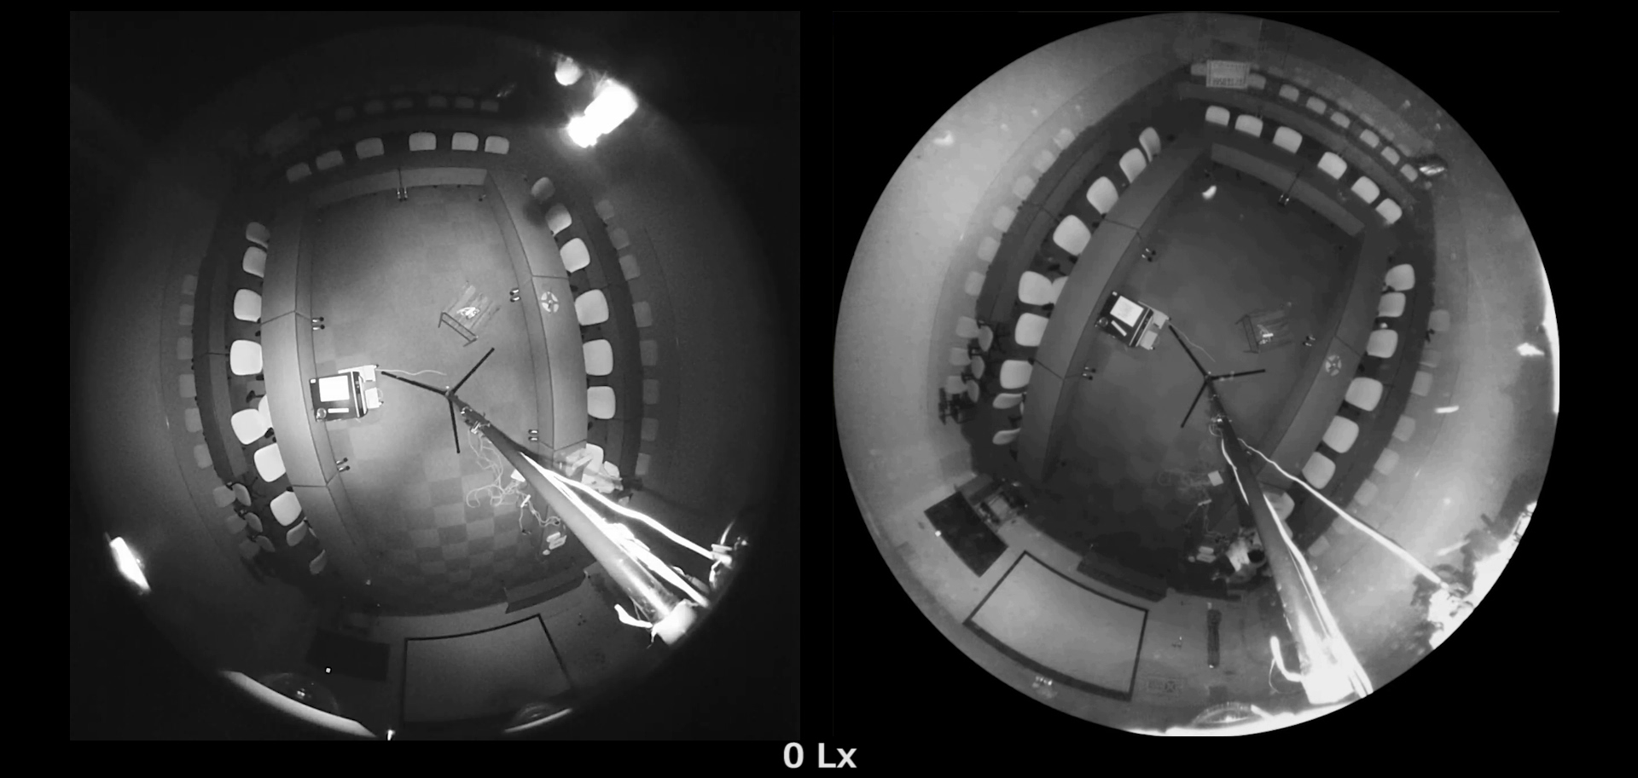
Extreme Visibility
High sensitivity with built-in IR LED ex. moving picture image
Enables to visible objects with built-in IR light even 0 lux of dark condition
Leading brand
New i-PRO Extreme
6

Slide 7
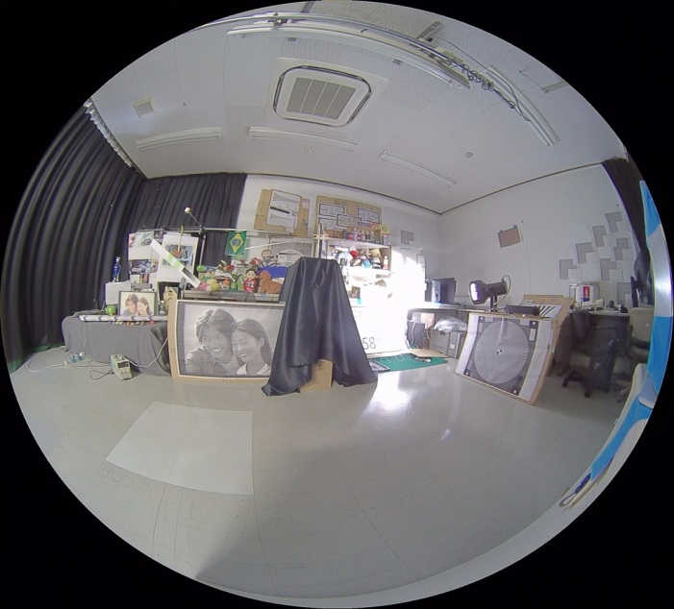
Extreme Visibility
Super dynamic 108dB
Both bright and dark area are visible by super dynamic function.
Leading brand (5MP)
New i-PRO extreme with SD (5MP)
7

Slide 8
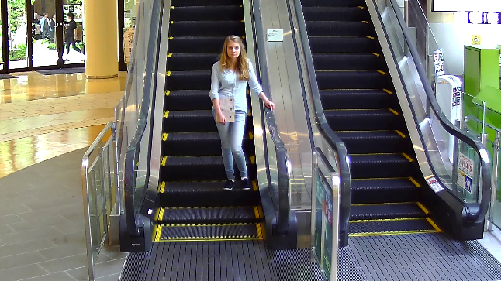
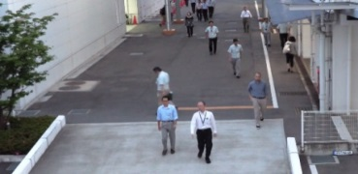
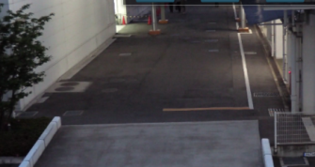

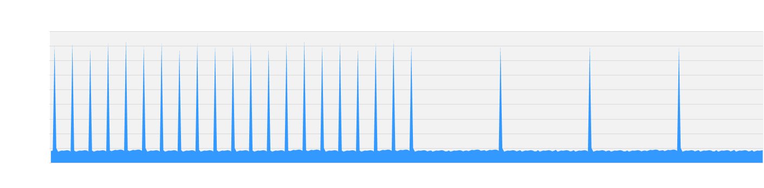

Extreme Compression
Smart coding Technology
With the latest bitrate reducing technology, GOP control with new frame rate control , Auto-VIQS, these cameras save the network bandwidth and the recorder disk space. The cameras can reduce the amount of data by up to approx. 95% for still scene and up to approx. 80% for moving scene compared with the normal H.264 codec. When comparing with Panasonic H.264 camera (WV-SF438 etc) , the amount of data is reduced by up to approx. 70% for moving scene and up to approx. 90% for still scene.
GOP control
Auto-VQOS
Reduces encoding data by using p-frame in place of i-frame
when no motion is detected.
Automatically determine areas with and without motion
and reduce the data volume of those without motion.
WITH MOTION
WITHOUT MOTION
Low Bitrate
(Higher
Compression)
Generated
code amount
Predicted
Frame
Predicted
Frame
Predicted
Frame
I-frame is inserted
at regular intervals as usual.
I-frames are thinned down
to reduce the amount of data.
With
Motion
Without
motion
The I-frames refresh interval is depending on the presence or absence of motion, the bit rate at the time of scene shooting without motion is further reduced. (Max. I-frames refresh interval/480sec, 1fps)
With
Motion
New
frame rate control
30fps
15fps
7.5fps
3ps
1ps
1ps
Mid. Bitrate
(Original compression)
*Simulated image
4sec
16sec
32sec
64sec
160sec
480sec
480sec
4sec
8

Slide 9
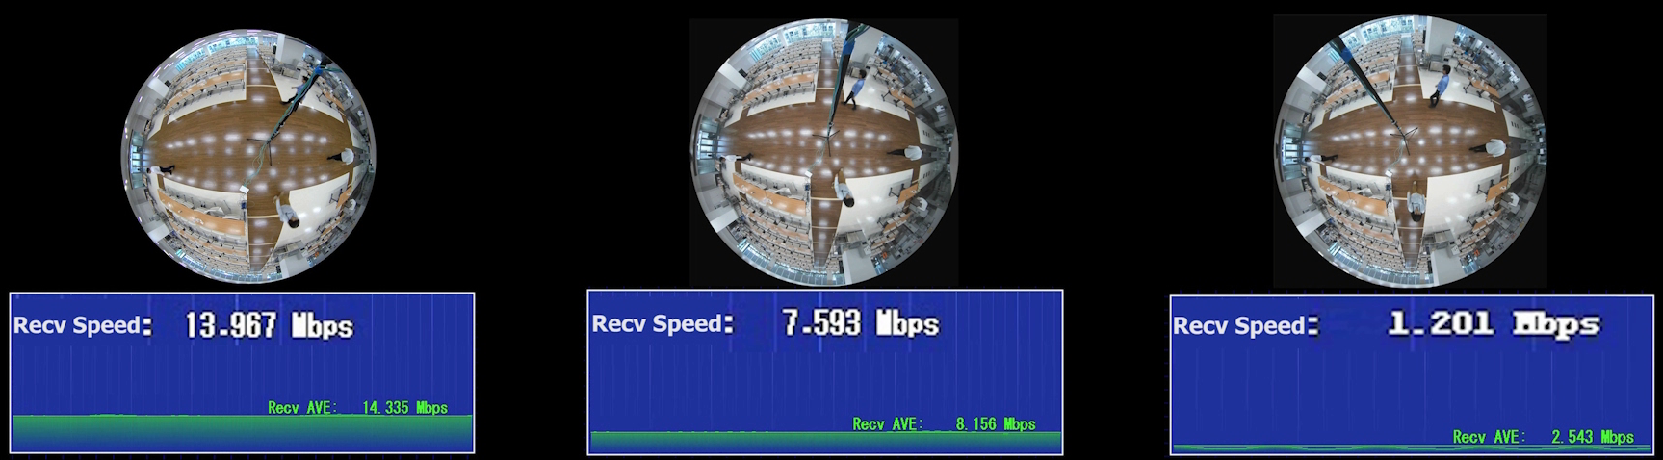







Extreme Compression With 5MP models
H.264
New H.265 i-PRO extreme
New H.265 i-PRO extreme
with smart coding
50%
95%
Reduce TCO
Solution!
Server/HDD OPEX , No need for special network
9

Slide 10




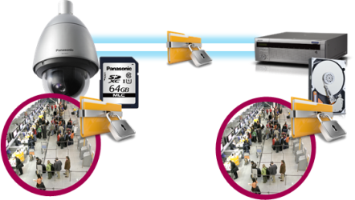








Extreme Data Security
Secure Communication
Protect the devices from cyber attacks
Prevention leakage of the video
Eliminated vulnerability with the latest CVE* support
*CVE : Common Vulnerabilities and Exposures. Common Vulnerabilities and Exposures is a dictionary of common names
(i.e., CVE Identifiers) for publicly known
Panasonic cameras deliver the encrypted video, and it‘s stored in WJ-NX200K (Panasonic recorder).
The data can be password-protected and alteration detection helps ensure credibility of data.
*When using this function, you need optional licenses.
The stream and video are encrypted by the module meet FIPS140-2 level 1 CAVP*. Panasonic fully protect the stream and the video on the End-to-End System.
*Evaluated by WV-TW370P
Prevention leakage of the data
on communication network
Realize secure communication between devices by using communication encryption (SSL/TLS communication).
By using hash value, can detect Video alteration.
10

Slide 11
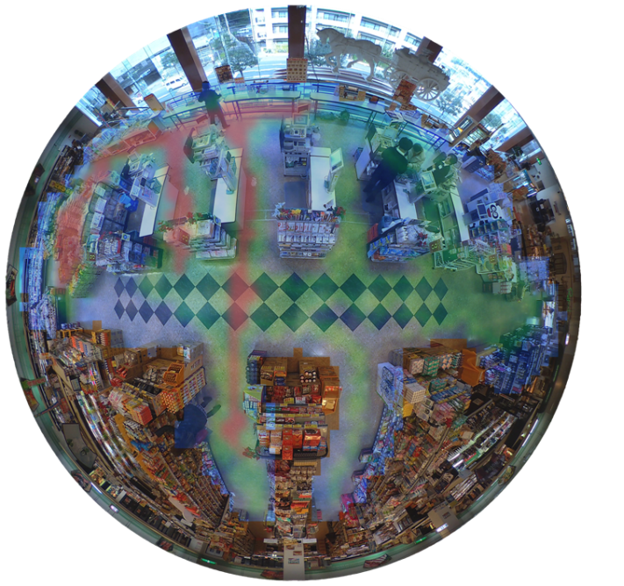
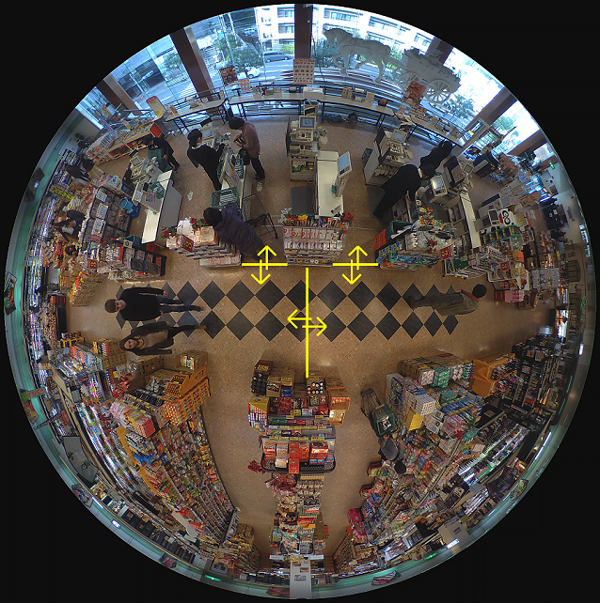
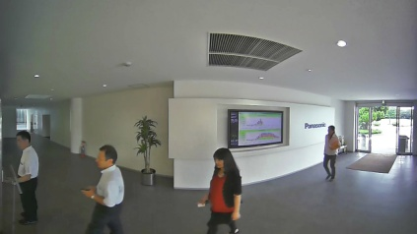
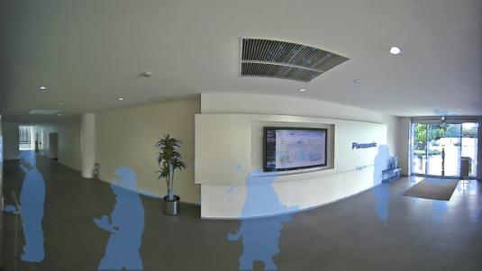
Extreme Analytics
Behavior Analysis / Privacy Protection
*With optional software WV-SAE200
11
Heat Mapping
People Counting
Moving Object Removal
Analyze high-traffic and
long-stay zones
Take a head count
of visitors
Remove people and moving
objects from the video
11
Notes:
Vandal Resistant
Pan angle up to 100 degree for outdoor box model.
Salt (Corrosion)-resistant screw

Slide 12
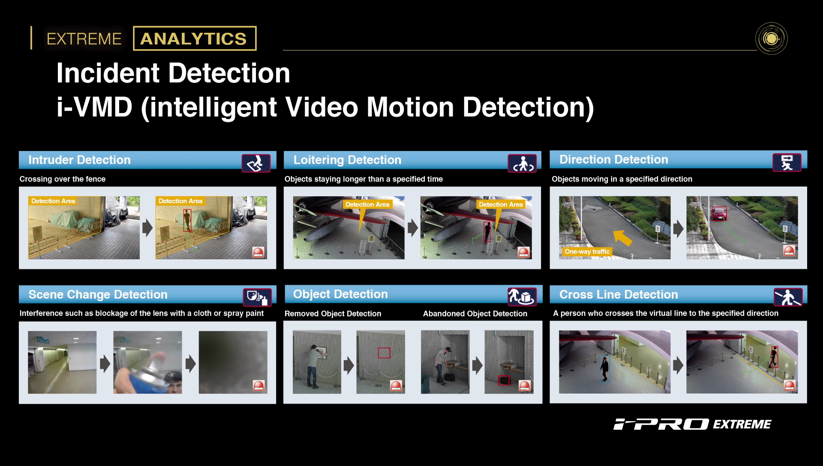
Extreme Analytics - Intelligent VMD
Detect various abnormal behavior of person by Optional intelligent VMD (i-VMD) software WV- SAE200
12

Slide 13
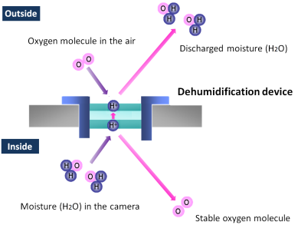
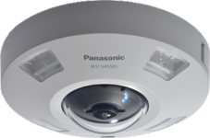
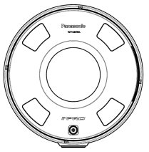
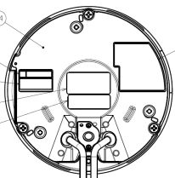
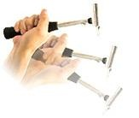
Extreme Reliability
Achieves high endurance under extreme condition
Anti-humidity
The built-in electrical dehumidification keeps the camera dry inside, using
electrolysis to remove any moisture from the camera. This anti-humidity
technology is safe and green due to low power consumption
and no heaters or mechanical fans being used.
Salt (Corrosion)-resistant screw
(All the screws of the outer)
Vandal Resistant
Prevention from fixation at maintenance.
Highly impact resistant.
Compliant with IEC 60068-2-75 test Eh,
50 J / IEC 62262 IK10.
Water & Dust Resistant
IP66
NEMA 4X compliant.
13
Notes:
Vandal Resistant
Pan angle up to 100 degree for outdoor box model.
Salt (Corrosion)-resistant screw

Slide 14
Specifications
 |  |  | WV-S4150L | WV-S4550L | WV-S4550LM
Image sensor |  |  | 1 / 3” type MOS
Max. video resolution (pixel) |  |  | 2192x2192 (Fish eye)
Max. frame rate |  |  | 30 fps
Video Compression |  |  | H.265 / H.264 / MJPEG
Minimum Illumination *Shutter speed 1/30s |  | Color | 0.3lx @F2.4, 0.02 lx @ shutter speed 16/30
 |  | B/W | 0.2lx @F2.4, 0.013 lx @ shutter speed 16/30 | 0.04lx @F2.4, 0.0025 lx @ shutter speed 16/30, 0 lx @ IR
IR LED / Maximum irradiation distance |  |  | - | Yes / 10m
Angular Field of View | Horizontal/Vertical |  | 186°/ 186°
Audio Compression |  |  | G.726, G.711, AAC-LC
SD memory card slot |  |  | 1slot (SDXC/SDHC/SD)
Zoom Ratio |  |  | Digital zoom (x1, x2, x4)
Wide dynamic range |  |  | Super dynamic 108dB
Smart coding |  |  | Yes
M12 connector / Railway application |  |  | - |  |  | Yes / EN50155-TX
External I/O Terminals |  |  | ALARM IN 1 (Auto time adjustment) (x1), ALARM IN 2 (ALARM OUT) (x1), ALARM IN 3 (AUX OUT) (x1)
Audio input / output |  |  | ø3.5 mm stereo mini jack x 1 / ø3.5 mm stereo mini jack x1
Water and Dust Resistance |  |  | - | IP66, NEMA 4X compliant
Shock Resistance |  |  | - | 50J IEC60068-2-75, IK10 (IEC 62262)
Ambient Operating Temperature |  |  | -10°C ~ +50°C (14 °F ~ +122 °F) | -40°C ~ +50°C (-40 °F ~ +122 °F) @ IR LED ON, -40°C ~ +60°C (-40 °F ~ +140 °F) @ IR LED OFF
Dimension (mm) / Mass(approx.) |  |  | ø150 mm × 50.5 mm (H) / Approx. 390 g | ø164 mm × 96.3 mm (H) *with the base bracket / Approx. 1.3 kg
14

Slide 15
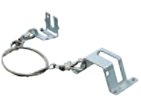
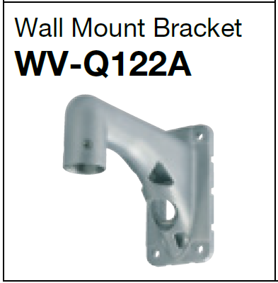
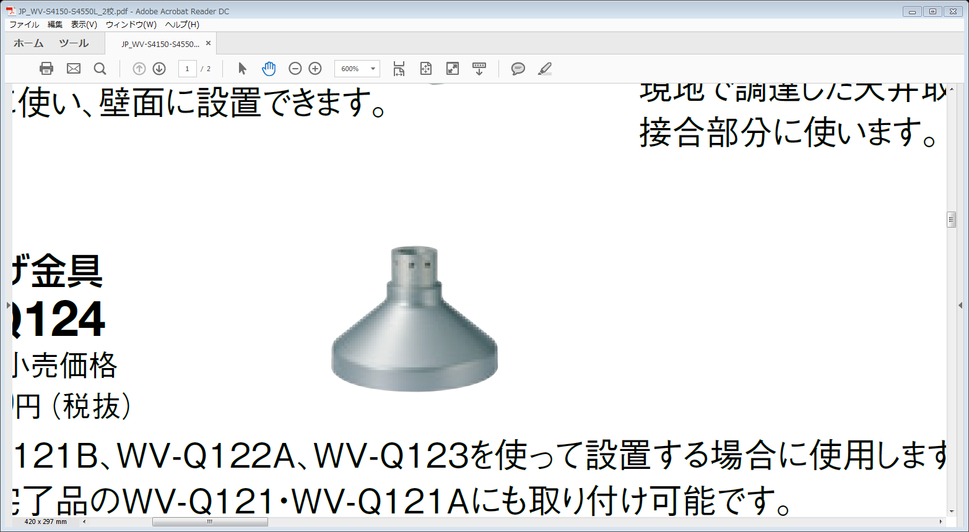
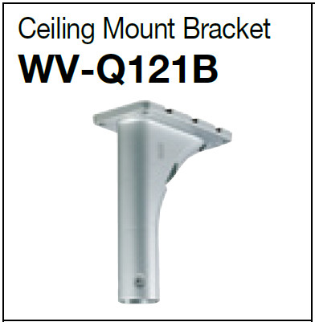
Optional Accessories
  Mount brackets
  WV-S4150
  WV-S4550L/S4550LM
WV-Q105A
Ceiling Mount Bracket
WV-Q122A
Wall Mount Bracket
WV-Q124
Mount Bracket
WV-Q121B
Ceiling Mount Bracket
WV-Q185
Wall Mount Bracket
WV-Q186
Mount Bracket
15

Slide 16
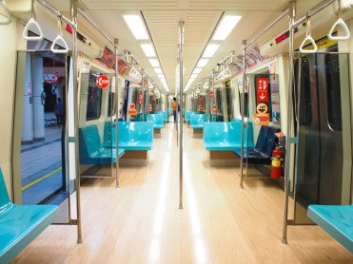
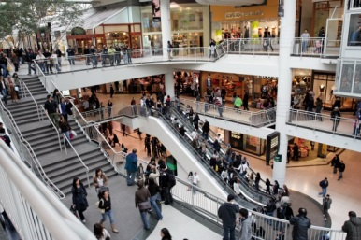
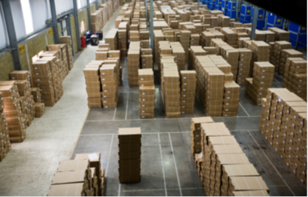
Applications
Those cameras are suitable under the extreme conditions
Retails / Shopping mall
Airport
Train / Subway
Bank
Education / Hospitals
Buildings
Logistics and more.
16

