Slide 1
H.265 Indoor PTZ Cameras
WV-S6131/S6111, WV-S6130
Ver. 1.01
Panasonic i-PRO Sensing Solutions Co., Ltd.

Slide 2





Concept & Main Features
New H.265 PTZ cameras are shown extreme performance under extreme condition.
 | Extreme Visibility | ・High powered zoom function : 40x (S6131/S6111), 21x (S6130) ・High sensitivity with color night vision ・Extreme super dynamic 144dB ・Intelligent Auto
 | Extreme Compression | ・H.265 compression with new Smart coding technology
 | Extreme Data Security | ・Secure communication with Symantec certification
WV-S6131(FHD)
WV-S6111(HD)
WV-S6130(FHD)
2

Slide 3
Extreme Visibility
High powered zoom function can survey further long distance objects clearly
40x optical zoom(WV-S6131/S6111)
21x optical zoom(WV-S6130)
High zoom lens
Focal Length 4.25 ~ 170mm
High zoom lens
Focal Length 4.0 ~ 84.6mm
Wide view angle
H: 1.9° (TELE) - 66° (WIDE)
V: 1.1° (TELE) - 39° (WIDE)
Wide view angle
H: 3.5° (TELE) - 74° (WIDE)
V: 2.0° (TELE) - 42° (WIDE)
40x zoom
21x zoom
Around 33 meter
Around 33 meter
3

Slide 4
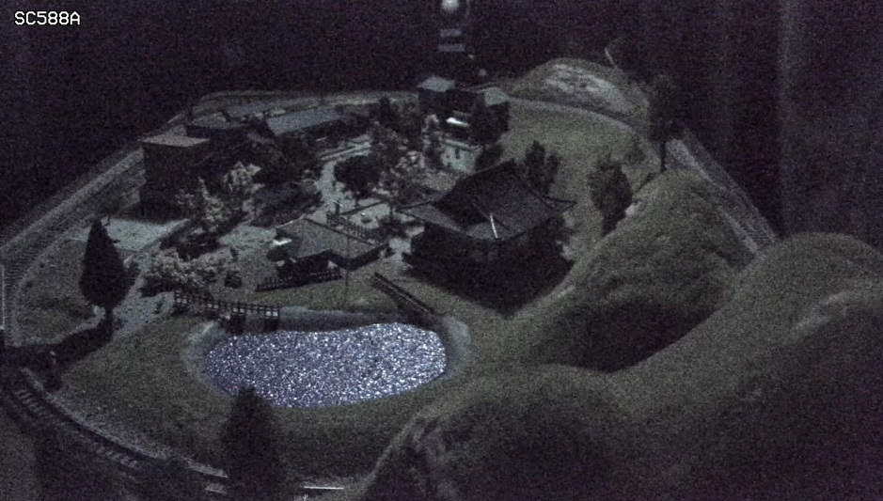
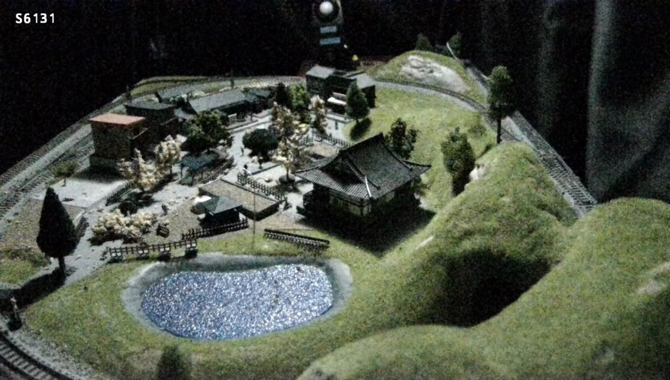
Extreme Visibility
High sensitivity with color night vision
It shows clear color images in low light condition at nigh time.
Panasonic new night view enhancer technology changes your 1/3 inch sensor camera into a outstanding low light performance camera to provide you TRUE color information under very low lighting conditions.
Illumination : 0.3 lx
4

Slide 5
Extreme Visibility
Extreme super dynamic 144dB
Both bright and dark area are visible by extreme super dynamic function.
Super Dynamic : OFF
Super Dynamic : OFF
Combine face detection and super dynamic technology to visible the face at dark area
Super Dynamic : ON
Super Dynamic : ON
Bright area is more clear

Slide 6
Extreme Visibility
Intelligent Auto
Automatically optimizes camera parameters for best tuned image for various scenes, using techniques like Full Auto Shutter & Iris control, Backlit compensation , auto image stabilization.
It also can detect characteristics and movement within the scene to optimize camera settings to provide best fit picture quality.
OFF
ON
OFF
ON
6

Slide 7
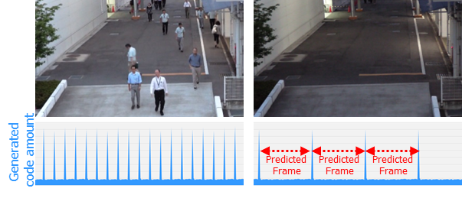
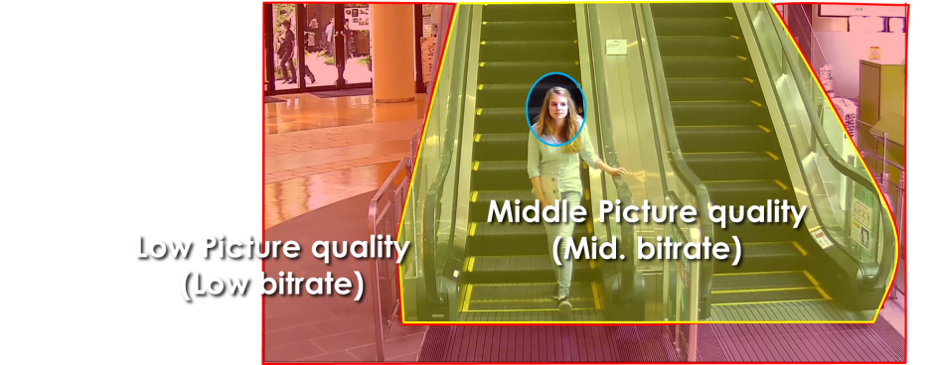
Extreme Compression
Smart coding Technology
With the latest bitrate reducing technology, GOP control, Auto-VIQS, Smart face coding, these cameras save the network bandwidth and the recorder disk space.
The cameras can reduce the amount of data by up to approx. 95% for still scene and up to approx. 80% for moving scene compared with the normal H.264 codec. When comparing with Panasonic H.264 camera (WV-SPN531, SPN631 etc) , the amount of data is reduced by up to approx. 70% for moving scene and up to approx. 90% for still scene.
When people are walking, I-frame is inserted at regular intervals as usual.
When there is no person walking,
I-frames are thinned down to reduce the amount of data.
GOP control reduces encoding data by using p-frame in place of i-frame when no motion is detected.
Scene | Without GOP | With GOP
Heavy traffic of people | 3 Mbps | 3 Mbps
Minimal traffic of people | 2 Mbps | 1 Mbps(-50 to - 60%)
Keep high
Picture quality
Auto - VIQS can automatically determine areas with and without motion and reduce the data volume of those without motion.
The camera can also detect faces and keep the area of the face at most highest picture quality to keep your most important evidence to be kept clear, Smart facial coding.
*Simulated image
7

Slide 8





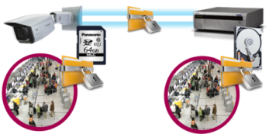







Extreme Data Security
Secure Communication
Protect the devices from cyber attacks
Prevention leakage of the video
Eliminated vulnerability with the latest CVE* support
*CVE : Common Vulnerabilities and Exposures. Common Vulnerabilities and Exposures is a dictionary of common names
(i.e., CVE Identifiers) for publicly known
Panasonic cameras deliver the encrypted video, and it‘s stored in WJ-NX200K (Panasonic recorder).
The data can be password-protected and alteration detection helps ensure credibility of data.
*When using this function, you need optional licenses.
The stream and video are encrypted by the module meet FIPS140-2 level 1 CAVP*. Panasonic fully protect the stream and the video on the End-to-End System.
*Evaluated by WV-TW370P
Prevention leakage of the data
on communication network
Realize secure communication between devices by using communication encryption (SSL/TLS communication).
By using hash value, can detect Video alteration.
8

Slide 9
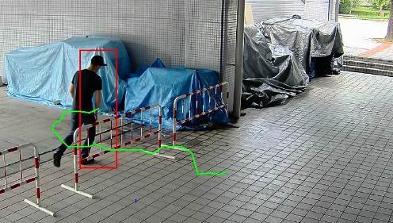
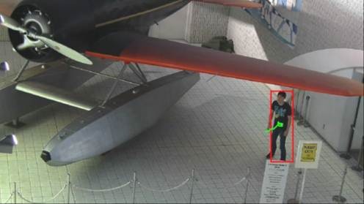
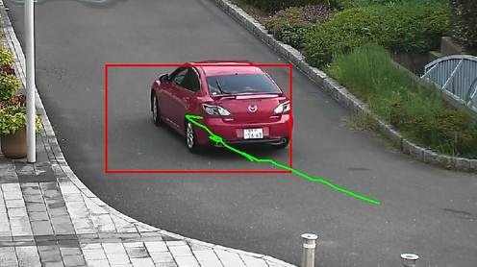
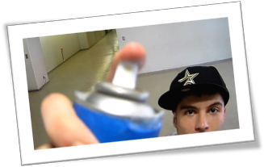
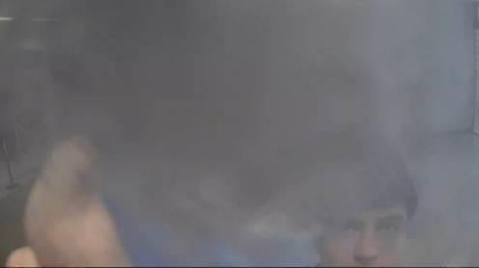
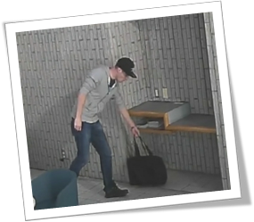
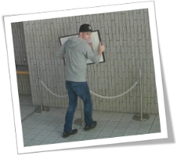
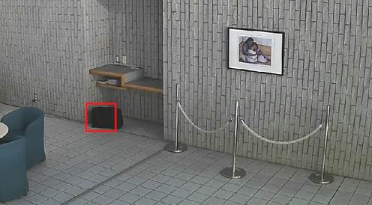
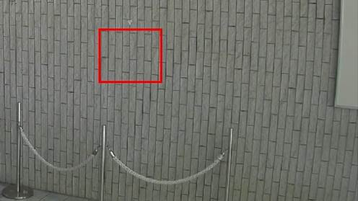
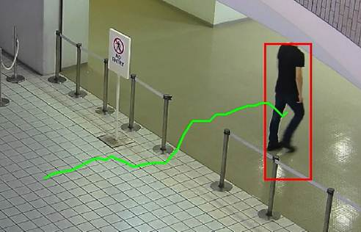
Optional Intelligent VMD
Detect various abnormal behavior of person by Optional intelligent VMD (i-VMD) software WV- SAE200
Intruder detection
detects people or cars trespassing in restricted areas.
Loitering detection
detects people who has loitered for too long in the area.
Direction detection
detects people or cars that go the wrong direction.
Scene change detection detects tampering with the camera view.
Object detection (left)
detects something left behind that shouldn’t be there.
Object detection (removed)
detects objects disappearing that should be present.
Cross line detection
detects people or objects crossing the imaginary lines.
9

Slide 10


Specifications
 |  | WV-S6131 | WV-S6111 | WV-S6130
Image sensor |  | 1 / 2.8 type MOS |  | 1 / 2.9 type MOS
Max. video resolution (pixel) |  | 2048 x 1536 (Super resolution) | 1280 x 960 | 2048 x 1536 (Super resolution)
Max. frame rate |  | 60 fps
Day / Night |  | Yes (ICR)
Minimum Illumination *Shutter speed 1/30s | Color | 0.015lx @F1.6 | 0.011lx @F1.6 | 0.015lx @F1.6
 | B/W | 0.006lx @F1.6 | 0.005lx @F1.6 | 0.006lx @F1.6
Angular Field of View *16:9 mode | Horizontal | 1.9°(Tele) - 66°(Wide) |  | 3.5°(Tele) - 74°(Wide)
 | Vertical | 1.1°(Tele) - 39°(Wide) |  | 2.0°(Tele) - 42°(Wide)
Panning range |  | 360°Endless panning |  | 0° - 350°
Audio |  | Two-way
SD memory card slot |  | 1slot (SDXC/SDHC/SD)
Zoom Ratio |  | 40x Optical, 60x with HD Extra Optical Zoom(Resolution 1280x720) |  | 21x Optical, 31x with HD Extra Optical Zoom(Resolution 1280x720)
Image stabilizer |  | Yes(Electric Image Stabilization)
Ambient Operating Temperature |  | -10°C ~ +50°C (14 °F ~ +122 °F) |  | -10°C ~ +50°C (14 °F ~ +122 °F) *Ceiling/Camera mount bracket
Dimension (mm) |  | Φ185 x 214 (H) |  | Φ185 x 157 (H) *Including the decorative cover
10

Slide 11
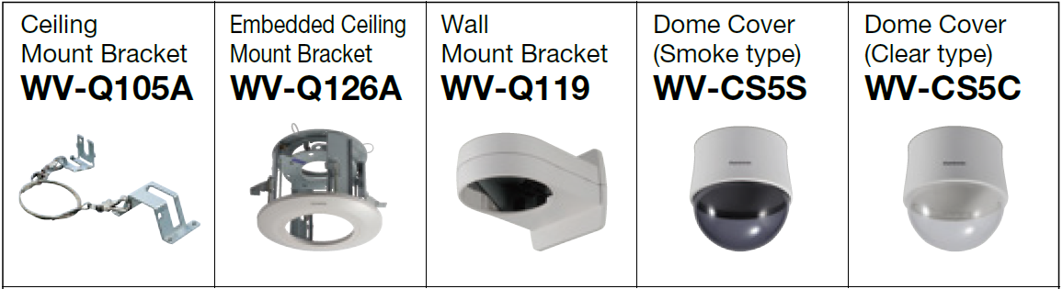
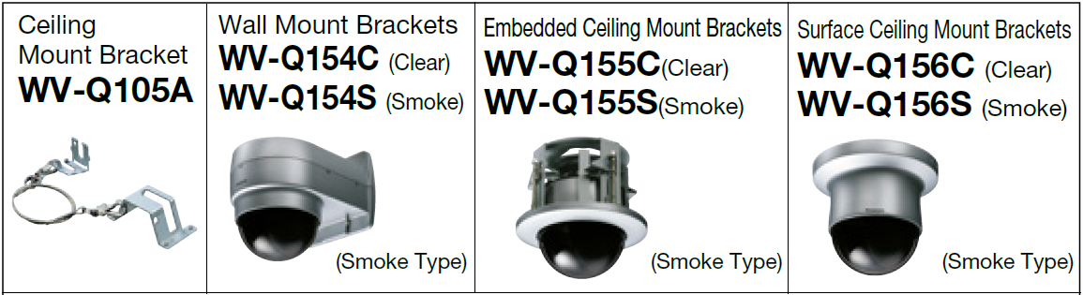

Optional Accessories
  Mount brackets and dome covers
1. WV-Q121B
2. WV-Q122A
WV-S6131/S6111
Inner Dome Cover
WV-Q158C (Clear)
WV-Q158S (Smoke)
WV-Q159C (Clear)
WV-Q159S (Smoke)
WV-Q160C (Clear)
WV-Q160S (Smoke)
WV-Q161
WV-S6130
11

Slide 12
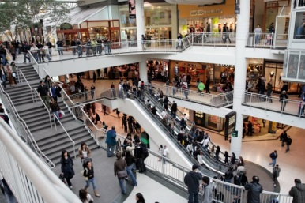
Applications
Those cameras are suitable under the extreme conditions
WV-S6131/S6111
Retails / Shopping mall
Airport
Subway
Casino
Logistics and more.
WV-S6130
Retails
Bank
Hospital
Building and more.
12

