Slide 1
Network Video Disk Recorder
WJ-NX300K
【PAL】
Ver. 1.01
Panasonic i-PRO Sensing Solutions Co., Ltd.

Slide 2

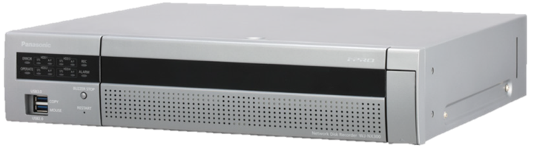
Concept & Main Features
H.265/H.264 high-throughput and scalable recorder featuring integrated GUI and
robust embedded IP security enabling a secure end-to-end PC-Less surveillance solution
Secure & High Compression Recording
PC-Less Surveillance Solution
Up to 32 cameras (H.264/H.265) support
512 Mbps Maximum Total throughput
Secure Communication between cameras and WJ-NX300K and between WJ-NX300K and applications
Dual Stream Recording for narrow band network playback
Easy installation & operation
High speed copy to the USB storage
Built-in GUI and Dual HDMI Outputs
TURBO-RAID Function
TURBO-RAID recording
TURBO-RAID recovery
High Reliability & Redundancy
Eco-writing : Acceleration of data access
Long-life control
Momentary power failure resistance
Vibration proof structure

Slide 3

Secure & High Compression Recording
32 cameras (H.264/H.265)
WJ-NX300K supports up to 32 cameras. As basic recorder, WJ-NX300K support
16 cameras. When adding three additional licenses WJ-NXE30(W) in WJ-NX300, WJ-NX300K supports up to 32 cameras.
In addition, WJ-NX300K can record both H.264 and H.265 stream.
It is easy to configure a coexisting system of i-PRO H.264 cameras and i-PRO H.265 cameras since WJ-NX300K can record both H.264 and H.265 stream.
Add two licenses
(up to 32 cameras)
Add a license
(up to 24 cameras)
NXE30
Camera
Additional kit
NXE30
Camera
Additional kit
512 Mbps Total throughput
WJ-NX300K is equipped with maximum 512 Mbps as total throughput. Maximum recording throughput is 256 Mbps, and it is possible to record the images of 32 cameras when connecting Full-HD H.265 camera (30ips, 2 Mbps). Maximum output throughput is 256 Mbps, and the video of 32 all cameras (Full-HD, 30ips, 2M bps) can be output to a monitoring software at one time.
Basic : up to 16 cameras
WJ-NX300K
Network Video Disk Recorder

Slide 4




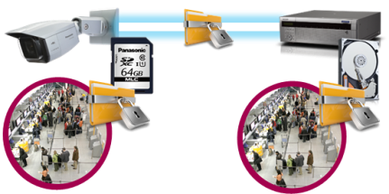







Secure & High Compression Recording
Secure Communication
Protect the devices from cyber attacks
Prevention leakage of the video
Eliminated vulnerability with the latest CVE* support
*CVE : Common Vulnerabilities and Exposures. Common Vulnerabilities and Exposures is a dictionary of common names
(i.e., CVE Identifiers) for publicly known
Panasonic cameras deliver the encrypted video, and it‘s stored in WJ-NX300K (Panasonic recorder).
The data can be password-protected and alteration detection helps ensure credibility of data.
*When using this function, you need optional licenses.
The stream and video are encrypted by the module meet FIPS140-2 level 1 CAVP*. Panasonic fully protect the stream and the video on the End-to-End System.
*Evaluated by WV-TW370P
Prevention leakage of the data
on communication network
Realize secure communication between devices by using communication encryption (SSL/TLS communication).
By using hash value, can detect Video alteration.

Slide 5








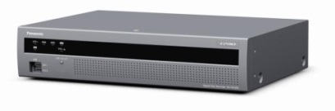

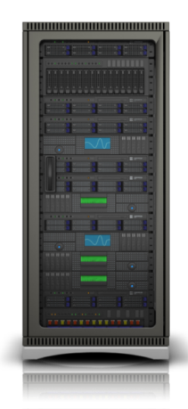
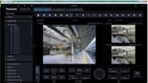

Secure & High Compression Recording
Dual Stream Recording for narrow band network playback
Video delay may be happened as playing a several cameras at one
time or playing on a narrow band. Therefore, WJ-NX300K has
the function which can record 2 stream per a camera.
When using this function, an operator can set the stream
depending on their playback environment.
i.e)
1st stream is recorded at Full-HD resolution and 2nd stream is
recorded at VGA resolution.
・When network band of an operating environment is narrow band.
・When playing the video on WV-ASM300, it plays a video of 1st stream.
・When an operator play a several cameras at one time.
It is possible to use 2nd stream when playing the video on
multiscreen on WV-ASM300.
i-PRO Extreme H.265
i-PRO H.264 cameras
1st stream
2nd stream
1st stream
2nd stream
Rec
Rec
WJ-NX300K
Playback
WV-ASM300 series

Slide 6
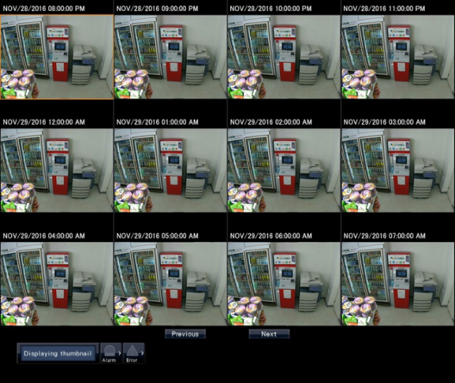
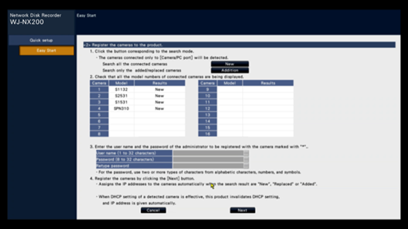
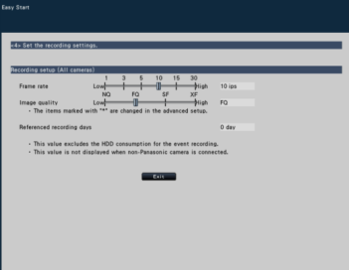
PC-Less Surveillance Solution
Easy installation & operation
・Automatic Security System configuration wizard
・Image search with thumbnail
With only 4-steps “Easy start” of WJ-NX300K, the setting of the recorder and cameras is completed in a few minutes from main display (without PC).
Easy to find out image by thumbnail search
Time and date setting
Camera registration
Multi-screen layout setting
Recording image quality setting
[Note]
Multiple cameras are not supported
It is necessary to select start date and time and display interval
Camera registration GUI

Slide 7


PC-Less Surveillance Solution
High speed copy to the USB storage
Data copy speed will be 3 times higher than current NVR
Example
・2 cameras x 48 hours data copy
・ USB3.0
・Smart coding :efficiency of data compression
NV300K
(Current)
Approximately 18.0 Hours
NX300K
6.0 Hours
Built-in GUI and Dual HDMI Outputs
Main display (HDMI)
Equipped with two HDMI output, WJ-NX300K provides PC-less operation that enables users operate just about all features from the main display without running a PC. The main and sub displays support multi-screen viewing. The main display supports up to 4K resolution, and the sub display supports up to Full-HD resolution.
Display | Interface | Viewing live images | Playback videos | Operation and Setting
Main display | HDMI | P | P | P
Sub display | HDMI, BNC | P | - | -

Slide 8
TURBO-RAID Function
TURBO-RAID Recording
TURBO-RAID Recovery
Keep throughput performance
Achieve high-speed recovery time
RAID of WJ-NX300K equipped with Turbo-RAID keeps it the same as non RAID configuration. An additional unit by the reduced performance isn't needed. Turbo-RAID can provide the ensuring reliability of data and the high-performance throughput.
If a recorder needs to recover for crashing the data, it is possible to recover in a short time.
WJ-NX300K equipped with Turbo-RAID can be recovered in half the time more than a general network recorder when recording mode is on.
Non-RAID
Recording rate performance
Ordinary NVR
RAID
Ordinary NVR
RAID
performance
-50%
1/2 hours
Panasonic
Turbo-RAID
Panasonic
Turbo-RAID
Recovery Time
*Compare with ordinary NVR
performance
100%

Slide 9
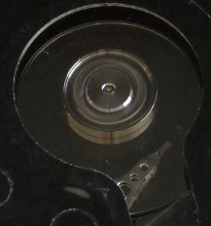
High Reliability and Redundancy
Eco-writing : Acceleration of data access (reading/writing) by original filesystem
Reduce the movement of a head to the utmost limit
Reduce the movement of a head to the utmost limit
WJ-NX300K can reduce the movement of a head to the utmost limit to access own HDD since it equips with Panasonic proprietary file system. Thus WJ-NX300K achieves the high efficiency of writing control, and can extend the life of HDDs.
Reduce fever of actuator motor
Reduce abrasion of motor
NX300

Slide 10


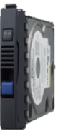
High Reliability and Redundancy
Long-life control - HDD stand-by control individually
WJ-NX300K can manage the status of each HDD using three state.
1st is the active state which is ready accessed by WJ-NX300K to a HDD.
2nd is the idle state, it indicates the status which is ready for next access.
3rd is the stand-by state, it indicates the state stopping a motor.
Reduce
a HDD operation time
Management of HDD in a WJ-NX300K
In the case of the RAID configuration
Active
idle
Stand-by
Activating only when access to HDD is required.

Slide 11
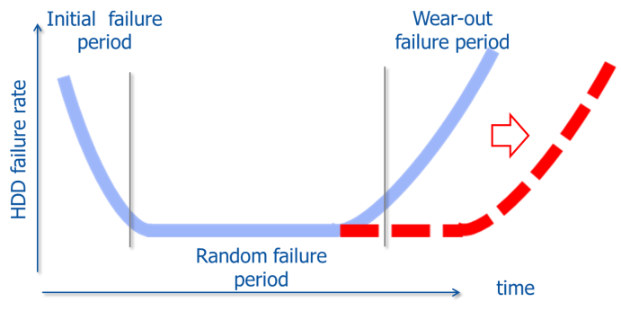
High Reliability and Redundancy
Long-life control - Reduce the movement of a head to the utmost limit
WJ-NX300K can reduce the movement of a head to the utmost limit to access own HDD since it equips with Panasonic proprietary file system. Thus WJ-NX300K achieves the high efficiency of writing control, and can extend the life of HDDs.

Slide 12
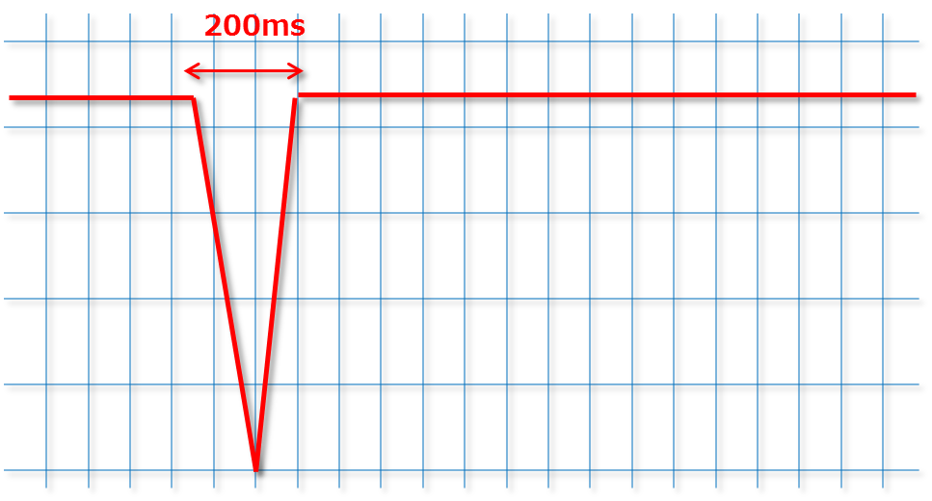
High Reliability and Redundancy
Momentary power failure resistance
“Keep working & recording” without UPS
WJ-NX300K doesn’t have UPS, but it doesn’t stop and doesn’t reboot even when occur a instantaneous voltage drop within 200ms.
When a power failure time is longer than 200ms, WJ-NX300K detects a power interruption and shuts safe down by itself. WJ-NX300K provide a stable recording and a stable operation for you.
Salvable
momentary power failure
95%
*This is an electric power condition of late Japan.

Slide 13
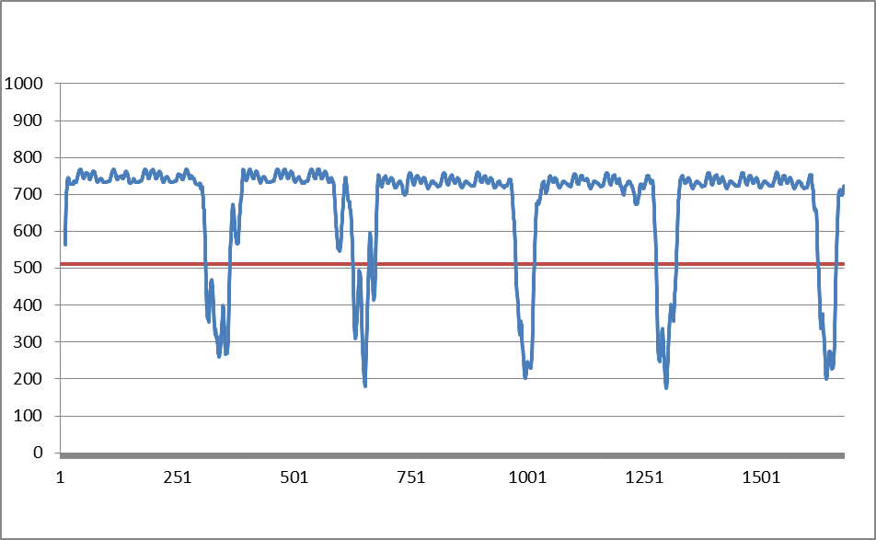
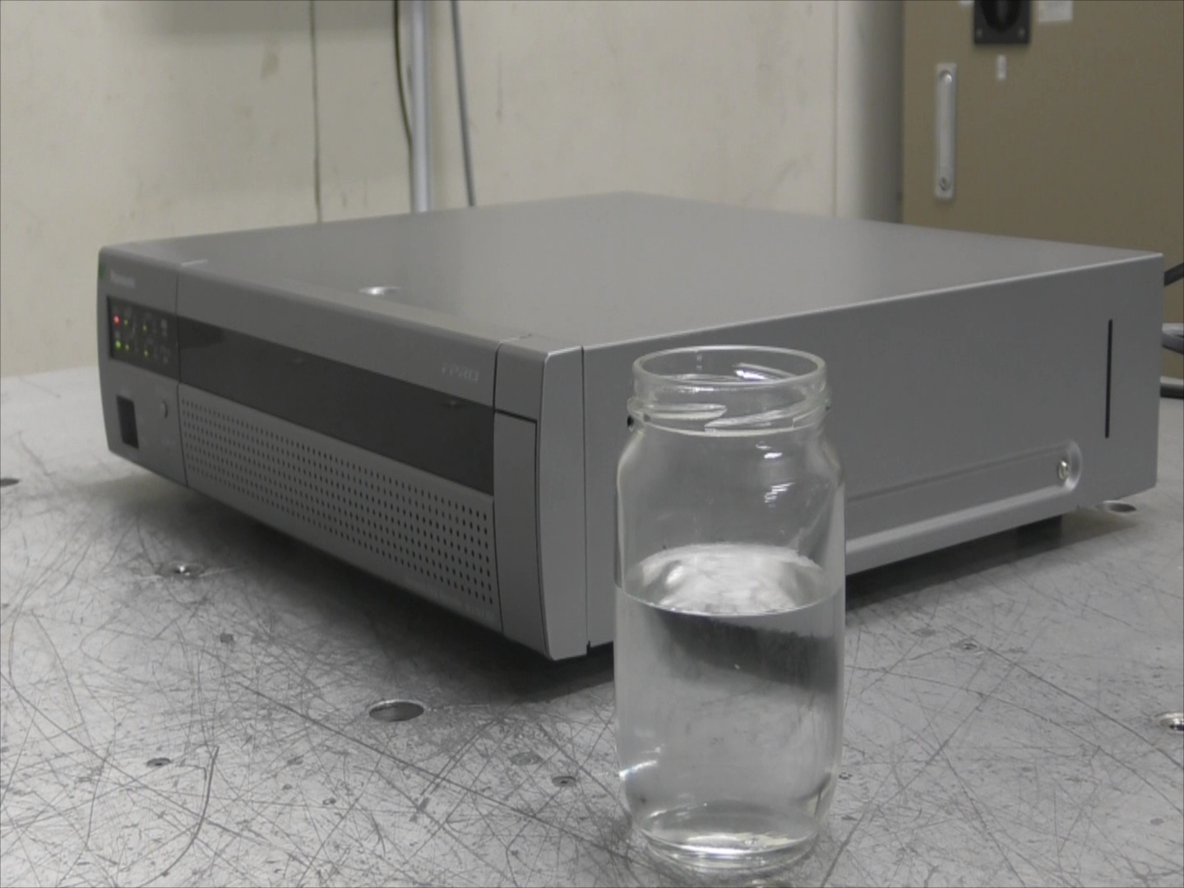
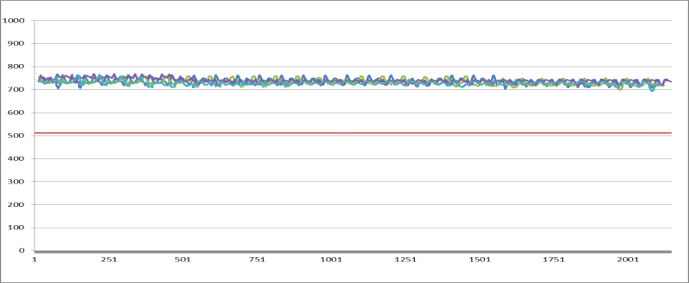
High Reliability and Redundancy
Vibration proof structure
Keep recording even in a vibrating environment like blower and compressor vibration
Ordinary NVR
Vibration test : Vibration frequency 5 Hz-100 Hz in 5 minutes period
Transfer rate
WJ-NX300K
Transfer rate
It enables to stable recording even when receiving vibration from surrounding environment such as air conditioner, walking if NVR on the desk
Number of writes to a HDD in 5 minutes

Slide 14





Others – Useful Features
Camera Group Recording
Camera group recording function allows to set saving period of recorded image for each camera
group at each installation locations.
Area (A)
Recording for area(A) : Saving period 180days
Camera 1
Camera 2
Set up 2 camera group
HDD1
HDD2
HDD3
Camera 3
Camera 4
Area (B)
Camera 5
Camera 6
WJ-NX300K
HDD4
Recording for area(B) : Saving period 30days
Camera 7

Slide 15

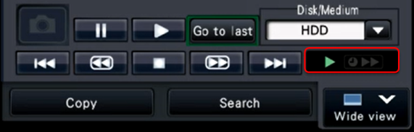

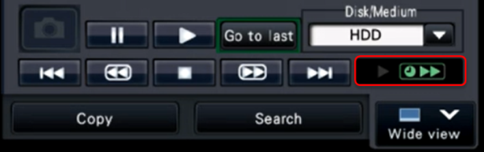


Others – Useful Features
Time-saving playback
Playback time can be saved by high speed playback when there is no movement during playback mode.
In case of recorded image is played back on up to 4 screen
Status indication
1x speed playback
During there is movement
i-PRO cameras
Time-saving playback During there is no movement
NW
Single screen : 4x playback
2/3/4 screen : 2x playback
WJ-NX300K

Slide 16


Others – Useful Features
MP4 Download
WJ-NX300K built in MP4 download function to USB storage media for video and audio data.
Download
WJ-NX300K
 | Recording Condition
 | Video | Audio
1 | H.264/H.265 | AAC-LC
2 | H.264/H.265 | G.726/G.711 360-degree microphone
3 | JPEG/MPEG | N/A
 | MP4 Output result
1 | Video and Audio
2 | Video only
3 | Error

Slide 17
Others – Useful Features
Corridor mode
Corridor mode enables the capture of a more vertically-oriented on several screen layout
2-screen layout
3-screen layout
4-screen layout
1 | 2
1 | 2 | 3
1 | 2 | 3 | 4
(960x1080)
(640x1080)
(480x1080)
5-screen layout
6-screen layout
7-screen layout
1 | 2 | 3
 |  | 4
 |  | 5
1 | 2 | 3 | 4
 |  |  | 5
 |  |  | 6
1 | 4 | 5
2 |  | 6
3 |  | 7
(640x360)
(480x360)
(640x360)
(640x360)
(640x1080)
(480x1080)
(640x1080)

Slide 18















System Configuration
ASM300
Monitor output
(up to 32 cameras)
Mobile
HXE400
Software license
NX300K
NXE30
Camera
additional
kit
NXR30
Additional
RAID kit
NW
NXF02
Business
intelligence
kit
NXSxx
Secure
Comm.
kit
Basic up to 16 cameras
NW camera
Key-board
Mouse
Coax-Lan convertor
Analog camera
Encoder
Decoder
Monitor

Slide 19
WJ-NX300K Specifications
Supported Cameras | Supported Cameras | Panasonic i-PRO series Network camera
 | Supported Image Format | H.265,H.264,JPEG,
 | Supported Audio Format | G.726 32kbps, G.711 64kbps (For ONVIF camera), AAC-LC
 | Maximum Number of Cameras | MAX.32
Recording | Recording Mode | Event, Schedule, Emergency
 | Frame Rate/Camera | Up to 60 ips
 | Others | Pre-Event Recording, 2 stream recording
HDD | Type | 3.5 inch Serial ATA HDD, Up to 4x HDDs can be installed
 | Maximum Capacity | 4 HDD slots Up to 24TB(4x 6TB) will be supported
 | RAID(Hardware RAID) | RAID 1 / 5 / 6 * Additional RAID kit (WJ-NXR30/NXR30W) is required.
Network | Interface | 2x 10BASE-T / 100BASE-TX / 1000BASE-T (RJ45)
 | Maximum Band Width | Total throughput : Max. 512Mbps Recording throughput : Max. 256Mbps, Output throughput : Max. 256Mbps
External Interface | Spot Output Connector | 1x 1 V [p-p] / 75 (BNC)
 | Monitor (HDMI) Connector | [Main monitor] HDMI 4K UHD(3840x2160p) /30Hz, 4K UHD(3840x2160p) /25Hz, 1920x1080p /60Hz, 1920x1080p /50Hz, 1920x1080i /60Hz, 1920x1080i /50Hz [Sub monitor] HDMI 1920x1080p /60Hz, 1920x1080p /50Hz, 1920x1080i /60Hz,1920x1080i /50Hz
 | Alarm Connector | Alarm input: 9 / Alarm output:1 / Error output:4 / Control etc.:5 / output:1(1x -10 dBV, 600 ohm ,Unbalanced (RCA)
 | USB connector | Front x2: USB3.0 x1 (copy), USB2.0 x1(mouse, keyboard), Rear x2: USB3.0 x1 (copy), USB2.0 x1(mouse, keyboard)
General Specifications | Power Source/Power Consumption | WJ-NX300K/G : 220 V to 240 V AC, 50 Hz/60 Hz , Approx.72W
 | Ambient Operating Temperature | +5 °C to +45 °C (41 °F to 113 °F)
 | Ambient Operating Humidity | 5 % to 90 % (no condensation)
 | Dimensions (W x H x D) | 420 mm x 88 mm x 370 mm (16-9/16" x 3-7/16" x 14-9/16“, excluding rubber feet and projections)
 | Weight | Approx.7.0kg (15.4lbs) [without HDD] / Approx.10.0kg (22.0 lbs.) [with 4x 6TB HDDs]

Slide 20



WJ-NX300K Specifications
 | NX300K | NX200K | NX400K
 |  |  | Standard (No camera additional kit) | with camera additional kits
Compression | H.265,H.264 | H.265,H.264 | H.265 | H.265
Max. number of CH | 32 CH *With camera additional kit | 32 CH *With camera additional kit | 1-64CH | 65-96CH (1 kit) 96-128CH (2 kits)
Through put in | 256Mbps | 192Mbps | 384Mbps | 384Mbps
Through put out | 256Mbps | 192Mbps | 256Mbps | 256Mbps
Num. HDD | 4 | 2 | 9 | 9
Raid | 1, 5, 6 | 1 | 1*,5,6 | 1*,,5,6
Extension unit | HXE400x2 | NO | HXE400x5 | HXE400x5
Monitor out | HDMI x2 | HDMI x2 | HDMIx2 | NO
Transcode | 2user access | 2user access | 2 user access | NO
Sub-stream Rec. | Yes (Full CH) | Yes (Full CH) | Yes (Full CH) | NO
NAS back up | NO | NO | YES * | NO
Face recognition | Yes (2cam) | Yes (2cam) | NO | NO
Failover between NVRs | NO | NO | YES * | YES
HDD long-life control | YES | NO | YES * | YES
Copy port/(USB port num.) | USB/(4) | USB/(4) | USB/(4) | ←
Dimensions | 420x88x370mm | 420x88x300mm | 430x132x400mm | 430x132x400mm
Easy Installation | Yes | Yes | Yes | Yes
RJ45 port (rear side) | 2 | 2 | 2 | 2
RJ45 maintenance port (front side) | 0 | 0 | 1 | 1

Slide 21
WJ-NX300K optional line-up
Software
Additional Camera kit | WJ-NXE30(W) | Additional channel license(Up to two license for 32 cameras)
Additional Business Intelligence kit | WJ-NXF02(W) | 2 cameras per a additional business intelligent kit for “people counting” and “Face matching/Age & Gender judgment”
Additional RAID kit | WJ-NXR30(W) | Additional RAID license for enable RAID function
Secure Communication license | WJ-NXS32(W) | Secure optional license for 32ch
 | WJ-NXS16(W) | Secure optional license for 16ch
 | WJ-NXS04(W) | Secure optional license for 4ch
 | WJ-NXS01(W) | Secure optional license for 1ch

Slide 22





Applications
This recorder is suitable under the extreme conditions :
Public safety
Transportation
(Airport/Train/Subway)
Banks
Retails
Hospitals
Education
Factories and more.

