Slide 1
H.265 Outdoor Camera With Heavy Salt Damage Resistance
WV-X6531NS (H.265 PTZ Camera)
WV-S1531LNS (H.265 BOX Camera)
Panasonic i-PRO Sensing Solutions Co., Ltd.

Slide 2

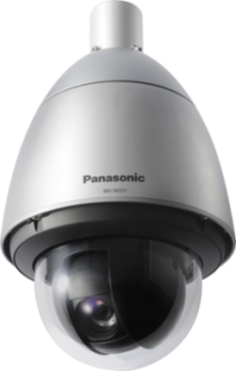


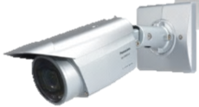
Concept & Main Features
New i-PRO extreme cameras performs under heavy salt air condition
<Environment performance for vertical market>
Salt-air Corrosion Resistant
<Key concepts>
Extreme Visibility Intelligent Auto /Color night vision
Extreme super dynamic 144dB
Extreme Compression
Extreme Data Security
Extreme Reliability
Extreme Analytics Vehicle incident detection(X6531NS only)
2

Slide 3

Salt-air Corrosion Resistant
New H.265 i-PRO extreme cameras with salt-air corrosion resistant body
are able to use in in a heavy salt damaging environment.
Salt-air corrosion resistant coating
for the part of aluminum die-cast
Corrosion-resistant screws
Prevention from fixation at maintenance. (e.g. Geomet®coarings)
ISO14993 Compliant
[3-layer coating process]
Over coat, thicker than 35μｍ
Middle coat, thicker than 65～100μｍ
Oxide film process
die-cast
1 cycle
International Standard specifies test procedure of accelerated corrosion tests
“Salt mist spray” condition (2hours/35℃/5% NaCl)
Cyclic
exposure
“Dry” condition (4hour/60℃/Less than 30%RH)
“Wet” condition (2hour/50℃/More than 95%RH)
3

Slide 4




Salt-air Corrosion Resistant
Supports a variety of coastal areas security
for Gulf monitoring and disaster countermeasures
Gulf Guard
Disaster / Tsunami Measures
Coastal logistics warehouse
Flood gate monitoring
4

Slide 5
Specifications - H.265 PTZ Camera
Model |  | New Model WV-X6531NS | WV-X6531N
Image Sensor |  | Approx. 1/2.8 MOS type
Minimum Illumination |  | 0.015lx (F1.6)
Wide Dynamic Range |  | Super Dynamic 144dB
Frame Rate (Max) |  | 60fps
Optical Zoom |  | 40x
Angular field of view | 16:9 | H: 2.1°-65°, V: 1.2°-39°
 | 4:3 | H: 1.6°-51°, V: 1.2°-39°
Image Resolution (max) | 16:9 | 1920 x 1080
 | 4:3 | 2048x1536 (with super resolution)
Video Analytics |  | i-VMD (Option WV-SAE200), Vehicle Incident Detection (Option WV-XAE100W)
Image stabilizer |  | Yes (Intelligent Zoom Stabilization)
Operating Temperature |  | -50 to 60℃ (AC24V / 60W PoE Injector), -30 to 60℃ (PoE+)
ClearSight Coating |  | Yes
Salt-air Corrosion Resistant |  | YES | -
Common Features |  | 360 endless pan, Advanced auto tracking, Eyelid mechanism, SD memory card slot, Audio I/O, External I/O, IP66, IK10, Privacy Zone: up to 32
5

Slide 6
Specifications – H.265 Box Camera
Model |  | New Model WV-S1531LNS | WV-S1531LN
Image Sensor |  | 1/ 3“ MOS Type 2MP
Minimum Illumination |  | 0.012 lx
Wide Dynamic Range |  | Super Dynamic 144dB
Frame Rate (Max) |  | 60fps
Lens |  | 2.8-10mm, F1.6
Auto Focus (ABF) |  | yes
Motorized zoom |  | ー
Angular field of view | 16:9 | 31 °-to 112 °-.
 | 4:3 | 26°- to 91 °-
IR-LED distance |  | 40m (131 feet)
Audio codec |  | G.711/G.726/AAC-LC
Alarm I/O |  | 3 in 2 out
Vandal Resist. |  | IK10
Water Resist. |  | Yes
ClearSight Coating |  | Yes
Salt-air Corrosion Resistant |  | YES | -
6

Slide 7
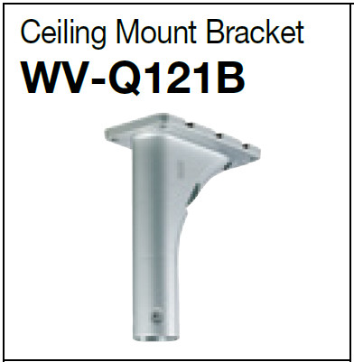
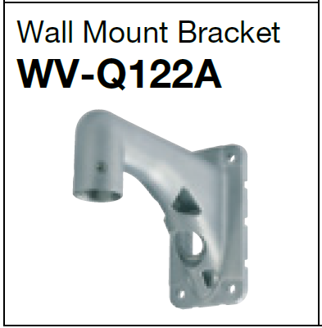
Optional Accessories
  Mount brackets
  Salt-air corrosion resistant coating for WV-X6531NS
  ISO14993 Compliant
WV-Q121AS
WV-Q122BS
7

Slide 8
Same as WV-X6531N & WV-S1531N
Key Concepts & Features

Slide 9
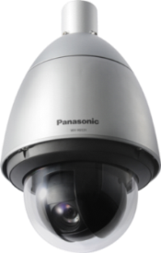
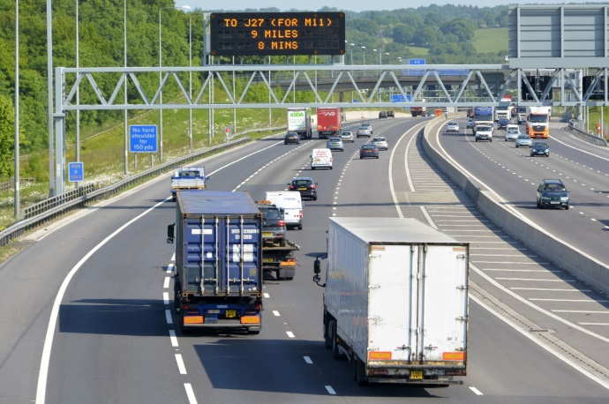
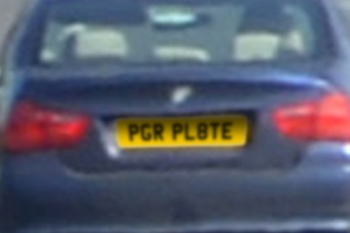
Extreme Visibility
40x optical zoom function can survey further long distance objects clearly
WV-X6531NS only
40x zoom

Slide 10

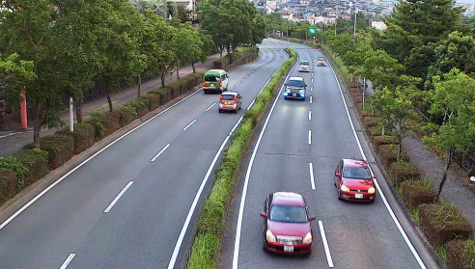

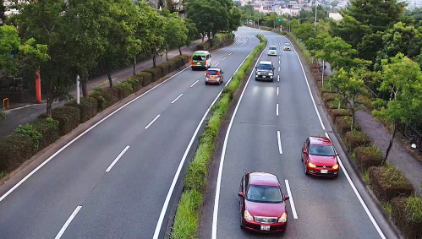

Extreme Visibility
Intelligent auto mode adapts to your application scene
Automatically optimizes camera parameters for best tuned image for various scenes, using techniques like Full Auto Shutter & Iris control, Backlit compensation , auto image stabilization.
Also can detect characteristics and movement within the scene to optimize camera settings to provide best fit picture quality.
Conventional model
iA mode : ON

Slide 11
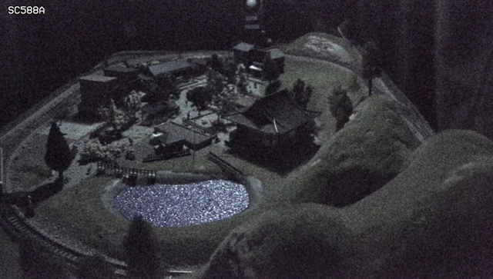
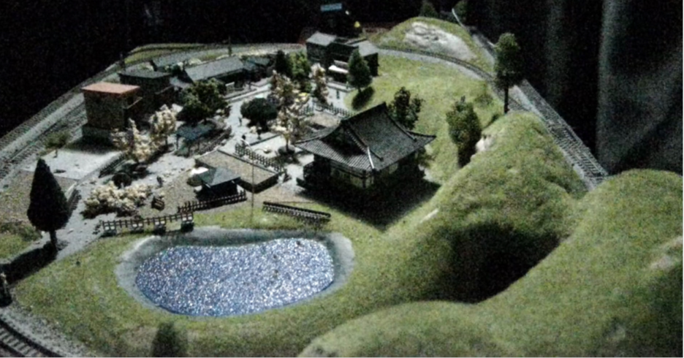
Extreme Visibility
High sensitivity with color night vision
It shows clear color images in low light condition at night time.
Panasonic new night view enhancer technology changes your 1/3 inch sensor camera into a outstanding low light performance camera to provide you TRUE color information under very low lighting conditions.
Illumination : 0.3 lx
11

Slide 12
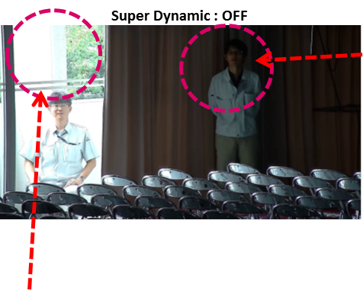
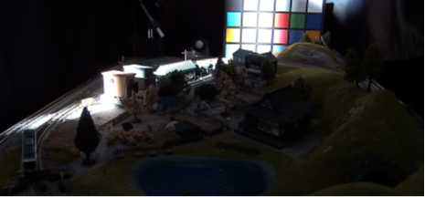
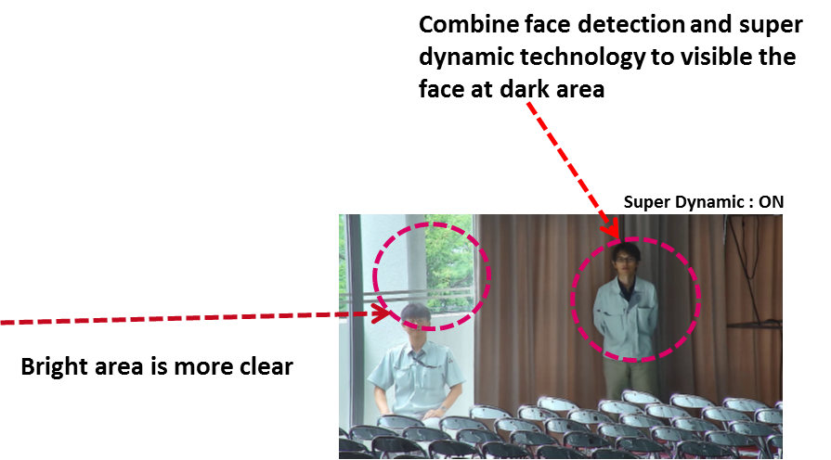
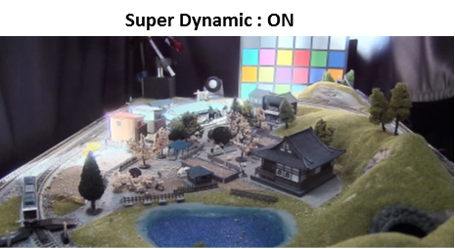
Extreme Visibility
Extreme super dynamic 144dB
Both bright and dark area are visible by extreme super dynamic function.
Super Dynamic : OFF

Slide 13
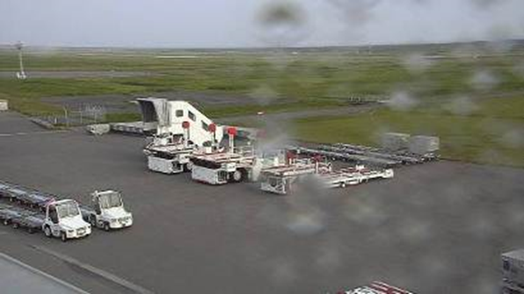
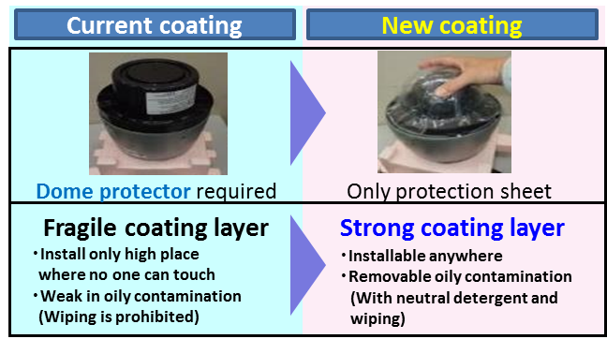
Extreme Visibility
ClearSight Coating
New ClearSight coating significantly increases the operational utility of outdoor cameras in rain weather. The specially coated surface resists water stains and dust accumulation, reducing the need for periodic maintenance.
ClearSight Coating can be wiped with a damp cloth or washed with a neutral detergent.
Improve ease of handling and maintenance
With ClearSight coating
Without any special coating
13

Slide 14
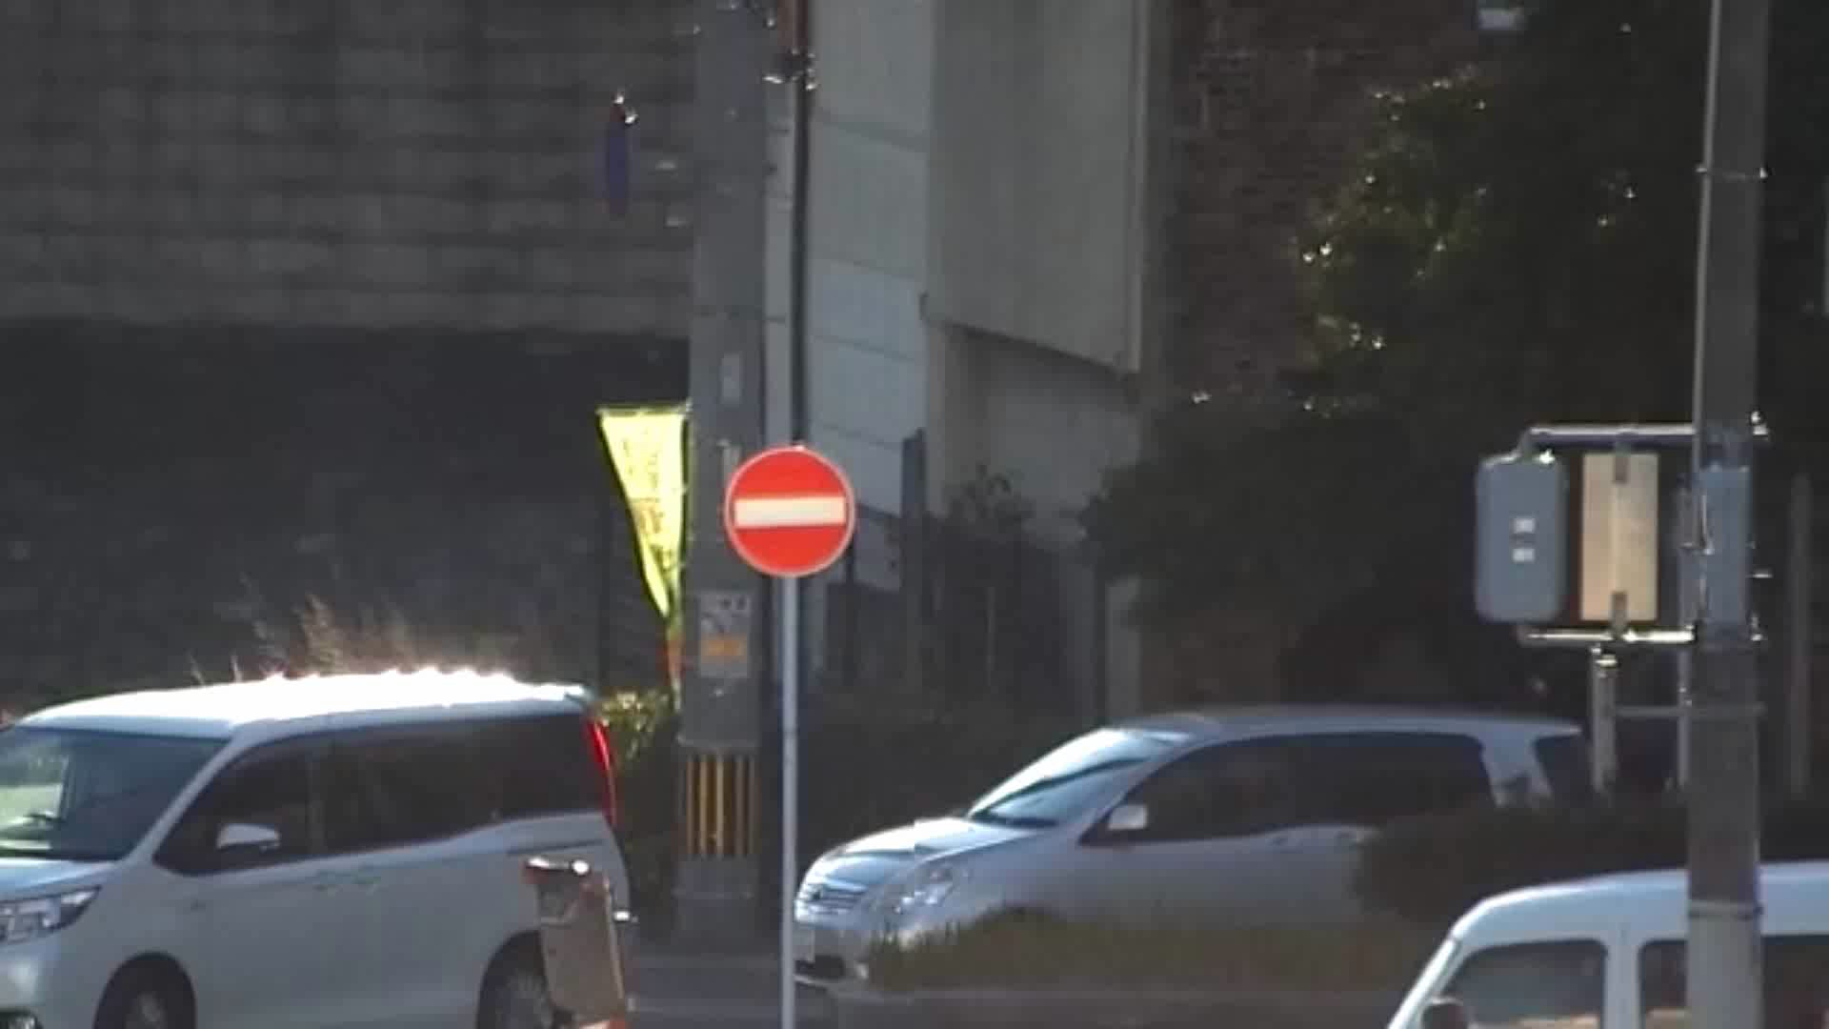
Extreme Visibility
Intelligent Zoom Stabilization *WV-X6531NS only
Stabilization: ON
Stabilization: OFF

Slide 15
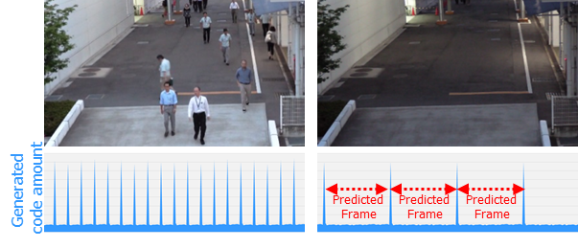
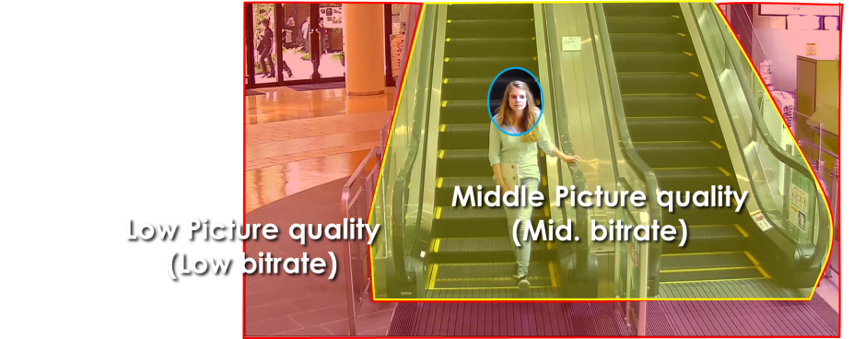
Extreme Compression
Smart coding Technology
With the latest bitrate reducing technology, GOP control, Auto-VIQS, Smart face coding, these cameras save the network bandwidth and the recorder disk space.
The cameras can reduce the amount of data by up to approx. 95% for still scene and up to approx. 80% for moving scene compared with the normal H.264 codec. When comparing with Panasonic H.264 camera (WV-SPN531, SPN631 etc) , the amount of data is reduced by up to approx. 70% for moving scene and up to approx. 90% for still scene.
When people are walking, I-frame is inserted at regular intervals as usual.
When there is no person walking,
I-frames are thinned down to reduce the amount of data.
GOP control reduces encoding data by using p-frame in place of i-frame when no motion is detected.
Scene | Without GOP | With GOP
Heavy traffic of people | 3 Mbps | 3 Mbps
Minimal traffic of people | 2 Mbps | 1 Mbps(-50 to - 60%)
Keep high
Picture quality
Auto - VIQS can automatically determine areas with and without motion and reduce the data volume of those without motion.
The camera can also detect faces and keep the area of the face at most highest picture quality to keep your most important evidence to be kept clear, Smart facial coding.
*Simulated image
15

Slide 16




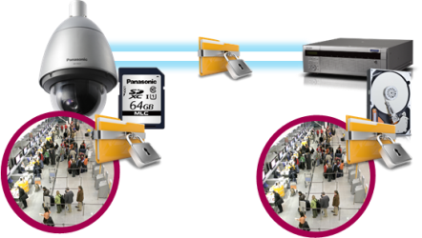








Extreme Data Security
Secure Communication
Protect the devices from cyber attacks
Prevention leakage of the video
Eliminated vulnerability with the latest CVE* support
*CVE : Common Vulnerabilities and Exposures. Common Vulnerabilities and Exposures is a dictionary of common names
(i.e., CVE Identifiers) for publicly known
Panasonic cameras deliver the encrypted video, and it‘s stored in WJ-NX200K (Panasonic recorder).
The data can be password-protected and alteration detection helps ensure credibility of data.
*When using this function, you need optional licenses.
The stream and video are encrypted by the module meet FIPS140-2 level 1 CAVP*. Panasonic fully protect the stream and the video on the End-to-End System.
*Evaluated by WV-TW370P
Prevention leakage of the data
on communication network
Realize secure communication between devices by using communication encryption (SSL/TLS communication).
By using hash value, can detect Video alteration.
16

Slide 17

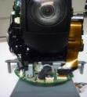



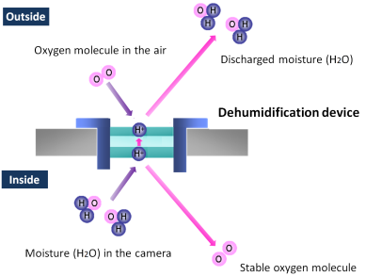
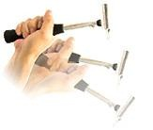
Extreme Reliability
Achieves high endurance under extreme condition
Durability *WV-X6531NS only
Salt (Corrosion)-resistant screw
(All the screws of the outer)
The gear-drive support exact internal standard
and longer life than belt-drive
Prevention from fixation at maintenance.
Note: Salt Resistant is applied
only to screws, not for whole body.
Pan/Tilt Gear Drive
（No backlash mechanism）
Anti-humidity
Connection cable is FPC
The built-in electrical dehumidification keeps the camera dry inside, using electrolysis
to remove any moisture from the camera.
This anti-humidity technology is
safe and green due to low power
consumption and no heaters or
mechanical fans being used.
Vandal Resistant
Highly impact resistant.
Compliant with IEC 60068-2-75 test Eh,
20 J / IEC 62262 IK10.
17
Notes:
Vandal Resistant
Pan angle up to 100 degree for outdoor box model.
Salt (Corrosion)-resistant screw

Slide 18

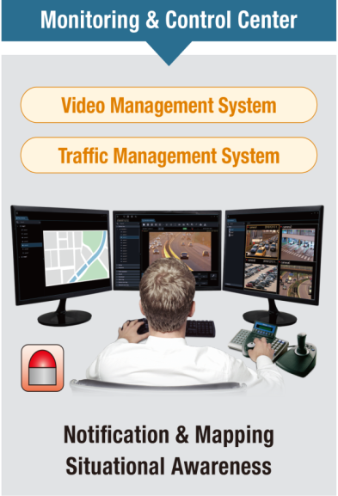
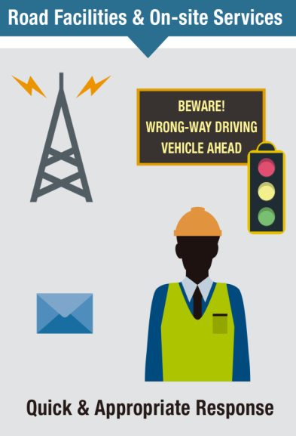
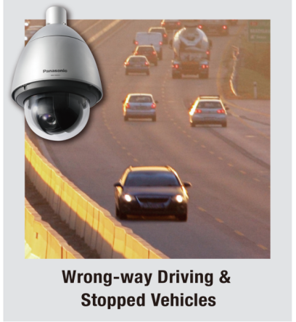

Extreme Analytics
Vehicle incedent detection with optional software WV-XAE100W *WV-X6531NS only
The Vehicle Incident Detection function enables the early detection of traffic accidents
and the efficiency of traffic control center.
High detection accuracy
with extreme visibility
Intelligent Zoom Stabilization
Blur-Free Image
Blurry Image
High Powered 40 times Zoom
Intelligent Auto
18
Notes:
Vandal Resistant
Pan angle up to 100 degree for outdoor box model.
Salt (Corrosion)-resistant screw

Slide 19
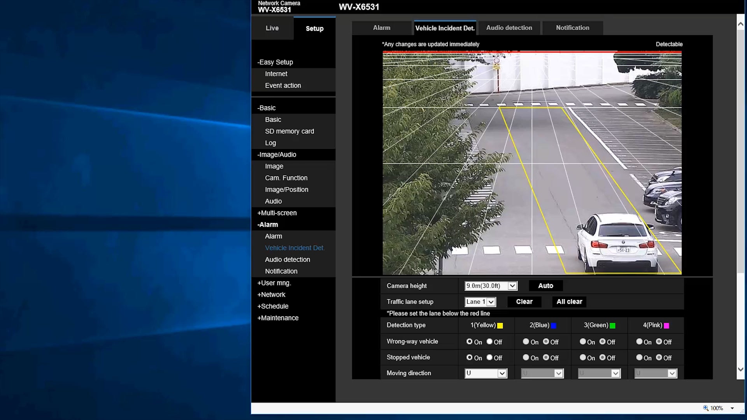
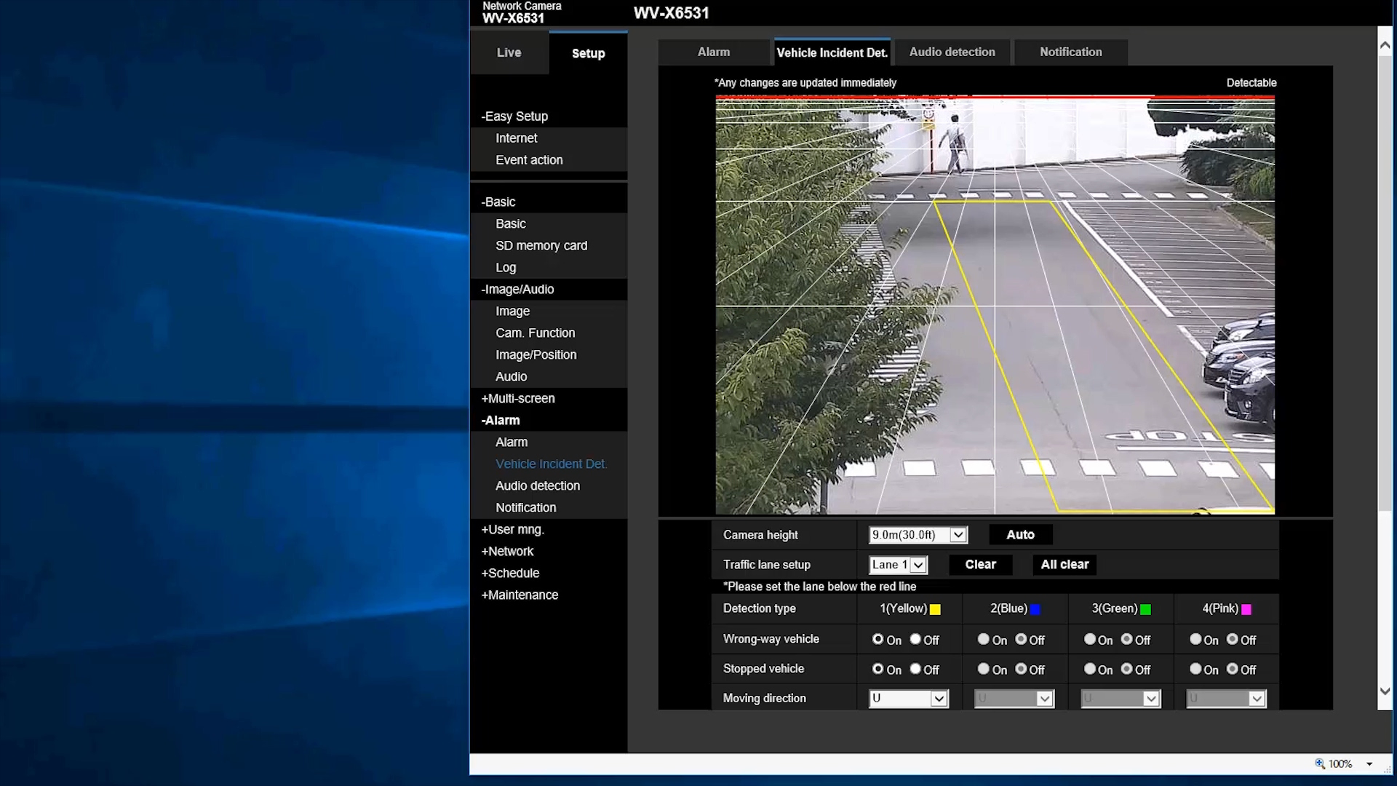
Extreme Analytics
Vehicle incedent detection with optional software WV-XAE100W *WV-X6531NS only
Wrong-way Driving Detection
Stopped vehicle detection
19
Notes:
Vandal Resistant
Pan angle up to 100 degree for outdoor box model.
Salt (Corrosion)-resistant screw

Slide 20
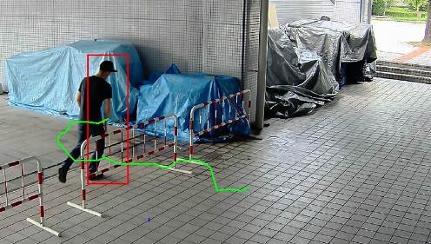
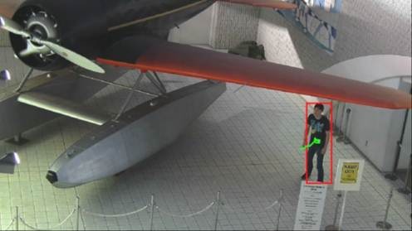
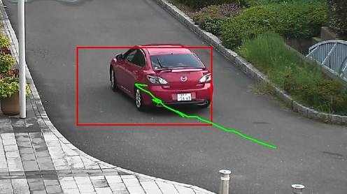
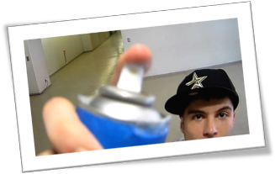
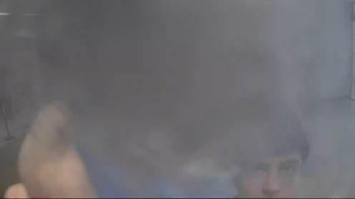
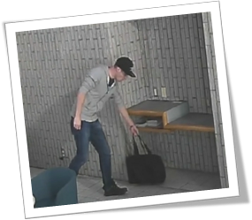
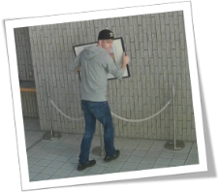
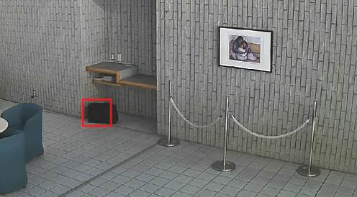
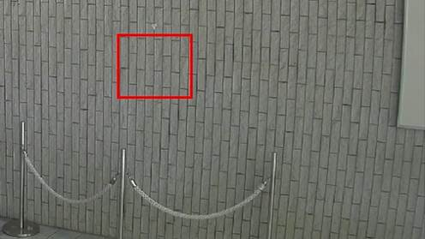
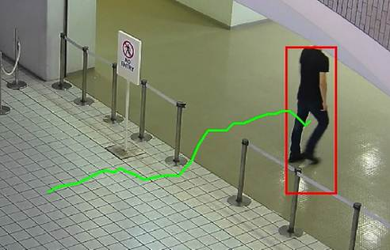
Optional Intelligent VMD
Detect various abnormal behavior of person by Optional intelligent VMD (i-VMD) software WV- SAE200
Intruder detection
detects people or cars trespassing in restricted areas.
Loitering detection
detects people who has loitered for too long in the area.
Direction detection
detects people or cars that go the wrong direction.
Scene change detection detects tampering with the camera view.
Object detection (left)
detects something left behind that shouldn’t be there.
Object detection (removed)
detects objects disappearing that should be present.
Cross line detection
detects people or objects crossing the imaginary lines.
20

