Slide 1
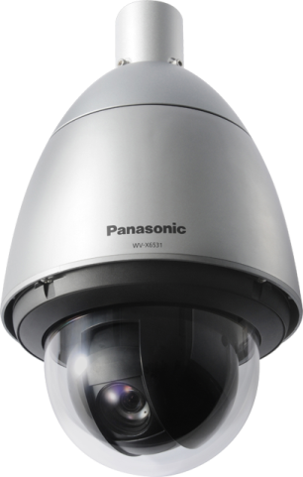

PTZ dome cameras
Camera : WV-X6531N, WV-X6511N
Option Software : WV-XAE100W
Security Systems Business Division
Panasonic Co., Ltd.

Slide 2


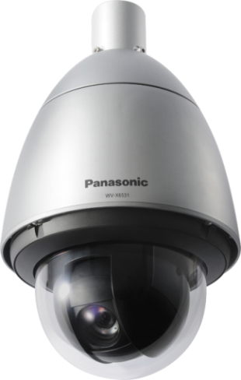
PTZ Dome cameras
Can capture clear images at any scene (Extreme Visibility )
Can reduce the recording capacity ( Extreme Compression )
Can monitor further distant object by 40x zoom.
In order to capture stable images, Intelligent Zoom Stabilization reduces vibrations when large vehicles pass.
Automatically adapts to your application scene,
(intelligent auto mode ).
Under very low lighting conditions, you can get the clear color images with Color night vision.
Even if the situation under backlight,
keep your evidence (face) clear at door steps
with Enhanced Super Dynamic, 144dB.
Can keep clear images with ClearSight cover,
even if it is rain weather.
Even when it tilts above the horizontal position,
-15°~195°-tilt, deliver a clear image with
Auto Eyelid Mechanism.
Can reduce the network bandwidth and the recorder disk space by H.265 compression.
By Smart coding Technology for new camera, can more reduce the network bandwidth and the recorder disk space.
Extreme Secure stream / data
Protect the devices from cyber attacks
Prevention leakage of the data on communication network by SSL/TLS with CA certificate.
Prevention leakage of the video by FIPS140-2 level 1 CAVP** compliant module.
Even if tempering the data, can detect the video alteration with CA certificate.
Can detect any incidents
( Extreme Analytics )
Detect vehicle incident
Detect various abnormal behavior of person
**Evaluated by WV-TW370P

Slide 3
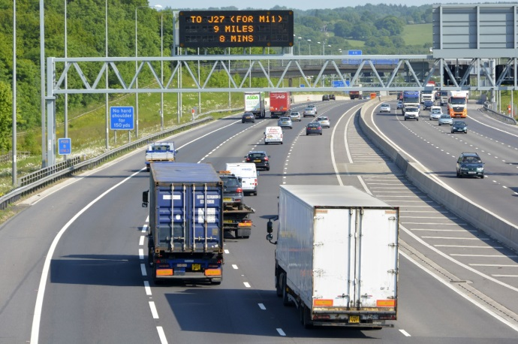
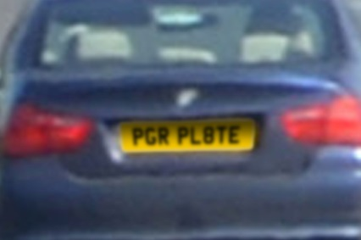
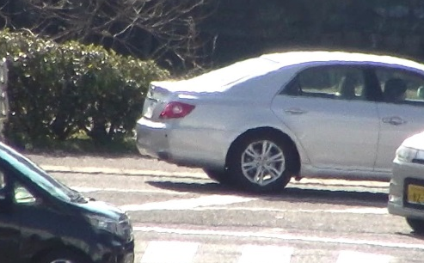
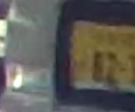


Extreme Visibility
Can monitor further distant object by 40x zoom
Intelligent Zoom stabilization reduces vibrations when large vehicles pass.
With the 40x optical with extra zoom, the WV-X6531N and WV-X6511N PTZ cameras enable zooming in on distant people and objects clearly.
The cameras is equipped with intelligent zoom stabilization function, and reduces the various vibrations and stream stable images even if the camera is installed on the plenty-vibration place.
Can reduce the vibrations even if zooming by 40x, and can recognize the number plate of vehicle.
Image stabilization :
ON
40x zoom
Image stabilization :
OFF

Slide 4

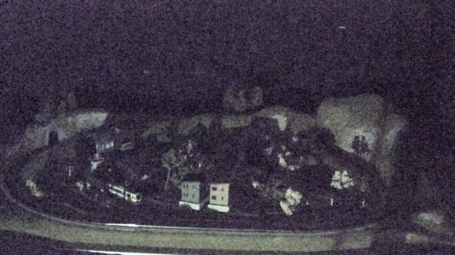
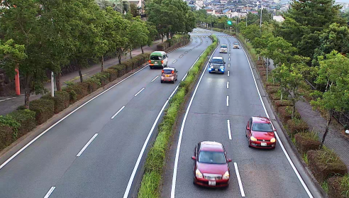

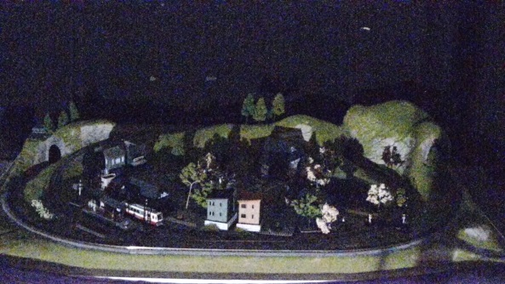
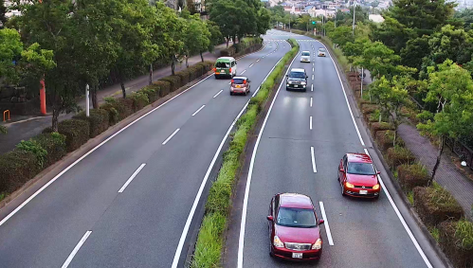

Extreme Visibility
Automatically adapts to your application scene, (intelligent auto ) mode
Clear color images with low light
Panasonic new night view enhancer technology changes your 1/3 inch sensor camera into a outstanding low light performance camera to provide you TRUE color information under very low lighting conditions.
Automatically optimizes camera parameters for best tuned image for various scenes, using techniques like Full Auto Shutter & Iris control, Backlit compensation , auto image stabilization.
Also can detect characteristics and movement within the scene to optimize camera settings to provide best fit picture quality.
0.1lux
WV-SPW531
Conventional model
new cameras, iA : ON
0.1lux,
new cameras

Slide 5
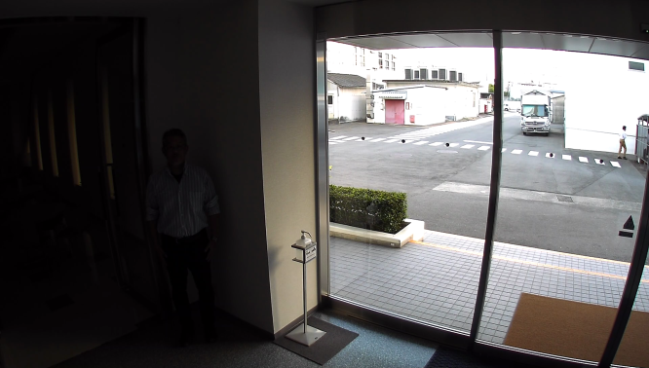
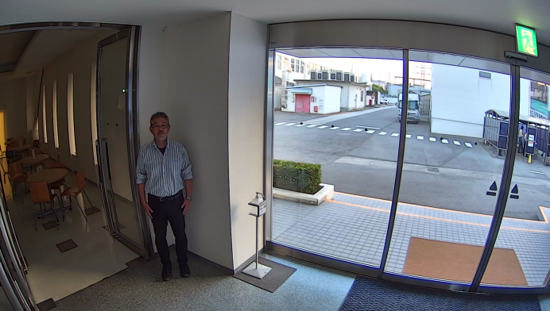
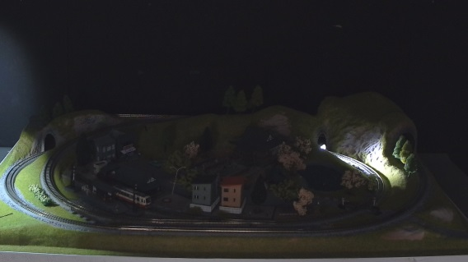
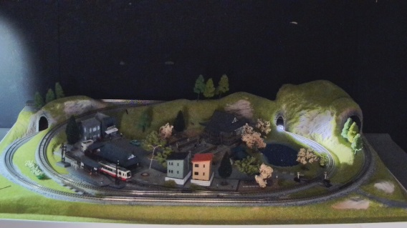
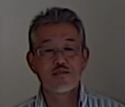
Extreme Visibility
Keep your evidence (face) clear at door steps
Day,
Super Dynamic : OFF
Combining high performance face detection technology inside the camera with the new 144dB enhanced Super Dynamic, keeps persons face at the most suitable brightness for better recognition. With variable exposure and shutter speed control, Enhanced Super Dynamic captures multiple images with optimal short and long exposures.
The feature is suitable for road traffic monitoring application where backlit conditions are severe.
Night, Super Dynamic : ON
Day,
Super Dynamic : ON
Night, Super Dynamic : OFF

Slide 6
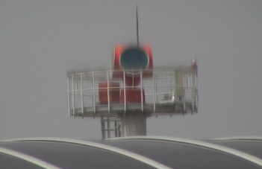
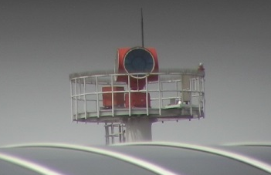
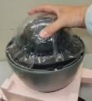
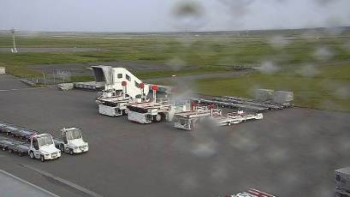
Extreme Visibility
Can keep clear images, even if it is in the rain
-15°~195°-tilt outdoor camera
ClearSight coating significantly increases the operational utility of outdoor cameras in rain weather. The specially coated surface resists water stains and dust accumulation, reducing the need for periodic maintenance.
ClearSight Coating can be wiped with a damp cloth or washed with a neutral detergent.
The PTZ cameras deliver a clear image even when it tilts above the horizontal position. Auto Eyelid Mechanism (AEM) removes extra light that makes the image blurred due to the small curvature difference between the lower spherical part and upper cylindrical part of the camera dome.
AEM light shield
AEM is off.
AEM is on.
upper cylindrical part
AEM light shield
lower spherical part
upper cylindrical part
ClearSight coating. For comparison, the right half is not coated.
Auto Eyelid
Mechanism (AEM)
lower spherical part
Doom cover
Doom cover
Auto Eyelid Mechanism (AEM)

Slide 7
Extreme Compression
Higher H.265 compression
With the latest compression standard, these cameras save the network bandwidth and the recorder disk space, keeping high quality of images.
In addition, when using Smart Coding function, you can more save the network bandwidth and the recorder disk.
Approx. -50%
Cameras | WV-SW598A | WV-X6531N
Full HD at 30fps | 4 Mbps | 2 Mbps

Slide 8
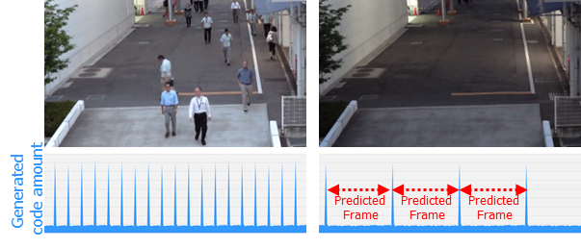
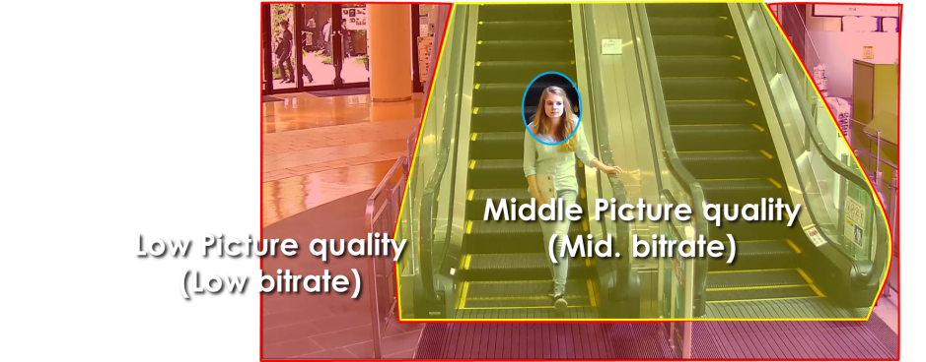
Extreme Compression
Smart coding Technology for New camera
With the latest bitrate reducing technology, GOP control, Auto-VIQS, Smart face coding, these cameras save the network bandwidth and the recorder disk space.
The cameras can reduce the amount of data by up to approx. 95% for still scene and up to approx. 80% for moving scene compared with the normal H.264 codec. When comparing with Panasonic H.264 camera (WV-SPN531, SPN631 etc) , the amount of data is reduced by up to approx. 70% for moving scene and up to approx. 90% for still scene.
When people are walking, I-frame is inserted at regular intervals as usual.
When there is no person walking,
I-frames are thinned down to reduce the amount of data.
GOP control reduces encoding data by using p-frame in place of i-frame when no motion is detected.
Keep high
Picture quality
Scene | Without GOP | With GOP
Heavy traffic of people | 3 Mbps | 3 Mbps
Minimal traffic of people | 2 Mbps | 1 Mbps(-50 to - 60%)
Auto-VIQS can automatically determine areas with and without motion and reduce the data volume of those without motion.
The camera can also detect faces and keep the area of the face at most highest picture quality to keep your most important evidence to be kept clear, Smart facial coding.
*Simulated image

Slide 9

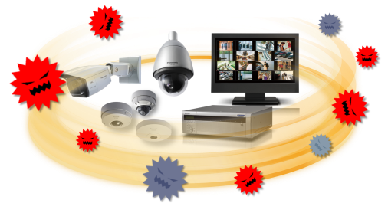
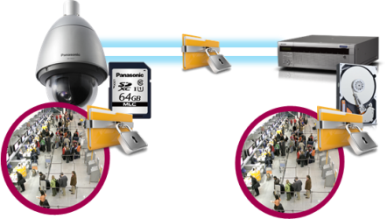
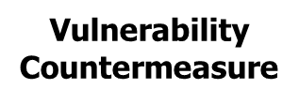


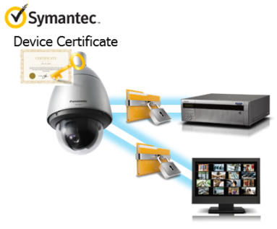
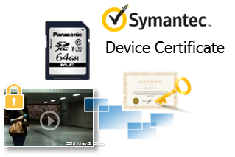
Extreme Secure
Protect the devices from cyber attacks
Prevention leakage of the video
Eliminated vulnerability with the latest CVE* support
*CVE : Common Vulnerabilities and Exposures. Common Vulnerabilities and Exposures is a dictionary of common names
(i.e., CVE Identifiers) for publicly known
Equipped with an SD memory card slot, the camera
stores encrypted videos locally. The data can be
password-protected and alteration detection helps ensuring credibility of data.
The stream and video are encrypted
by the module that meet
FIPS140-2 level 1 CAVP**.
Panasonic fully protect the stream
and the video in the End-to-End System.
Prevention leakage of the data on communication network
Realize secure communication between devices by using communication encryption (SSL/TLS communication).
By using Symantec certification and the hash function, the system can detect Video alteration and confirm which camera created the video.
**Evaluated by WV-TW370P

Slide 10
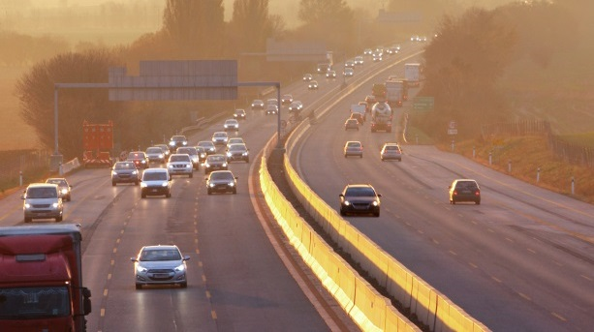
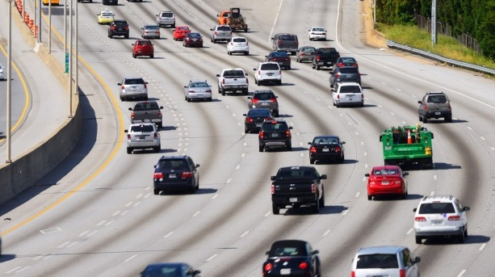
Extreme Analytics
Built-in Vehicle Incident Detection (with option software WV-XAE100W)
- The camera can detect a car which is running wrong-way or stopped on the road with video analytic technology.
- It sends alarm to your Video Management System and/or Traffic Management System for immediate action.
- The function is built-in the camera with option software. No additional server is required.
- You can configure the settings for this function up to 4 lanes individually.
Wrong-way detection
detects cars going in the wrong direction.
Stopped vehicle detection
detects stopped cars on the road.

Slide 11
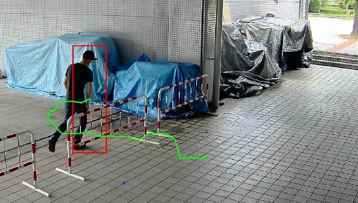
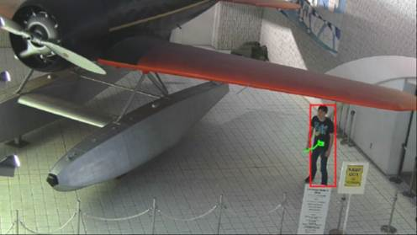
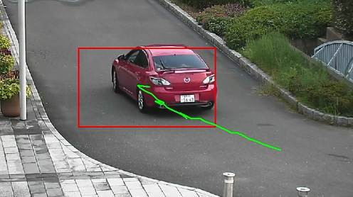
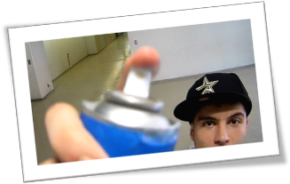
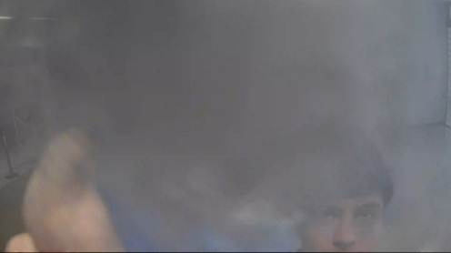
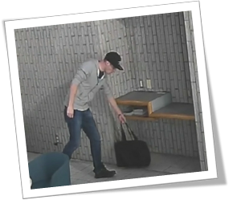
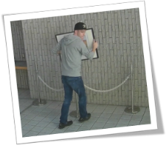
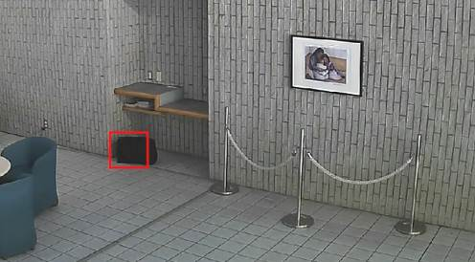
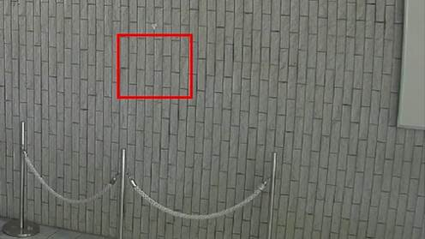
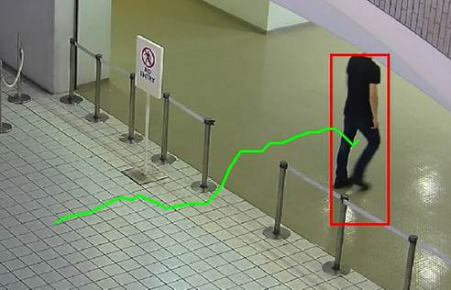
Extreme Analytics
Detect various abnormal behavior of person by Optional intelligent VMD (i-VMD)
Intruder detection
detects people or cars trespassing in restricted areas.
Loitering detection
detects people who has loitered for too long in the area.
Direction detection
detects people or cars that go the wrong direction.
Scene change detection detects tampering with the camera view.
Object detection (left)
detects something left behind that shouldn’t be there.
Object detection (removed)
detects objects disappearing that should be present.
Cross line detection
detects people or objects crossing the imaginary lines.

Slide 12
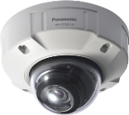
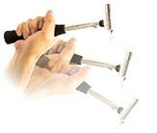
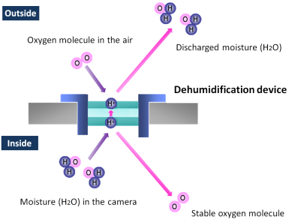
… and other useful features
Unbreakable, even if shocked externally
Capture clear images, no matter
what environment ;
IP66- and NEMA 4X-rated robustness
The cameras (WV-X6531N, WV-X6511N) are IK10-rated impact resistant. In case the camera is subjected to mechanical shock, an impact-resistant
aluminum die-cast body protects
the optical system from the impact.
The outdoor cameras (WV-X6531N, WV-X6511N) support IP66- and NEMA 4X-rated weather resistant. The built-in electrical dehumidification keeps the camera dry inside, using electrolysis to remove any moisture from the camera. This anti-humidity technology is safe and green due to low power consumption and no heaters or
mechanical fans being used.

Slide 13
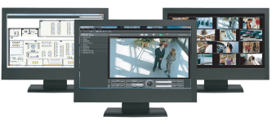
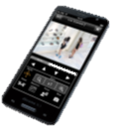
… and other useful features
Central management
The WV-ASM300 and System970 i-PRO management software enables central management of the cameras, recorders and monitors.
Viewing on smartphones and tablets
Panasonic Security Viewer enables viewing outside the surveillance center. It support only the H.264 mode of these cameras.
Alarm notification
When VMD, advanced auto tracking alarm, terminal alarm such as door alarm or command alarm is detected, the camera sends alarms to the operators based on pre-configured alert rule and/or saves images to FTP server.
Privacy masking
The camera supports electronic privacy masking. Zones, the masked areas of the image, are easily defined.

Slide 14
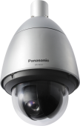

Specifications
 |  | WV-X6531N | WV-X6511N
Image sensor |  | 1 / 2.8 type MOS
Max. video resolution (pixel) |  | 2048 x 1536 (Super resolution) | 1280 x 960
Max. frame rate |  | 60 fps
Day / Night |  | Yes (ICR)
Minimum Illumination | Color | 0.015lx @F1.6 | 0.011lx @F1.6
 | B/W | 0.006lx @F1.6 | 0.005lx @F1.6
Angular Field of View *16:9 mode | Horizontal | 2.1°(Tele) - 65°(Wide)
 | Vertical | 1.2°(Tele) - 39°(Wide)
Audio |  | Two-way
SD memory card slot |  | 1slot (SDXC)
Zoom Ratio |  | 40x
Image stabilizer |  | Yes
Ambient Operating Temperature |  | -50°C ~ +60°C (-58 °F ~ +140 °F), -30°C ~ +60°C (-22 °F ~ +140 °F)(PoE+ device)
Dimension (mm) |  | Φ229 x 392 (H)
Area selling products as of April 2017 (North America, Europe, Russia, Latin America, Asia, Middle East Asia, South Africa) |  | all | except Europe

Slide 15
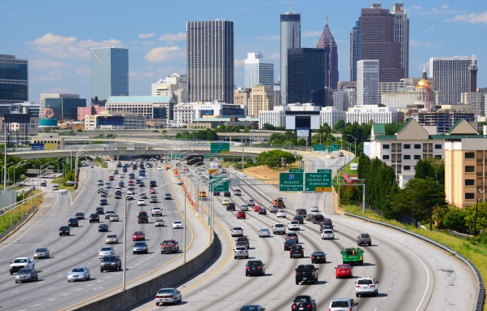
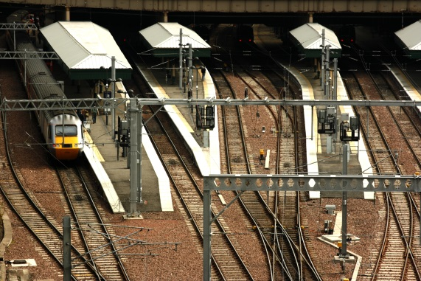
Applications
These cameras are suitable under the extreme conditions :
City Surveillance
Intersections
Airport
Stations
Port facilities
Plant
Shopping Malls and more.

Slide 16
i-Pro Extreme product naming structure
(cameras released at Oct, 2016 or later)
1 | ２ | ３ | ４ | ５ | ６ | ７ | ８ | 9 | 10 | 11 | 12
W | V | - | X | 6 | 5 | 3 | 1 | N
 |  |  | Series | Form | Environment | Resolution | Serial number | Other features |  | Minor Change | Region (J/H)
 |  |  | X:Hi-end S:Standard | 9：- 8：- 7：PTZ(Aero) 6：PTZ(Dome) 5：PT 4：360 deg. 3：Compact DOME 2：Dome 1：Box 0 : - | 9：- 8：- 7：- 6：- 5：Outdoor Vandal 4：Outdoor normal 3：- 2：Indoor Vandal 1：Indoor normal 0：- | 9：- 8 :6K(24MP) 7 :4K (12MP) 6 : 5 :5MP 4： 3 :FHD 2 : 1 :HD 0 :- | 9 : 8 : 7 : 6 : 5 : 4 : 3 : 2 : 1 : 0： | L : LED N: ClearSight M: M12 W: Wireless F : Optical I/F V : With lens T : Long focal lens K : Fix lens |  | D : C : B : A :

