Slide 1
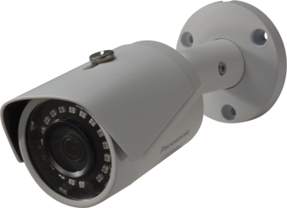
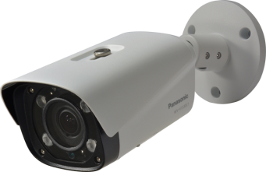
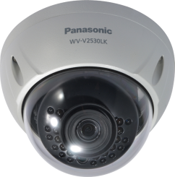
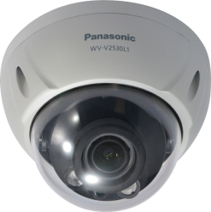
V-SERIES cameras
Fixed Box : WV-V1330LK, V1330L1
Fixed Dome : WV-V2530LK, V2530L1
Security Systems Business Division
Panasonic System Networks Co., Ltd.
Notes:
摂氏→華氏 F=(9/5)*C + 32
華氏→摂氏 C=(5/9)*(F-32)

Slide 2
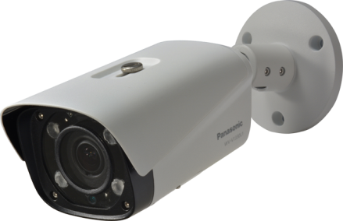
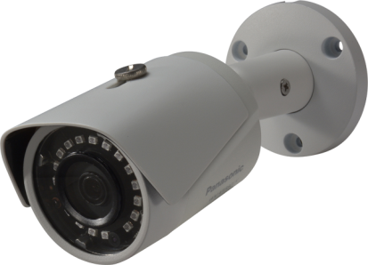

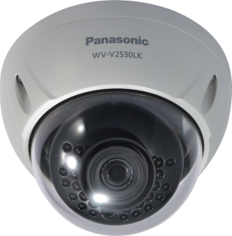
Lineup
Full HD Fixed Cameras
Full HD Fixed Dome Cameras
WV-V1330L1
(Full HD, Vari Focal, IR-LED)
WV-V1330LK
(Full HD, 60fps, IR-LED)
WV-V2530L1
(Full HD, Vari Focal, IR-LED)
WV-V2530LK
(Full HD, 60fps, IR-LED)

Slide 3
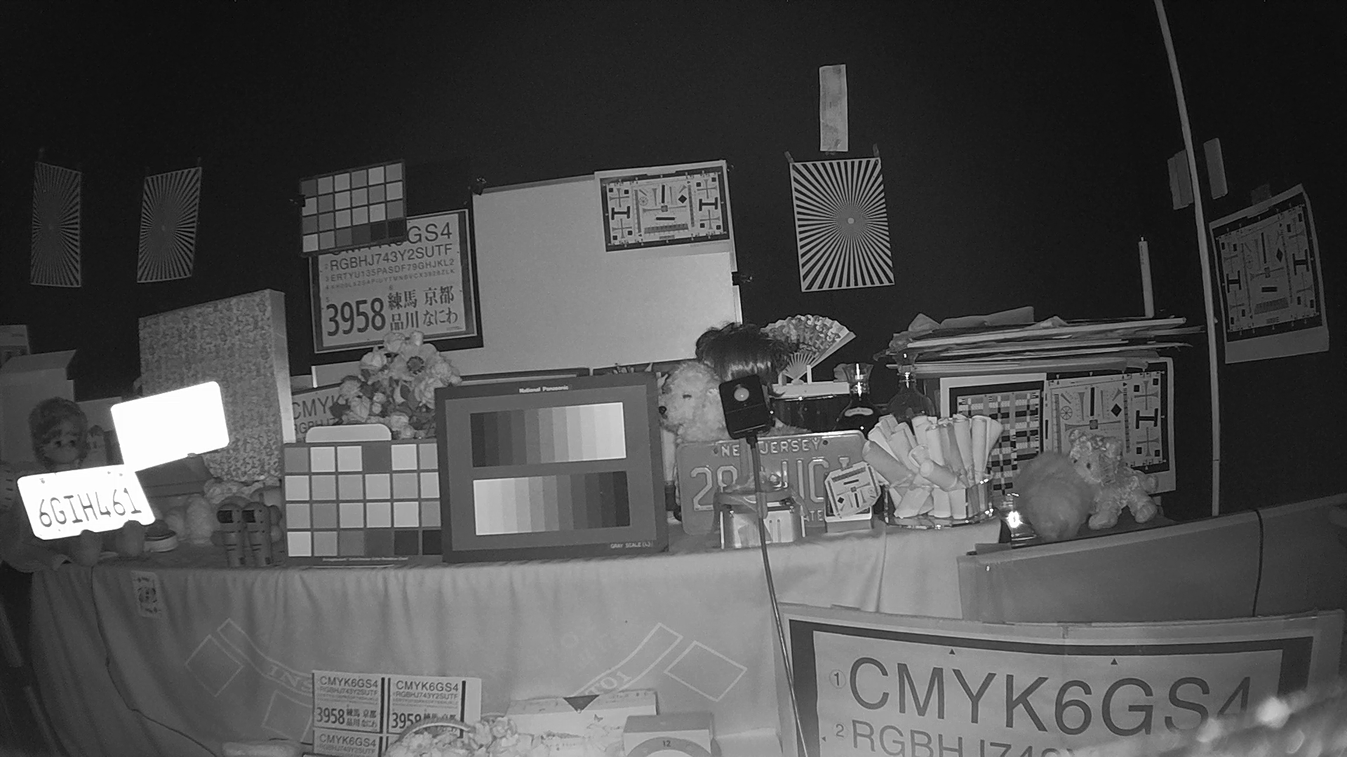
Outdoor Fixed Camera (Bullet)
2MP Full HD IR Bullet camera
Can reduce the network bandwidth and the recorder disk space by H.265 compression.
These cameras can also deliver H.264 and MJPEG stream.
Enables easy and clear identification of moving objects, combining Full HD 1080p resolution and 50/60fps high frame rate at WV-V1330LK fixed camera.
Be equipped with built-in long range IR LEDs which illuminate around 60m (196feet, WV-V1330L1) and around 30m (98feet, WV-V1330LK).
Be IP66-rated weather resistant.
Equipped with a micro SD memory card slot, WV-V1330L1/V1330LK camera stores recordings locally. It is supported up to 128GB.
WV-V1330L1
(1080p, 25/30fps, Vari Focal, IR-LED)
WV-V1330LK
(1080p, 50/60fps, IR-LED)
0 lx scene, WV-V1330LK
Notes:
288kmph= カトリーナ：280 km/h
伊勢湾台風=270km/h

Slide 4


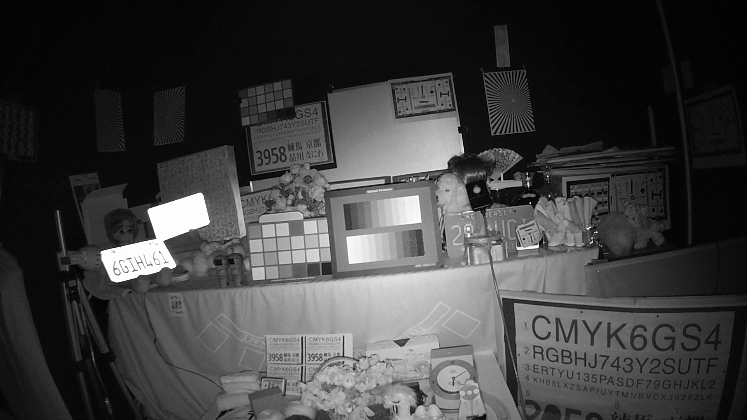
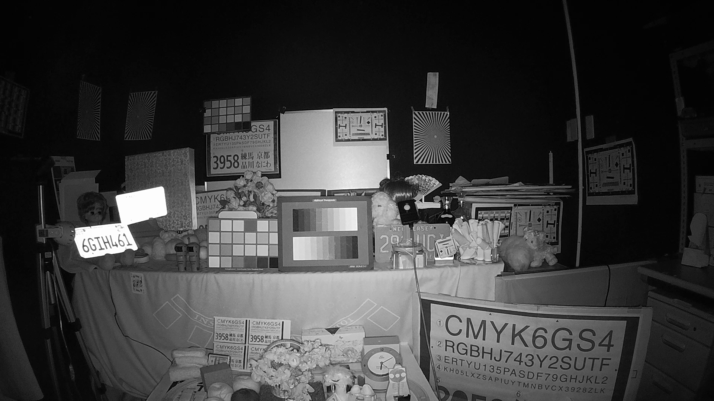
Outdoor Fixed Dome Camera
2MP Full HD IR Dome camera
Can reduce the network bandwidth and the recorder disk space by H.265 compression.
These cameras can also deliver H.264 and MJPEG stream.
Enables easy and clear identification of moving objects, combining Full HD 1080p resolution and 50/60fps high frame rate at WV-V2530LK.
Be equipped with built-in long range IR LEDs which illuminate around 30m (98feet).
Be IP66- and IK10-rated weather and impact resistant.
Equipped with a micro SD memory card slot, WV-V2530L1/V2530LK camera stores recordings locally. It is supported up to 128GB.
WV-V2530L1
(1080p, 25/30fps, Vari Focal, IR-LED)
WV-V2530LK
(1080p, 50/60fps, IR-LED)
0 lx scene, WV-V2530L1
0 lx scene, WV-V2530LK
Notes:
288kmph= カトリーナ：280 km/h
伊勢湾台風=270km/h

Slide 5
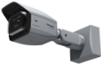






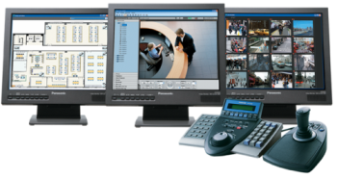






Sample System configuration diagram with Panasonic recorder
Site-A
HQ
i-PRO camera
Live
Live, playback
Rec
+
Playback
Live,Rec
Live, Playback
WJ-ND400/
NV300/NV200
Management Software
WV-ASM300 series
V-SERIESE
*WV-ASM300 will be released on Feb, 2017.
*The system supports only H.264 stream of V-SERIES cameras.
*Not every functions of i-PRO camera are supported by V-SEREISE cameras.
*V-SERIES cameras can connect to WV-ASM300 only via recorder.

Slide 6

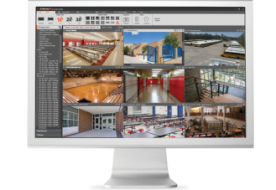
Sample System configulation diagram with Video Insight
Site-A
HQ
i-PRO camera
V-SERIESE
+
Live, Rec
Site-B
i-PRO camera
V-SERIESE
Live, playback
+
Live, Rec
Video Management Server
*The system supports only H.264 stream of V-SERIES cameras.
*Not every functions of i-PRO camera are supported by V-SEREISE cameras.

Slide 7

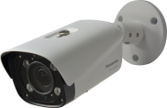

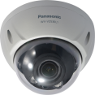
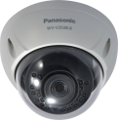
Specifications
 |  | WV-V1330L1 | WV-V1330LK | WV-V2530L1 | WV-V2530LK
Type |  | Outdoor Box |  | Outdoor Vandal
Image sensor |  | 1 / 2.8 type MOS
Max. video resolution (pixel) |  | 1920 x 1080
Max. frame rate |  | 25/30 fps | 50/60 fps | 25/30 fps | 50/60 fps
Day / Night |  | Yes (ICR)
Minimum Illumination | Color | 0.2 lx @F1.4 | 0.2 lx @F2.0 | 0.2 lx @F1.4 | 0.2 lx @F2.0
 | B/W | 0 lx @F1.4 with IR-LED | 0 lx @F2.0 with IR-LED | 0 lx @F1.4 with IR-LED | 0 lx @F2.0 with IR-LED
Built –in IR LED irradiation distance |  | Approx. 60m (196ft.) | Approx. 30m (98ft.)
(Vari) Focal Length |  | 2.7 - 12 mm | 3.6 mm | 2.7 - 12 mm | 3.6 mm
SD memory card slot |  | 1slot (Micro SD)
Ambient Operating Temperature |  | -30°C ~ +60°C (-22 °F ~ 140 °F)
Dimension |  | 90 (W) x 90 (H) x 214 (D)(mm) {3-17/32 x 3-17/32 x 8-7/16 (inches)} | 75 (W) x 71 (H) x 165 (D)(mm) {ø2-15/16 x 2-25/32 x 6-1/2 (inches)} | Φ 122 x 89 (H) (mm) {ø4-13/16 x 3-1/2 (H) (inches)} | Φ 110 x 81 (H) (mm) {ø4-11/32 x 3-3/16 (H) (inches)}
Area selling products as of Dec 2016 (North America, Russia, Latin America, Asia, Middle East Asia) |  | North America, Russia, Latin America, Middle East Asia

