Slide 1
i-PRO Management Software
WV-ASM300 series
Security Systems Business Division
Panasonic System Networks Co., Ltd.

Slide 2
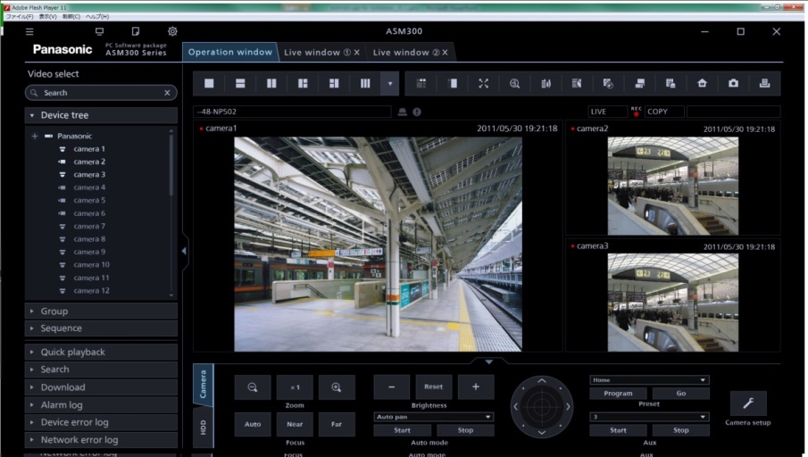
Video Surveillance Software
Fully Integrated & Secure
Powerful Interface
Camera control, viewing and recorder management
Integrates i-PRO Extreme H.265 & i-PRO H.264 equipment
Secure Communication
UI design & 4K native GUI enhance usability
Automatic Security System configuration wizard
Now include multi-monitor and WV-CU950 support
Scalable & Extendable
Base : 100 recorders, 64 encoders and 256 cameras
Expandable to thousands of cameras, recorders and encoders
Stream management

Slide 3
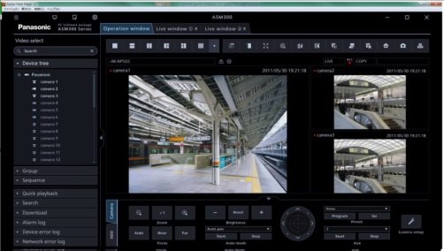
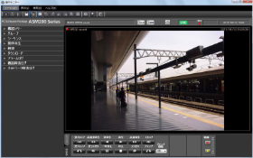
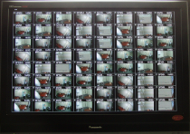
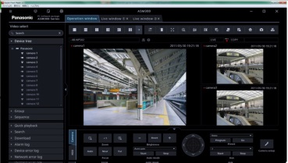


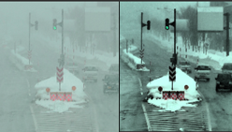

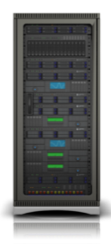

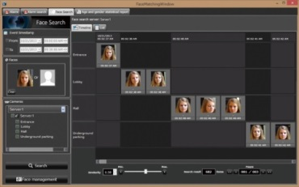
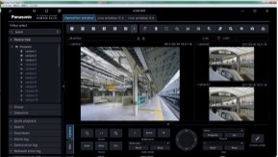


WV-ASM300 series line up
WV-ASM300
Base software
WV-ASM300UG
Upgrade software
WV-ASE202(Extension Software)
64split-screen live, 4 Live Windows
WV-ASE203
(Extension Software)
Expand the max. number of devices (Up to 4 licenses)
WV-ASE205(Extension Software)
Image Visibility Enhancement
WV-ASE306(Extension Software)
VI server link
WV-ASE204(Extension Software)
Control WJ-GXD400
WV-ASE231(Extension Software)
i-VMD, Face matching with WV-ASF900

Slide 4





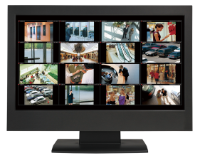
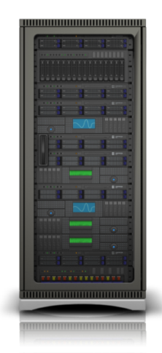
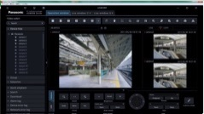




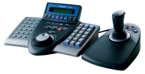





Fully Integrated & Secure
Camera control, viewing and recorder management
Live
WV-ASM300 can control i-PRO cameras directly or via recorder. It can also control some recorders to play some videos at a time.
Therefore, WV-ASM300 realizes quick-view of live stream and playback from any cameras.
i-PRO H.264
cameras
Rec
Playback
WJ-NV300/ND400
Integrates i-PRO Extreme H.265 &
i-PRO H.264 equipment
Live
Rec
WV-ASM300 can display both H.265 images and H.264 images at a time. As it can also play H.265 videos and H.264 videos at the same time, it easy for you to add the H.265 cameras in current surveillance environment and use the newly i-PRO extreme H.265 cameras.
i-PRO Extreme H.265
WV-ASM300 series
Rec
Playback
WJ-NX400
Live
i-PRO H.264 cameras

Slide 5


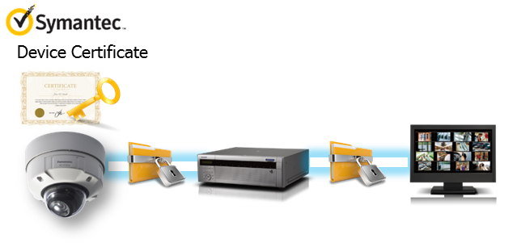

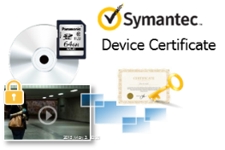
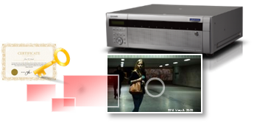
Fully Integrated & Secure
Secure Communication
Prevention leakage of the data on communication network
Prevention leakage of the video
Panasonic cameras deliver the encrypted video, and it's stored in WJ-NX400 (Panasonic recorder). WV-ASM300 can receive and decrypt them, and you watch them without being conscious.
Realize secure communication between devices by using communication encryption (SSL/TLS communication).
By using Symantec certification and hash value, can detect Video alteration and confirm which stored the video in a camera.
The video which stored in a Panasonic recorder can be detected Video alteration with ND Viewer by using hash value.
This tool can run on the same PC with WV-ASM300.

Slide 6
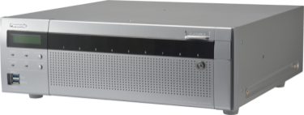
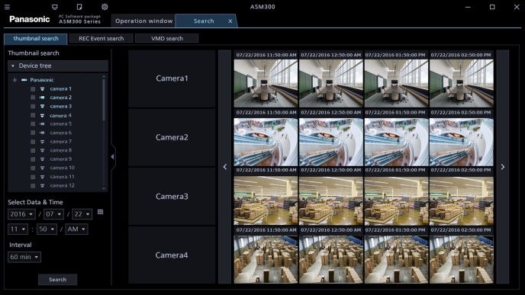
Powerful Interface
UI design & 4K native GUI enhance usability
Can easy detect the search
Can easy confirm the camera angle and the camera position
When using WJ-NX400 (Panasonic Network Disc Recorder), WV-ASM300 can display thumbnails for finding the search points easily. You can search effectively since thumbnails can be displayed the selected interval (1 / 5 / 10 / 15 / 30 / 60 min).
When you no longer know the place which a camera is set or the camera angle, can easily confirm it on the map window of WV-ASM300. The snap shot is displayed on it, if clicking a camera of which you'd like to know an angle .
WJ-NX400

Slide 7


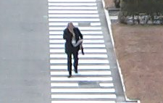
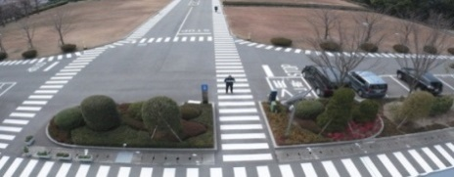


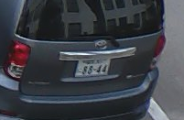
Powerful Interface
UI design & 4K native GUI enhance usability
Full angle view with high-resolution and 5 ROI areas(Cropping areas) are displayed. Operator can do PTZ operation in each ROI area and watch image in detail.
Operator can do effective “Live” and “Playback” monitoring by cropping on PC.
１
２
３
４
５

Slide 8
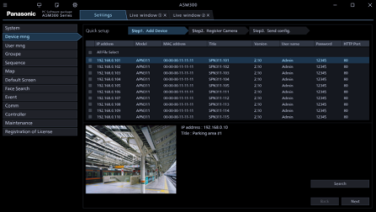
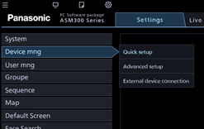
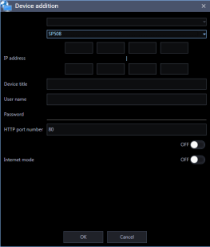
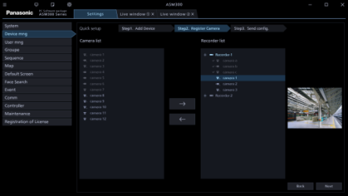
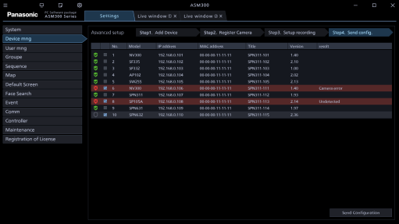
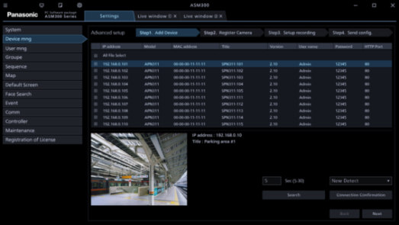
Powerful Interface
Automatic Security System configuration wizard
Can setup a system with only 3 steps
Can preparing the configuration data
A system with WV-ASM300 can be setup with only 3 steps by using quick setup mode.
Step 1. Automatically detect cameras / recorders.
Step 2. Associate cameras to a recorder.
Step 3. Send the configuration to each device.
WV-ASM300 has the advanced setup mode, if you set more details.
WV-ASM300 can be made the configuration data even if isn’t connecting with the network. Even if all products which are needed in system aren’t prepared, a configuration data can be created at WV-ASM300 on offline in advance.
When preparing the data, you can reduce work volume in field.

Slide 9
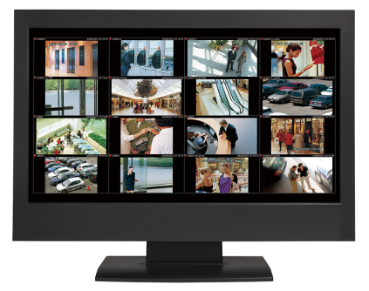
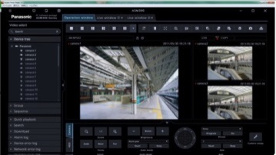
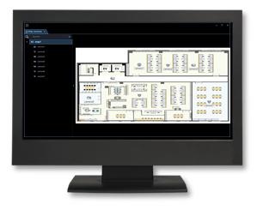
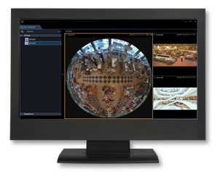

Powerful Interface
Now include multi-monitor and WV-CU950 support
WV-ASM300 provide the two ways for monitoring.
One is that all screens are had on one monitor. By creating and selecting tab, an operator can switch operation window, search window and live & map window.
Another is that each screen is displayed on each monitor independently. It is easy for an operator to get the situation at a time.
In addition, the controller WV-CU950 can be used together with WV-ASM300, and provides instinctive operation to an operator.
WV-CU950
Map window
Live window
Operation window

Slide 10
Scalable & Extendable
Base : 100 recorders, 64 encoders and 256 cameras
100 recorders, 64 encoders and 256 cameras can be managed by WV-ASM300 base software. When using an optional license WV-ASE202, an operator can monitor 64 screen at one live window or at 4 live windows (16 screen per one monitor).
WV-ASE202(Extension Software)
64split-screen live, 4 Live Windows
Expandable to thousands of cameras, recorders and encoders
When a customer wants to add monitoring areas, it is easy to add cameras, recorders and encoders if they use an optional license WV-ASE203. It is possible to install up to 4 licenses, and they can expand cameras, recorders and encoders until maximum 1,280 units, maximum 100 units and maximum 64 units.
WV-ASE203
(Extension Software)
Expand the max. number of devices (Up to 4 licenses)

Slide 11
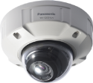

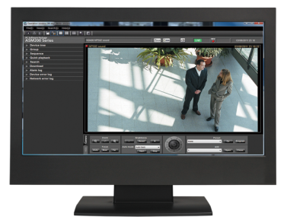
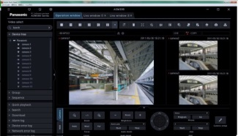
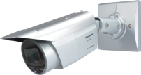


Scalable & Extendable
Stream management
Can set the stream used on the remote environment
WV-ASM300 displays videos and can be operated smoothly, even when using on the remote environment.
According to network environment, can set the stream number in order to receive the stream in WV-ASM300. Then, WV-ASM300 displays images from specified stream.
In addition, when recording the video from two streams per camera in WJ-NX400 (Panasonic network disk recorder), WV-ASM300 can play the video from specified stream which is set in it.
i.e)
When playing a video on 1 screen on WV-ASM300, it plays video of 1st stream.
When playing videos on multi-screen on WV-ASM300, it plays videos of 2nd stream.
Narrow band

Slide 12
Specifications
No. of Connected Devices | Camera | Direct | 256, Max 1,280 (ASE203×4)
 |  | Via Recorder | 6,400, Max. 32,000 (ASE203 x 4)
 | Recorder |  | 100, Max. 500 (ASE203 x 4)
 | Encoder |  | 64 , Max. 320 (ASE203 x 4)
 | Decoder |  | Max. 10 (ASE204)
 | Controller |  | 1
General | OS |  | Microsoft Windows 10 Pro 32 bit/64bit (Operates in WOW64) Microsoft Windows 8.1 Pro 32 bit/64bit (Operates in WOW64) Microsoft Windows 7 Professional SP1 32 bit/64bit (Operates in WOW64) *Windows Vista,Windows8 is not supported. *When connecting H.265 cameras, please use 64bit OS.
 | Computer |  | Compatible with IBM PC/AT
 | CPU |  | Intel Core i5-6500 or faster , Intel Core i7-6700 or faster
 | Memory |  | 4 GB or more *When connecting H.265 cameras, 8GB or more of dual memory is necessary.
 | HDD Capacity |  | 3 GB or more
 | Monitor |  | 1280x800 pixel s or more (1920x1080 or more for live view)
 |  |  | True color 24bit or more (recommend Full color)
 | Graphic accelerator |  | VRAM:512MB or more, compatible with DirectX9.0c or later
 | Network interface |  | Having a 100/1000 Mbps network port
Extension Software | Optional software |  | WV-ASE202 (4 monitors), WV-ASE203 (Add 100 recorders), WV-ASE204 (Decoder link), WV-ASE205 (Image Visibility Enhancement), WV-ASE231（Face matching）, WV-ASE306 (Video Insight server link)

Slide 13
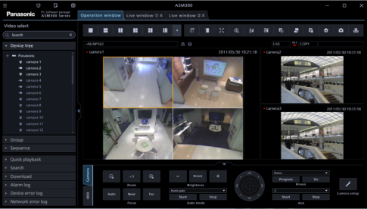
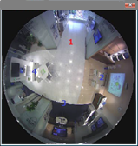

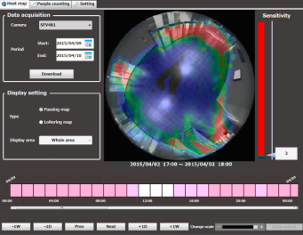
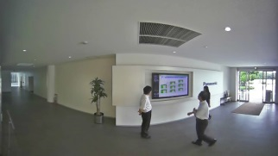
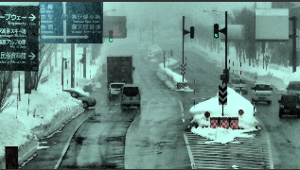
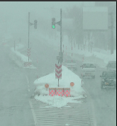
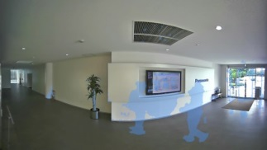
Applications
This software is suitable various situations :
Monitoring both the whole and details with 360-degree camera. (Fish-eye control)
Using the stream not only for monitoring but also for analyzing a stream of people.(Heat map & people counting)
Detecting a suspicious person, and confirming his/her traffic line.(Face recognition with WV-ASF900)
Improving the visibility of monitoring images of when it is snowstorm or heavy rain.(Enhanced Visibility)
Monitor while protecting the privacy of customer and employee.(MOR)
Fish-eye control
Face matching with WV-ASF900
Heat map & people counting
Enhanced Visibility
MOR (Moving Object Removal)

