Slide 1

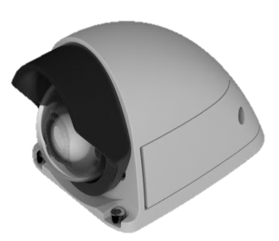

Full HD / HD Rugged Mobile Network Camera
WV-SBV131M / SBV111M
Ver. 1.21
Panasonic i-PRO Sensing Solutions Co., Ltd.

Slide 2
Full HD / HD Rugged Mobile Network Camera
2
WV-SBV131M
WV-SBV111M
  Tough body (Aluminum die cast shell body)
  Wide angle & High Picture Quality
  Easy installation
Notes:
As first introduction of 4K cameras, we will launch 2 new 360 degree cameras;
One is WV-SFV481, outdoor vandal model, and the other is SFN480, indoor dome model.
The 3 major points are
ULTRA High Resolution 9M pixel as 360 degree camera
ULTRA High Sensitivity
ULTRA Intelligent

Slide 3

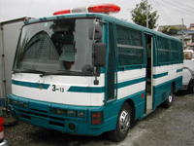
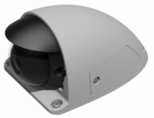
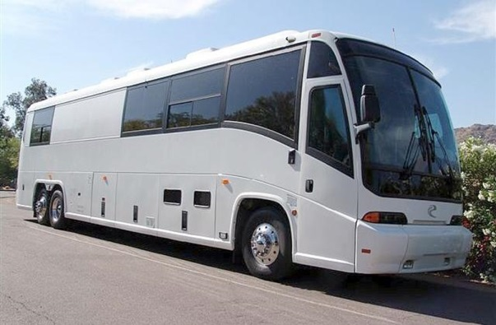
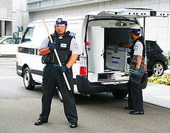
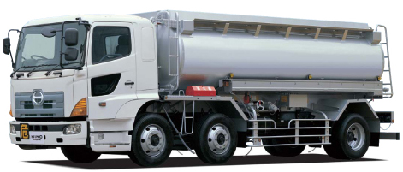
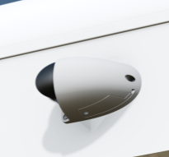
Applications
3
Rugged Mobile Network Cameras are suitable for monitoring on various vehicle:
Train
Wagon
Prisoner monitoring
Bus
Large vehicles and cargo vehicle
Armoured car
Notes:
As first introduction of 4K cameras, we will launch 2 new 360 degree cameras;
One is WV-SFV481, outdoor vandal model, and the other is SFN480, indoor dome model.
The 3 major points are
ULTRA High Resolution 9M pixel as 360 degree camera
ULTRA High Sensitivity
ULTRA Intelligent

Slide 4
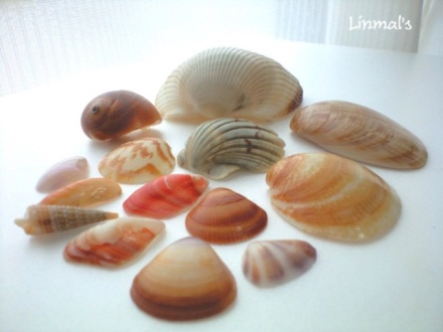
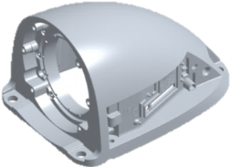
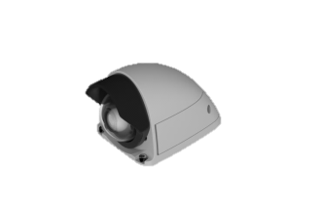
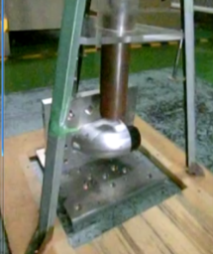
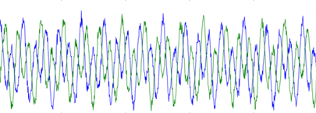
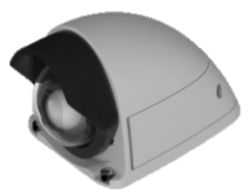
Tough body (Compatible with Railway applications )
4
The camera conforms to the outdoor harsh environment
Integrated shell body
Unbreakable, even if shocked externally ;
Fend off the car wash machine and street trees by vehicle integrated structure.
Then WV-SBV111M/131M can withstand severe shock and vibration since these cameras comply with EN50155 and Mil standard.
The WV-SBV111M/131M camera is IK10-rated impact resistant. In case the camera is subjected to mechanical
shock, an impact-resistant
aluminum die-cast body
protects the optical system
from the impact.
MIL-STD-810G
10～2000Hz 7.7G
IK10（20J） TEST *5kg（H=45cm）
Wide operating temperature range
The WV-SBV111M/131M operates in temperatures from -40 to +60 degree Celsius.
Outdoor-ready camera
With a polycarbonate camera dome and
aluminum die-cast body, the IP66- and
IP6K9K*-rated weather-resistant.
WV-SBV111M/131M outdoor cameras are ready
for mounting outdoor.
*High temperature and pressure washing water
Notes:
As first introduction of 4K cameras, we will launch 2 new 360 degree cameras;
One is WV-SFV481, outdoor vandal model, and the other is SFN480, indoor dome model.
The 3 major points are
ULTRA High Resolution 9M pixel as 360 degree camera
ULTRA High Sensitivity
ULTRA Intelligent

Slide 5
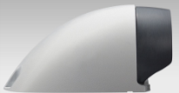
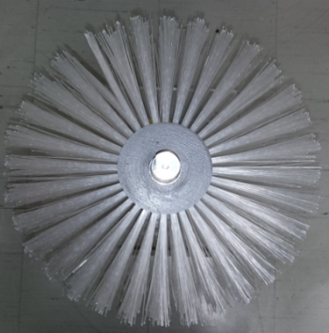
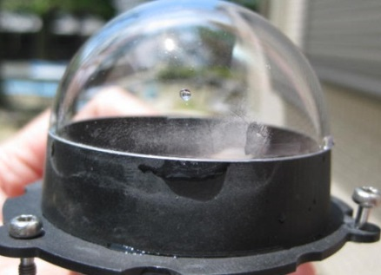
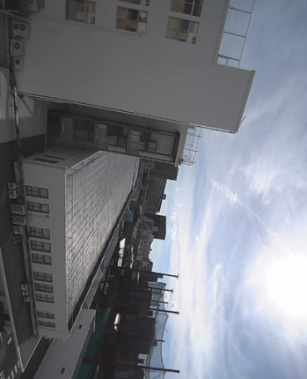
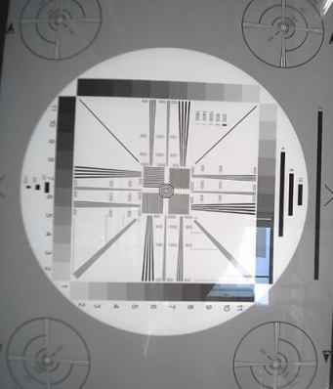
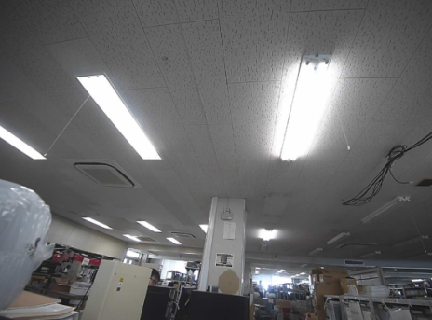
Tough body (Scratch Resistant Dome)
5
Hard camera dome-cover coating which can bear over 8,540 cycles (7 years) of a harsh washing machine. (Hard coating Level: 2H)
Test results
Camera
CAR WASHING BRUSH
■ No scratches occur to affect the image quality
■ In preparation for excessive external factors, Dome treated as consumables.
Notes:
As first introduction of 4K cameras, we will launch 2 new 360 degree cameras;
One is WV-SFV481, outdoor vandal model, and the other is SFN480, indoor dome model.
The 3 major points are
ULTRA High Resolution 9M pixel as 360 degree camera
ULTRA High Sensitivity
ULTRA Intelligent

Slide 6
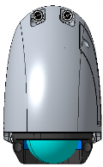
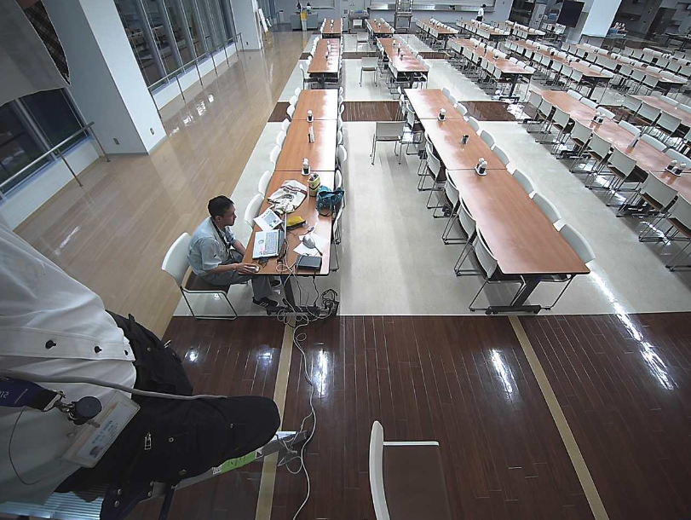


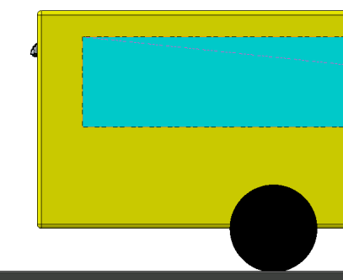

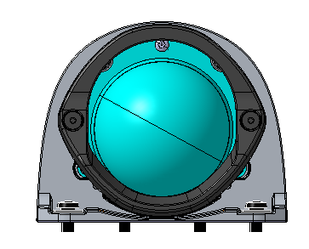
Wide angle (Back installation)
6
It covers the 20m (65ft) from the Bus body end to leave a reliable proof images
SBV111M
Back installation
Installation on the bus
4:3
Pan0° tilt45° yaw0°
16:9
2.5m
20m
Road
20m
SBV131M [16:9] H: 109°V: 73°, [4:3] H: 97° V:79°
SBV111M [16:9] H: 104°V: 69°, [4:3] H: 104°V: 85°
Notes:
As first introduction of 4K cameras, we will launch 2 new 360 degree cameras;
One is WV-SFV481, outdoor vandal model, and the other is SFN480, indoor dome model.
The 3 major points are
ULTRA High Resolution 9M pixel as 360 degree camera
ULTRA High Sensitivity
ULTRA Intelligent

Slide 7
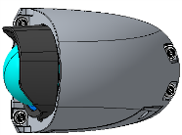
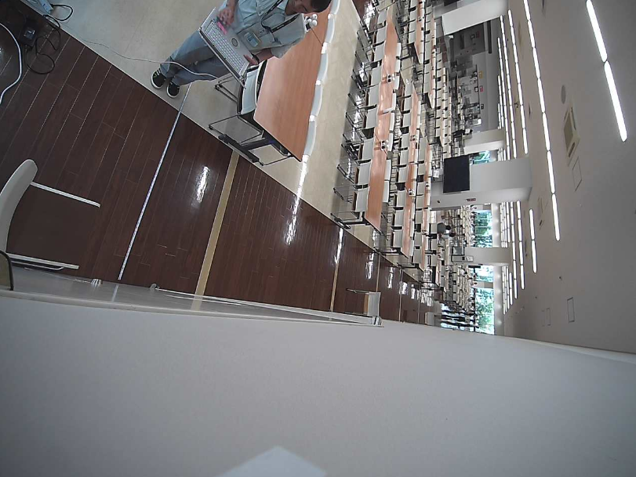
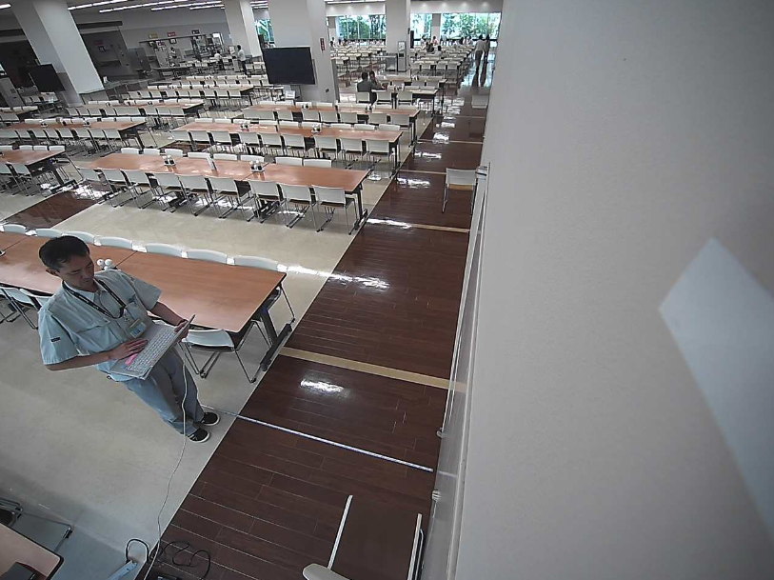
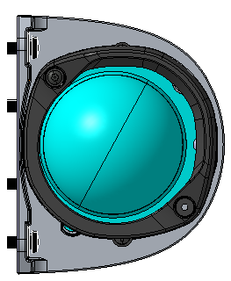
Wide angle (Side installation)
7
It covers backward 11m (36ft) from the front bus door to eliminate the blind spot
Installation on the bus
11m(36ft)
2.5m
SBV131M [16:9] H: 109°V: 73°, [4:3] H: 97° V:79°
SBV111M [16:9] H: 104°V: 69°, [4:3] H: 104°V: 85°
Side installation
Set to the required angle of view without changing the installation position of the camera
SBV111M
Pan55° tilt40° yaw125°
Pan75° tilt40° yaw20°
4:3
4:3
16:9
16:9
Road
11m（ Until the bus back）
11m（ Until the bus back）
Road
Front door of bus
Front door of bus
Notes:
As first introduction of 4K cameras, we will launch 2 new 360 degree cameras;
One is WV-SFV481, outdoor vandal model, and the other is SFN480, indoor dome model.
The 3 major points are
ULTRA High Resolution 9M pixel as 360 degree camera
ULTRA High Sensitivity
ULTRA Intelligent

Slide 8
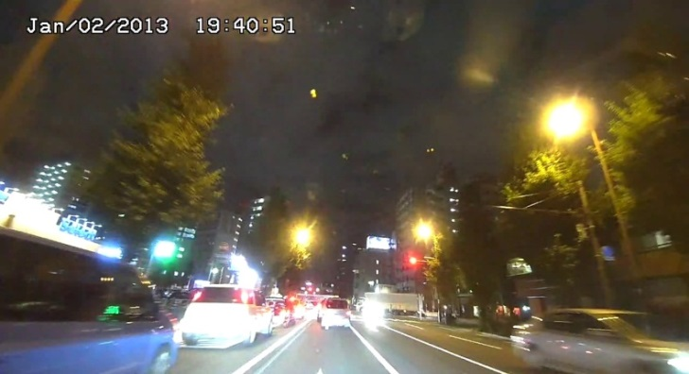
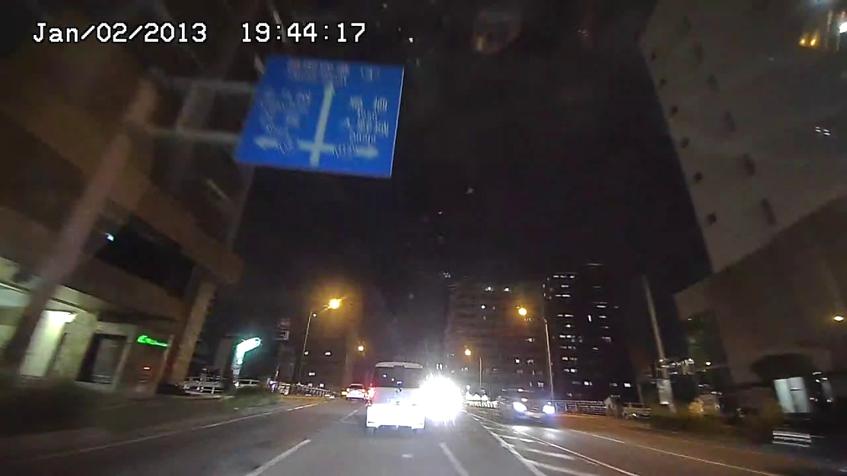
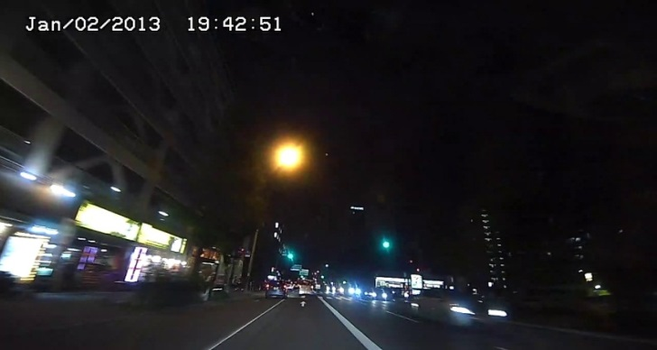
High Picture Quality at low light condition
8
Using HLC + ABS function to suppress the saturation of the car headlights, and correct the dark part.
HLC:OFF ABS:OFF
HLC: ON, ABS: ON
Bright parts are saturated.
HLC:ON ABS:OFF
While suppressing saturation of point light source, you can see bright and clear images.
Not saturated, but whole image is too dark.
Notes:
As first introduction of 4K cameras, we will launch 2 new 360 degree cameras;
One is WV-SFV481, outdoor vandal model, and the other is SFN480, indoor dome model.
The 3 major points are
ULTRA High Resolution 9M pixel as 360 degree camera
ULTRA High Sensitivity
ULTRA Intelligent

Slide 9
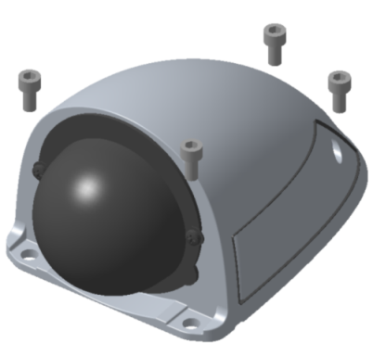
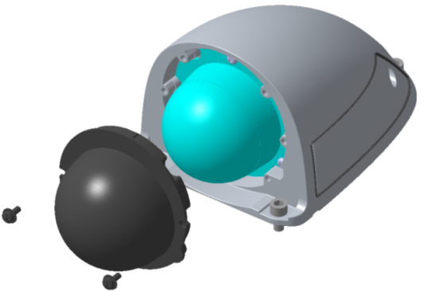
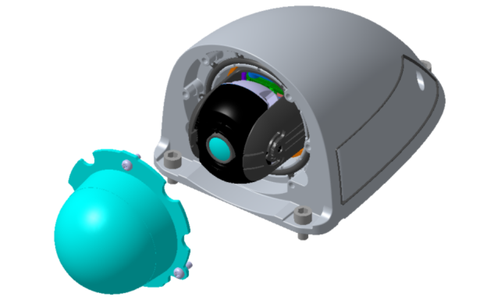

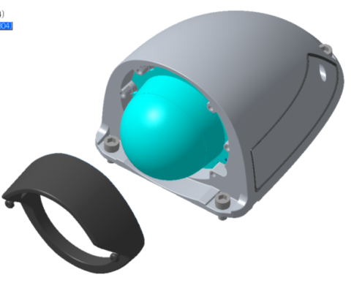
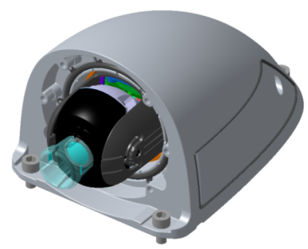
Easy Installation
9
Easy installation of six steps
Attached to the vehicle
Removal of the paint guard
Removal of the Dome
Adjustment of PTY
Attaching of the Dome
Attaching of the Guard
Notes:
As first introduction of 4K cameras, we will launch 2 new 360 degree cameras;
One is WV-SFV481, outdoor vandal model, and the other is SFN480, indoor dome model.
The 3 major points are
ULTRA High Resolution 9M pixel as 360 degree camera
ULTRA High Sensitivity
ULTRA Intelligent

Slide 10
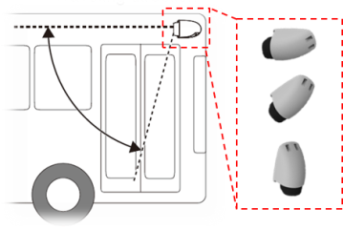
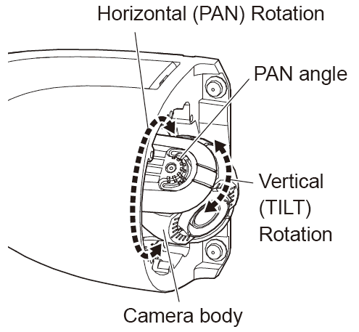
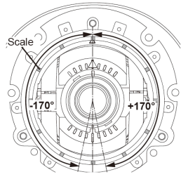
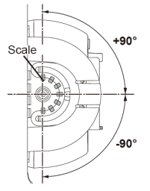
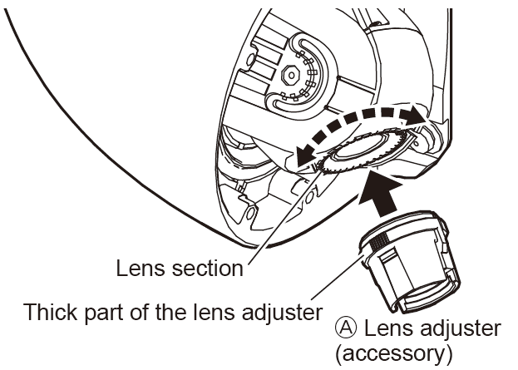
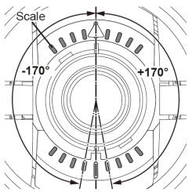
Easy Installation (View Angle Adjustment)
10
An angle of view can be adjusted in the direction you want to see, even if installing a camera in various directions.
PTY mechanism allows you easy angle adjustment
- Adjusting the horizontal (PAN)
You can adjust the rotation per 5° by grasping the left and right side of the lens part with your fingers and rotating it. *The spots are set up by 30° as the scale mark.
● Horizontal (PAN) angle: ±170°
- Adjusting the vertical (TILT)
You can adjust the rotation per 5° by grasping the left and right side of the camera part with your fingers and rotating it. *The spots are set up by 30° as the scale mark.
● Vertical (TILT) angle: ±90°
- Adjusting the image rotation (YAW).
Adjust by rotating per 5° using the Ⓐ lens adjuster (accessory). *The spots are set up by 10° as the scale mark.
● image rotation (YAW) angle: ±170°
Notes:
As first introduction of 4K cameras, we will launch 2 new 360 degree cameras;
One is WV-SFV481, outdoor vandal model, and the other is SFN480, indoor dome model.
The 3 major points are
ULTRA High Resolution 9M pixel as 360 degree camera
ULTRA High Sensitivity
ULTRA Intelligent

Slide 11
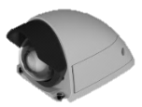
Specifications
11
 | WV-SBV131M | WV-SBV111M
Max. Output Resolution | 1920 x 1080 / 2048x1536 | 1280x720 / 1280 x 960
Lens | 1.95mm (F2.2) | 1.95mm (F2.2)
Angular field of view | [16:9] H:109°, V:73° [4:3] H: 97° , V:79° | [16:9] H:104°, V:69° [4:3] H:104°, V:85°
Adjust angle | PAN:±170°, TILT:±90°, YAW:±170° | PAN:±170°, TILT:±90°, YAW:±170°
Min. Lux (CLR) | 0.1 lx (F2.2) | 0.04 lx (F2.2)
IRLED | No | No
WDR | Yes | Yes
SD Slot | Yes | Yes
Operating temperature | -40℃ to +60℃ *Power On range: –30 °C to +60 °C | -40℃ to +60℃ *Power On range: –30 °C to +60 °
Shock Resistant | IK10 | IK10
Waterproof | IP66, IP6K9K | IP66, IP6K9K
Other standard | EN50155-T3, ECE-R10 (E approval), MIL-STD-810G standard Compliant | EN50155-T3, ECE-R10 (E approval), MIL-STD-810Gstandard Compliant
Power source | PoE (M12) | PoE (M12)
Notes:
As first introduction of 4K cameras, we will launch 2 new 360 degree cameras;
One is WV-SFV481, outdoor vandal model, and the other is SFN480, indoor dome model.
The 3 major points are
ULTRA High Resolution 9M pixel as 360 degree camera
ULTRA High Sensitivity
ULTRA Intelligent

