Slide 1

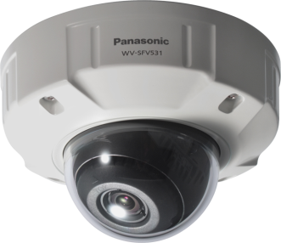
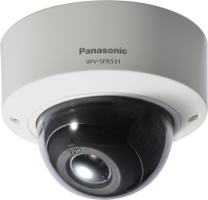
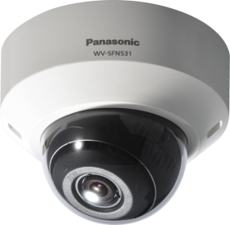

5 series Fixed Dome Network Cameras
WV-SFV531
WV-SFR531
WV-SFN531
Security Systems Business Division
Panasonic System Networks Co., Ltd.

Slide 2

5 series Fixed Dome Cameras
2
Outdoor vandal resistant
Indoor vandal resistant
Indoor
WV-SFV531 (1080p)
WV-SFR531 (1080p)
WV-SFN531 (1080p)
  Clearer monitoring with powerful Panasonic UniPhier® System LSI
  Watch images in any place
  Reduce workload for guardsmen with i-VMD
  Easy installation
Super Dynamic Fixed Dome Network camera
Notes:
As first introduction of 4K cameras, we will launch 2 new 360 degree cameras;
One is WV-SFV481, outdoor vandal model, and the other is SFN480, indoor dome model.
The 3 major points are
ULTRA High Resolution 9M pixel as 360 degree camera
ULTRA High Sensitivity
ULTRA Intelligent

Slide 3
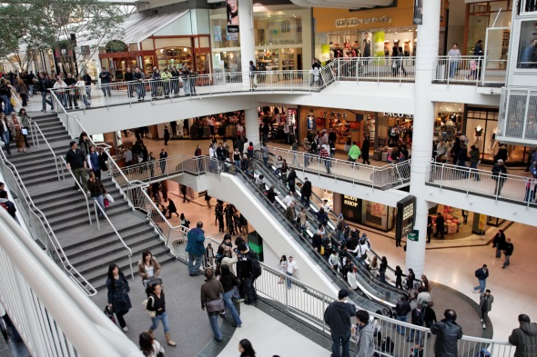
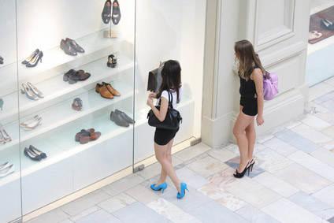

Applications
3
5 series Fixed Dome Network Cameras are suitable for monitoring open areas:
City Surveillance
Intersections
Airport
Stations
Port facilities
Shopping Malls and more.
Notes:
As first introduction of 4K cameras, we will launch 2 new 360 degree cameras;
One is WV-SFV481, outdoor vandal model, and the other is SFN480, indoor dome model.
The 3 major points are
ULTRA High Resolution 9M pixel as 360 degree camera
ULTRA High Sensitivity
ULTRA Intelligent

Slide 4
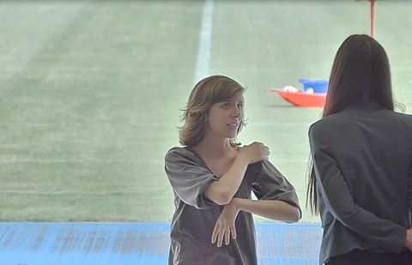


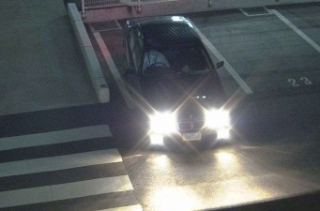

Clearer monitoring with powerful Panasonic System LSI
4
Clear images in a wide range of Lighting conditions
Even a single scene includes various lighting conditions such as bright, dark, glaring and backlight situations. Incorporating Panasonic’s superior image processing technologies, Panasonic
5-series fixed dome network cameras enable clear identification in a wide range of lighting conditions.
-Enhanced Super Dynamic
-High sensitivity MOS with Multi-process Noise Reduction (MNR)
-Super Chroma Compensation (SCC)
-Fog and sandstorm compensation
-High Light Compensation (HLC) and more…
Smoothly images at 60fps
Combining Full HD 1080p / HD 720p resolution and 60fps high frame rate, Panasonic 5 series network cameras enable easy and clear identification of rapid moving objects such as people moving chips and cards in casino, and a vehicle plate on the road.
Notes:
As first introduction of 4K cameras, we will launch 2 new 360 degree cameras;
One is WV-SFV481, outdoor vandal model, and the other is SFN480, indoor dome model.
The 3 major points are
ULTRA High Resolution 9M pixel as 360 degree camera
ULTRA High Sensitivity
ULTRA Intelligent

Slide 5

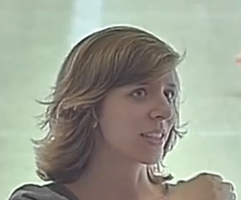
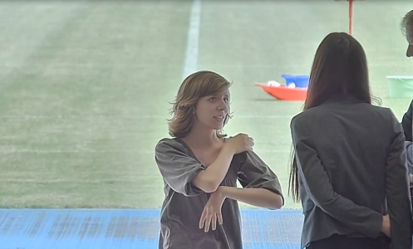
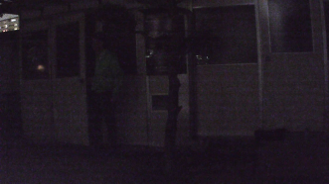
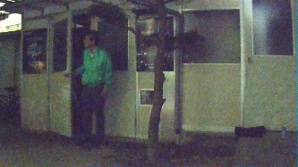
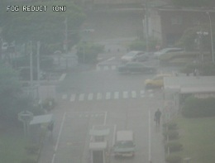
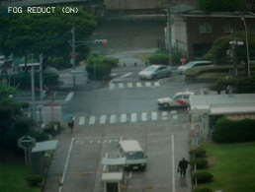
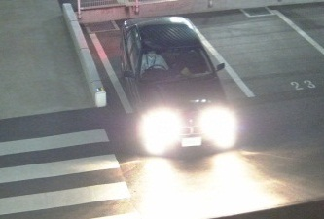


Clearer monitoring with powerful Panasonic System LSI
5
Enhanced Super Dynamic is a latest Super Dynamic technology that delivers an industrial leading 133dB wide dynamic range. With new variable exposure and shutter speed control, Enhanced Super Dynamic captures multiple images with optimal short and long exposures. Enhanced Super Dynamic produces clear images, combining them into one frame.
High sensitivity image sensor with MNR and 3D-DNR enables easy identification in low light conditions, delivering color images with low noise.
MNR: Multi-processing Noise Reduction.
3D-DNR:3D Digital Noise Reduction.
A previous model at 0.04lx
New MOS at 0.04lx
Without Enhanced Super Dynamic
With Enhanced Super Dynamic
Super Chroma Compensation
(SCC) recovers the colors of images, when built-in IR cut filter is removed to enhance light-sensitivity in low light conditions.
Fog compensation improves visibility in difficult weather conditions such as fog, sandstorms and more.
High Light Compensation (HLC)
produces clear images, reducing the effect from strong lights such as headlight glare.
Without
fog compensation
With
fog compensation
Without HLC
With HLC
Without SCC
With SCC
Notes:
As first introduction of 4K cameras, we will launch 2 new 360 degree cameras;
One is WV-SFV481, outdoor vandal model, and the other is SFN480, indoor dome model.
The 3 major points are
ULTRA High Resolution 9M pixel as 360 degree camera
ULTRA High Sensitivity
ULTRA Intelligent

Slide 6
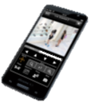




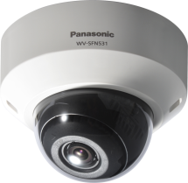
Watch images in any place
6
Appropriate-sized video stream
Monitors, recorders, smartphones and remote sites such as branches have different requirements for image quality and network bandwidth. Panasonic 5 series network cameras save the network bandwidth, sending out multiple H.264 and JPEG streams sized appropriately for each device requirement.
Higher H.264 compression
New UniPhier system LSI saves the network bandwidth and the recorder disk space, keeping high quality of images.
Various transmission modes
Supporting five transmission modes of Constant bitrate, Frame rate, Best effort, VBR and Advanced VBR, 5-series network cameras enables a flexible and effective network design for any purpose.
mobile
Monitors
QVGA
recorder
Full HD
Full HD
H D
Cameras | Conventional 5-series | 5-series
Full HD at 30fps | 4 Mbps | 3 Mbps ( -25%)
Full HD at 10fps | 4 Mbps | 2 Mbps ( -50%)
(frame rate priority mode)
Notes:
As first introduction of 4K cameras, we will launch 2 new 360 degree cameras;
One is WV-SFV481, outdoor vandal model, and the other is SFN480, indoor dome model.
The 3 major points are
ULTRA High Resolution 9M pixel as 360 degree camera
ULTRA High Sensitivity
ULTRA Intelligent

Slide 7
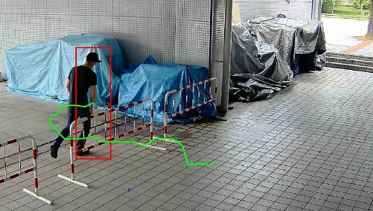
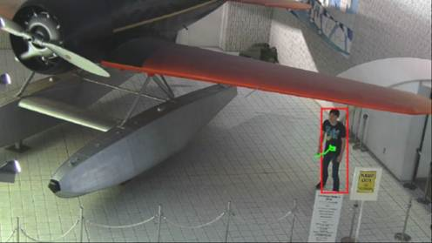
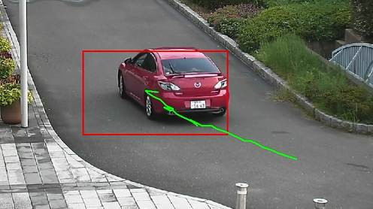
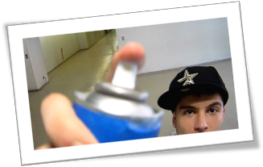
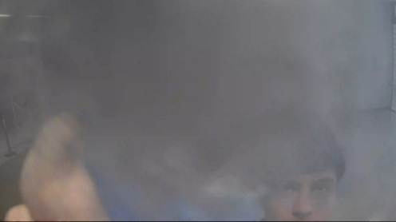
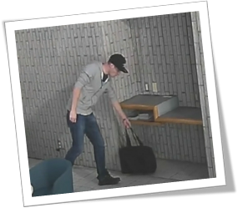
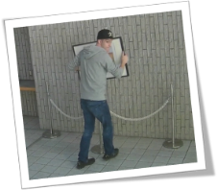
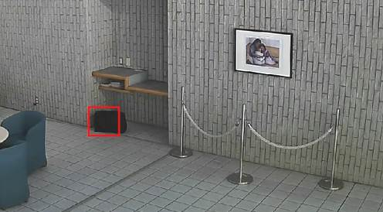
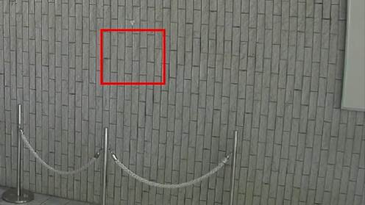
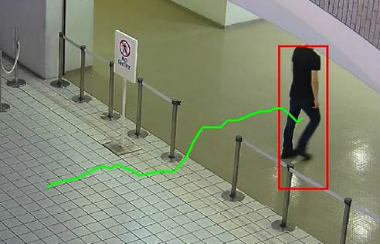
Reduce workload for guardsmen with i-VMD
7
Equipped with advanced self-learning algorithm and the latest powerful UniPhier system LSI,
new 5 series camera provides high detection accuracy.
Intruder detection
detects people or cars trespassing in restricted areas.
Loitering detection
detects people who has loitered for too long in the area.
Direction detection
detects people or cars that go the wrong direction.
Scene change detection detects tampering with the camera view.
Object detection (left)
detects something left behind that shouldn’t be there.
Object detection (removed) detects objects disappearing that should be present.
Cross line detection
detects people or objects crossing the imaginary lines.
Notes:
As first introduction of 4K cameras, we will launch 2 new 360 degree cameras;
One is WV-SFV481, outdoor vandal model, and the other is SFN480, indoor dome model.
The 3 major points are
ULTRA High Resolution 9M pixel as 360 degree camera
ULTRA High Sensitivity
ULTRA Intelligent

Slide 8
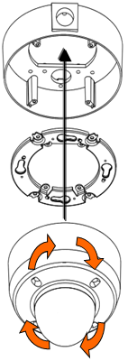

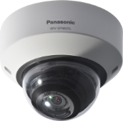
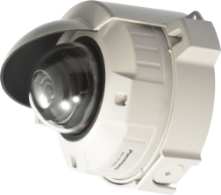
Easy installation
8
Flexible installation
Panasonic 5 series fixed dome cameras are ideal for discreet installation. It is harder to see the direction of camera, by adapting black and spherically-shaped lens.
The higher upper limit of visual angle enables installation in a lower place than previous models. It is also possible to install the camera on the exterior wall with the optional sun shade
Quick installation
The mounting attachment with four- point lock and the non-screw lock Pan-Tilt-Yaw (PTY) mechanism streamline the installation, simplifying positioning, screwing, cabling and adjusting the camera lens direction.
Base cover
Camera attachment
Conventional fixed dome camera
(Cropped data)
5 series fixed dome camera
(Cropped data)
WV-SFV531
with Sun shade
Twist to lock.
Notes:
As first introduction of 4K cameras, we will launch 2 new 360 degree cameras;
One is WV-SFV481, outdoor vandal model, and the other is SFN480, indoor dome model.
The 3 major points are
ULTRA High Resolution 9M pixel as 360 degree camera
ULTRA High Sensitivity
ULTRA Intelligent

Slide 9
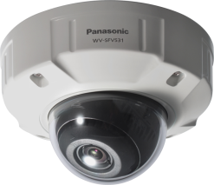
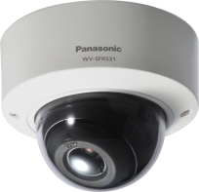

Specifications
9
 |  | WV-SFV531 | WV-SFR531 | WV-SFN531
Type |  | Outdoor Vandal resistant | Indoor Vandal resistant | Indoor
Image sensor |  | 1 / 3 type MOS Sensor
Max. video resolution (pixel) |  | 3 megapixel, 2,048 x 1,536
Max. frame rate |  | 60fps (2 mega pixel [16:9] mode), 30 fps (3 mega pixel [4:3] mode)
Day / Night |  | Yes (IR Cut filter Removal)
Minimum Illumination | Color | 0.07 lux
 | B/W | 0.01 lux
Angular Field of View *16:9 mode | Horizontal | 31° (Tele) – 109° (Wide) |  | 32° (Tele) – 110° (Wide)
 | Vertical | 18° (Tele) – 59° (Wide) |  | 18° (Tele) – 60° (Wide)
Audio |  | Two-way
SD memory card slot |  | 1 slot (SDXC/SDHC/SD)
Ambient Operating Temperature |  | -40°C ~ +50°C (-40°F ~ 122°F) | -10°C ~ +50°C (14°F ~ 122°F)
Dimension (excluding base bracket) |  | ø164 mm × 139 mm (H) | Ø129.5 mm × 102.5 mm (H) | Ø129.5 mm × 101 mm (H)
Notes:
As first introduction of 4K cameras, we will launch 2 new 360 degree cameras;
One is WV-SFV481, outdoor vandal model, and the other is SFN480, indoor dome model.
The 3 major points are
ULTRA High Resolution 9M pixel as 360 degree camera
ULTRA High Sensitivity
ULTRA Intelligent

