Slide 1

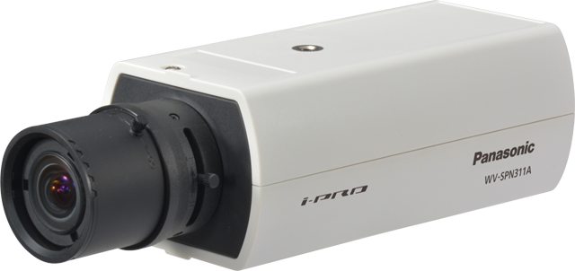

3 series Fixed Network Camera
Security Systems Business Division
Panasonic System Networks Co., Ltd.

Slide 2
5 series Fixed Network Camera
2
Indoor
WV-SPN311A (D/N (IR Cut filter Removal))
WV-SPN310A (D/N (Electrical))
(lens optional)
Super Dynamic Fixed Network camera
  Clear images in a wide range of lighting conditions
  Full HD at up to 60fps
  IP-Network friendly
  Optional intelligent VMD (i-VMD)

Slide 3
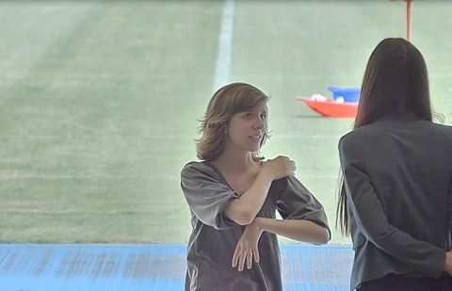

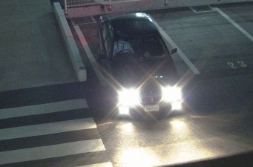


Clear images
3
133dB Wide Dynamic Range
Even a single image can include complex lighting conditions such as bright, glaring, dark of night and backlight situations. Equipped with Enhanced Super Dynamic (an industrial leading 133dB wide dynamic range), 3 series cameras enable clear and easy identification in high contrast scenes and backlight situations.
0.01lux minimum illumination for color images
The latest image sensor technology combined with Multi process Noise Reduction (MNR) and Frequency Divided Filter (FDF) results in a high sensitivity of 0.01 lux minimum illumination for color images. New 3 series cameras deliver color images even with minimum ambient light like a quarter moon.
HD 720p at up to 60fps
Combining HD 720p high resolution and 60fps high frame rate, 3 series cameras capture rapid moving objects such as people moving chips and cards in casino, bill in the bank and a vehicle plate on the road.

Slide 4
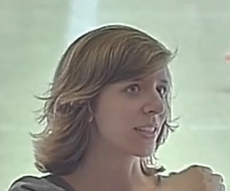

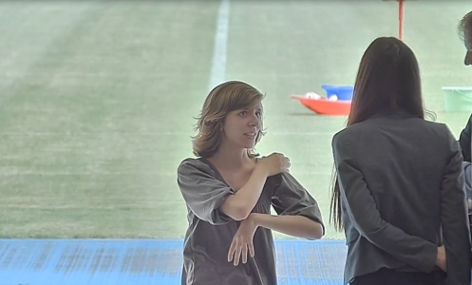
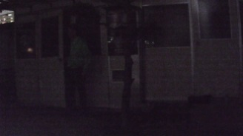
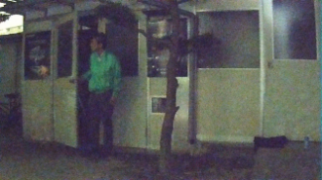


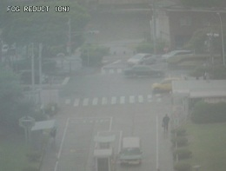
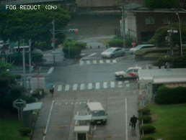
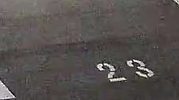
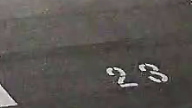
Panasonic image processing technologies
4
Enhanced Super Dynamic delivers an industrial leading 133dB wide dynamic range. With variable exposure and shutter speed control, Enhanced Super Dynamic captures multiple images with optimal short and long exposures. Enhanced Super Dynamic produces clear images, combining them into one frame.
High sensitivity image sensor with 3D-MNR enables easy identification, capturing color images with low noise in low light conditions.
3D-MNR: 3D Multi process Noise Reduction.
A previous model at 0.04lx
5-series camera
at 0.04lx
Without Enhanced Super Dynamic
With Enhanced Super Dynamic
Frequency Divided Filter (FDF) divides the images into multiple frequency ranges, removes the fine noise generated under low illumination for achieving a low bit rate without eliminating edge components.
Super Chroma Compensation
(SCC) recovers the colors of images, when built-in IR cut filter is removed to enhance light-sensitivity in low light conditions.
Fog compensation improves visibility in difficult weather conditions such as fog, sandstorms and more.
Without SCC
With SCC
Without fog compensation
With fog compensation
Without FDF
With FDF

Slide 5
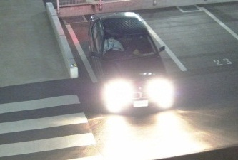
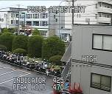




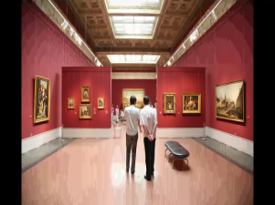
Panasonic image processing technologies
5
High Light Compensation (HLC)
produces clear images, reducing the effect from strong lights such as headlight glare.
High-speed Auto Back Focus (ABF) keeps fine focus, controlling precise image sensor position automatically. It streamlines installation and maintenance works.
Lens Distortion Compensation
(LDC) removes the distortion from images caused by wider lens.
Without HLC
With HLC
Before ABF
After ABF
Without LDC
With LDC
Face Super Dynamic enables clear identification of a person’s face, detecting a facial part in the picture and performing Super Dynamic automatically.
Variable Image Quality on Specified area (VIQS) saves the network bandwidth and recorder disk space, capturing clear images of region of interest with higher image quality.
Lower image quality
Higher image quality to region of interest
Without Face Super Dynamic
With Face Super Dynamic

Slide 6
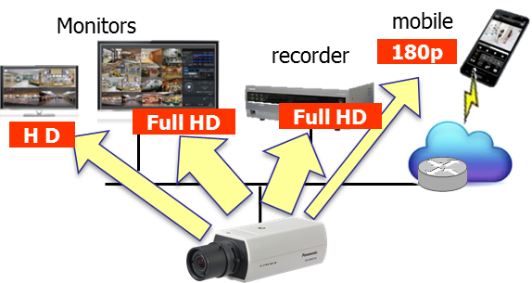
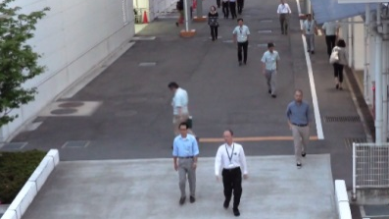
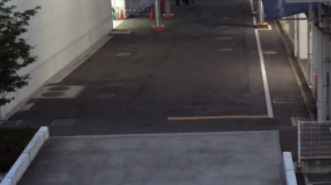
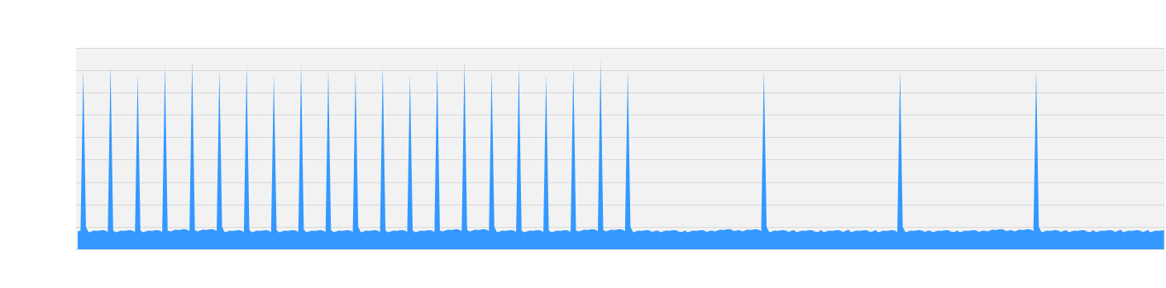
IP-Network friendly
6
Appropriate-sized video stream
Monitors, recorders, smartphones and remote sites such as branches have different requirements for image quality and network bandwidth. 3 series camera saves the network bandwidth, sending out up to four H.264 (High profile) streams and JPEG streams sized appropriately for each device requirement.
Higher H.264 compression
With the latest UniPhier system LSI, 3 series camera saves the network bandwidth and the recorder disk space, keeping high quality of images.
Smart coding Technology
Group of Picture (GOP) control removes unnecessary information from the frame for realizing efficient encoding.
With the latest bitrate reducing technology, GOP control, 3D-MNR and FDF, 3 series camera saves the network bandwidth and the recorder disk space.
Cameras | WV-SF/SW3xx | 3-series
HD at 30fps | 4 Mbps | 2 Mbps ( -50%)
HD at 10fps | 3 Mbps | 1 Mbps ( -66%)
(frame rate priority mode)
Scene | Without GOP | With GOP
Heavy traffic of people | 3 Mbps | 3 Mbps
Minimal traffic of people | 2 Mbps | 1 Mbps(-50%)
Generated
code amount
Predicted
Frame
Predicted
Frame
Predicted
Frame
When people are walking, I-frame is inserted at regular intervals as usual.
When there is no person walking, I-frames are thinned down to reduce the amount of data.

Slide 7
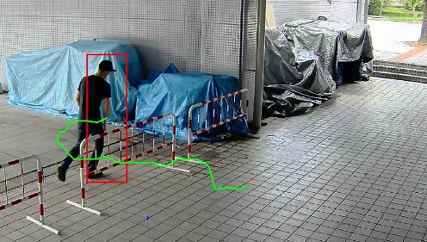
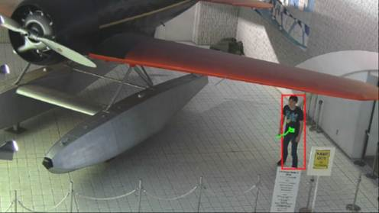
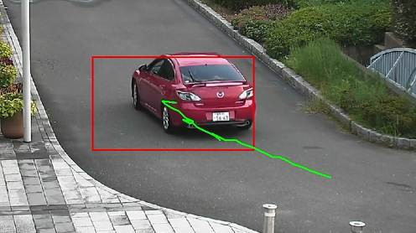
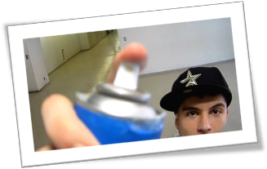
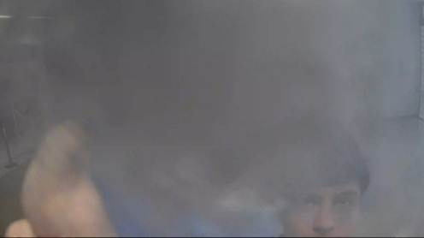
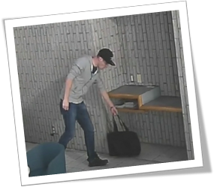
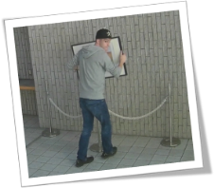
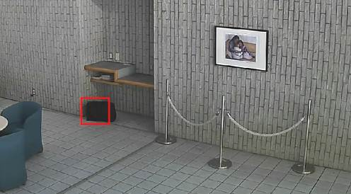
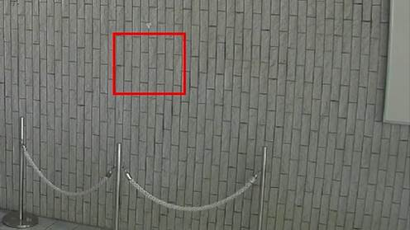
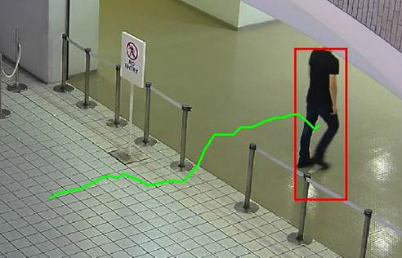
Optional intelligent VMD (i-VMD)
7
Intelligent VMD (Optional)
With the latest intelligent Video Motion Detection (i-VMD) technology, 3-series cameras improve the efficiency and effectiveness of surveillance. The evolved self-learning algorithm and powerful UniPhier system LSI results in the high detection rate with less false alerts.
Intruder detection
detects people or cars trespassing in restricted areas.
Loitering detection
detects people who has loitered for too long in the area.
Direction detection
detects people or cars that go the wrong direction.
Scene change detection detects tampering with the camera view.
Object detection (left)
detects something left behind that shouldn’t be there.
Object detection (removed)
detects objects disappearing that should be present.
Cross line detection
detects people or objects crossing the imaginary lines.

Slide 8
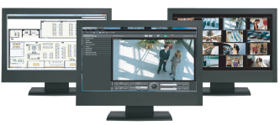
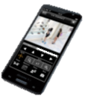
… and other useful features
8
Secure SD memory recording
Equipped with a SD memory card slot, 3 series camera stores recordings locally. Recordings can be password-protected and alteration detection helps ensure credibility of data.
Central management
The WV-ASM200 and System970 i-PRO management software enables central management of the cameras, recorders and monitors.
Viewing on smartphones and tablets
Panasonic Security Viewer enables viewing outside the surveillance center.
View and Setting with various browsers
When the camera is configured and checked, it does not have to be a specific browser such as only IE. Various browsers (Safari, Chrome*, Firefox and IE) can be used.
*The live display is supported only JPEG.
Alarm notification
When VMD, i-VMD, terminal alarm such as door alarm or command alarm is detected, the camera sends alarms to the operators based on pre-configured alert rule and/or saves images to the SD memory card or FTP server.
Privacy masking
The camera supports electronic privacy masking. Zones, the masked areas of the image, are easily defined.

Slide 9
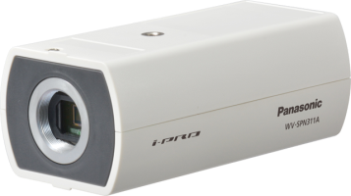

Specifications
9
 |  | WV-SPN311A | WV-SPN310
Appearance |  | (without optional lens) | (without optional lens)
Type |  | Indoor
Image sensor |  | 1/3 type MOS Sensor
Max. resolution |  | 1,920 x 1,080^{*1} / 1,280 x 960 *1:Super resolution technology
Max. frame rate |  | 60 fps
Day / Night |  | Yes (IR Cut filter Removal) | Yes (Electrical)
Minimum Illumination | Color | 0.01 lx (F1.4)
 | B/W | 0.003 lx (F1.4) | 0.008 lx (F1.4)
Lens mount |  | CS mount
Audio |  | Two-way | One –way, Built-in Microphone
SD memory card slot |  | 1 slot (SDXC/SDHC/SD)
Ambient Operating Temperature |  | -10°C ~ +50°C (14 °F ~ 122 °F)
Dimension |  | 75 mm (W) x 57 mm (H) x 146 mm (D) {2-15/16 inches (W) x 2-1/4 inches (H) x 5-47/64 inches (D)}

