Slide 1

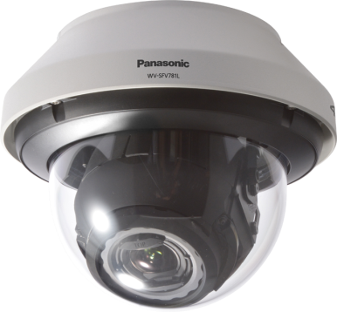
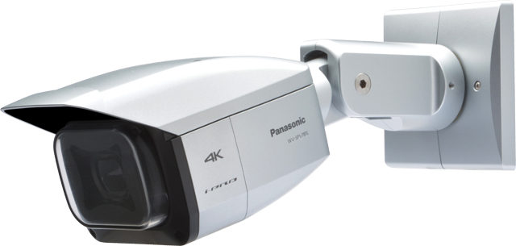

4K Fixed Dome/ Fixed Network Camera
WV-SFV781L
WV-SPV781L
Security Systems Business Division
Panasonic System Networks Co., Ltd.

Slide 2
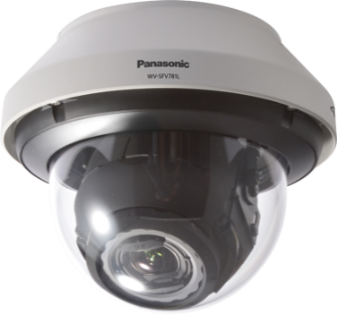
4K Fixed Dome/ Fixed Network Camera
2
Outdoor vandal resistant
WV-SFV781L
WV-SPV781L
(Available in July)
  Reduce the load on your operation and management
  Clearer monitoring with 4K resolution
  Capture clear images in any environment
4K Fixed Dome/ Fixed Network Camera
Notes:
As first introduction of 4K cameras, we will launch 2 new 360 degree cameras;
One is WV-SFV481, outdoor vandal model, and the other is SFN480, indoor dome model.
The 3 major points are
ULTRA High Resolution 9M pixel as 360 degree camera
ULTRA High Sensitivity
ULTRA Intelligent

Slide 3


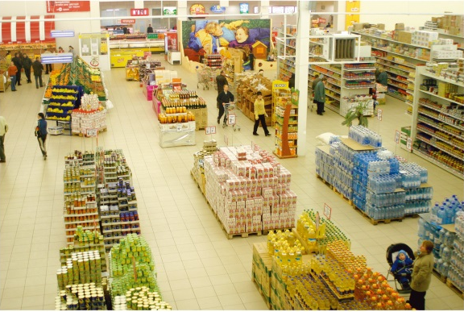
Applications
3
4K Fixed Dome/ Fixed Network Cameras are suitable for monitoring open areas:
City Surveillance
Intersections
Squares
Airport
Stations
Port facilities
Plant
Shopping Malls and more.
Notes:
As first introduction of 4K cameras, we will launch 2 new 360 degree cameras;
One is WV-SFV481, outdoor vandal model, and the other is SFN480, indoor dome model.
The 3 major points are
ULTRA High Resolution 9M pixel as 360 degree camera
ULTRA High Sensitivity
ULTRA Intelligent

Slide 4
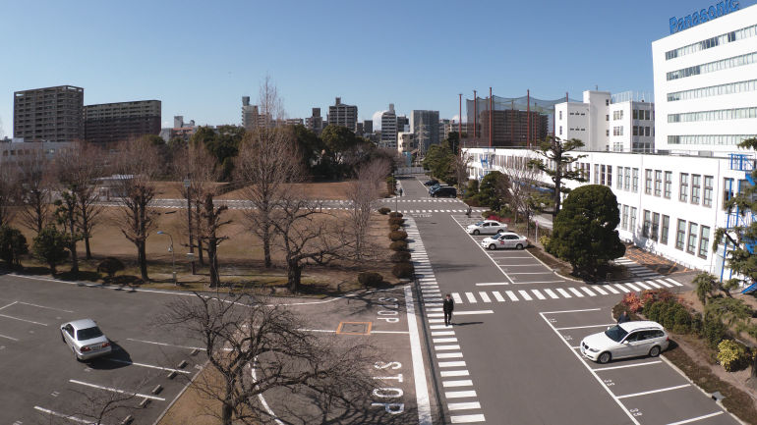
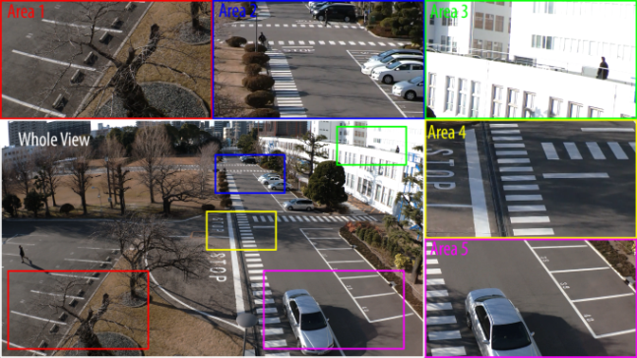
Reduce the load on your operation and management
4
Reduce the load on your operation
Reduce the number of cameras
4K cameras can cover angle of view the same as 9 units of 720p cameras or 4 units of 1080p cameras. Therefore, 4K cameras can reduce a blind spot as they cover wider than a Full HD camera or a HD camera.
Reduce the load on operation
The number of cameras to be monitored can be reduced by 4K camera which covers wider angle of view than a Full HD camera or a HD camera.
Whole area and five cropping areas can be viewed with i-PRO system at the same time. You can watch images of whole and detailed point at a time.
Full HD
ＨD
4K
Notes:
As first introduction of 4K cameras, we will launch 2 new 360 degree cameras;
One is WV-SFV481, outdoor vandal model, and the other is SFN480, indoor dome model.
The 3 major points are
ULTRA High Resolution 9M pixel as 360 degree camera
ULTRA High Sensitivity
ULTRA Intelligent

Slide 5
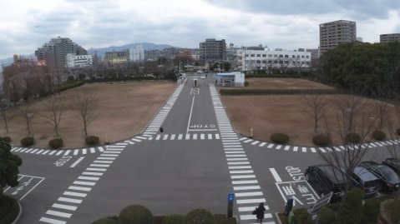
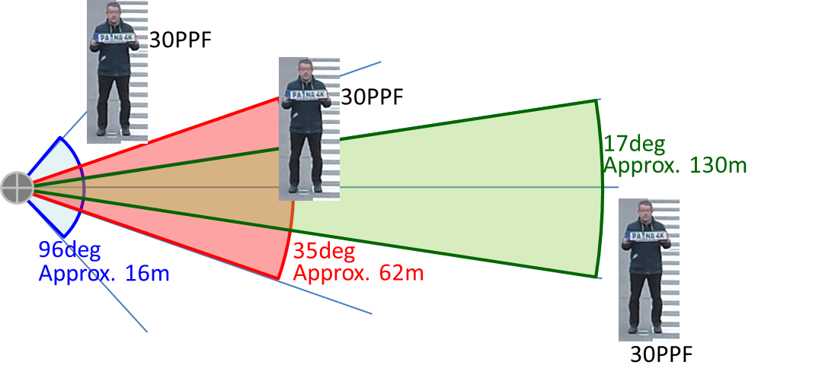
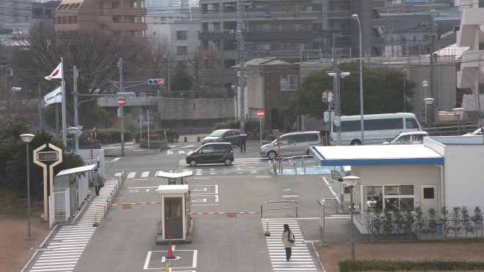

Clearer monitoring with 4K resolution
5
Wide to distant situational awareness
You can select and get 4K resolution images from a specific area to a wide area with 6x optical zoom, depending on the installation location. When capturing an all-around view of the surrounding area on the wide mode, the 4K cameras provide wide and distant situational awareness and eliminates blind spots.
96 ° (Wide)
Approx. 130m
17° (Tele)
Notes:
As first introduction of 4K cameras, we will launch 2 new 360 degree cameras;
One is WV-SFV481, outdoor vandal model, and the other is SFN480, indoor dome model.
The 3 major points are
ULTRA High Resolution 9M pixel as 360 degree camera
ULTRA High Sensitivity
ULTRA Intelligent

Slide 6

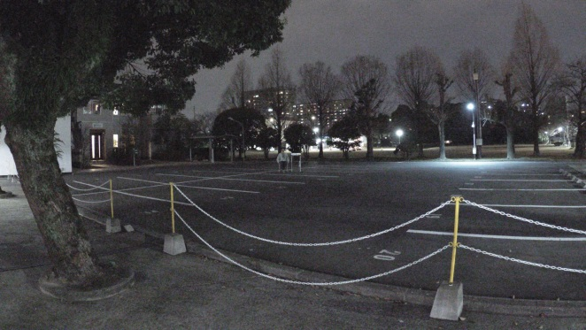
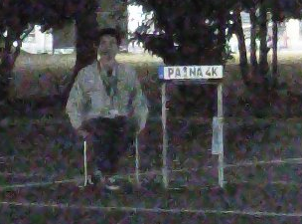
Clearer monitoring with 4K resolution
6
Detailed images with 4K resolution
High resolution is required to capture a large area in detail.
4K (8 megapixel) resolution enables clear identification from the center to the edge, delivering very detailed images.
edge part
Clear images with low light or complete darkness
Equipped with F1.6 large diameter lens and high-sensitive sensor, the 4K cameras produce a color image with a minimum illumination of 0.3 lux. And, these cameras have a built-in IR LED to capture clear images in low light or complete darkness.
0.3lx
Notes:
As first introduction of 4K cameras, we will launch 2 new 360 degree cameras;
One is WV-SFV481, outdoor vandal model, and the other is SFN480, indoor dome model.
The 3 major points are
ULTRA High Resolution 9M pixel as 360 degree camera
ULTRA High Sensitivity
ULTRA Intelligent

Slide 7
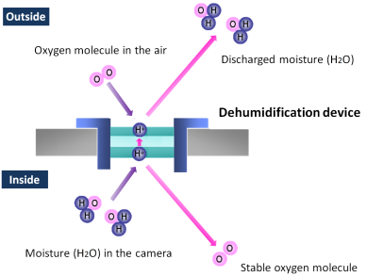
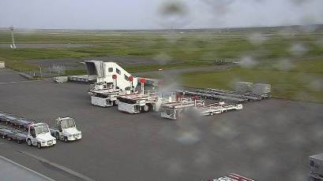
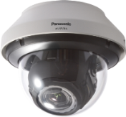
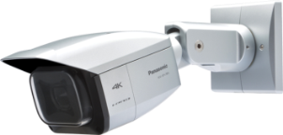
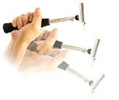
Watch clear videos in any environment
7
Capture clear images, no matter what environment ;
IP66- and NEMA 4X-rated robustness
Capture clear images, even if it is raining ;
Hydrophilic coating
The 4K cameras support IP66- and NEMA 4X-rated weather resistant. The built-in electrical
dehumidification keeps the camera
dry inside, using electrolysis to
remove any moisture from the camera.
This anti-humidity technology is safe
and green due to low power
consumption and no heaters or
mechanical fans being used.
The hydrophilic coating on the camera dome keeps visibility in rainy weather, sheeting water off instead of forming droplets that scatter light.
Unbreakable, even if shocked externally ;
Built-in shock absorber
The 4K cameras are IK10-rated impact resistant. In case the camera is subjected to mechanical shock, the built-in shock absorber protects the optical system from the impact by moving the lens system backward. The energy absorbing mechanism consisting of springs and a decelerator effectively diminishes the impact.
Notes:
As first introduction of 4K cameras, we will launch 2 new 360 degree cameras;
One is WV-SFV481, outdoor vandal model, and the other is SFN480, indoor dome model.
The 3 major points are
ULTRA High Resolution 9M pixel as 360 degree camera
ULTRA High Sensitivity
ULTRA Intelligent

Slide 8
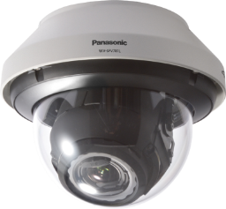
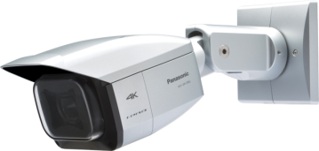

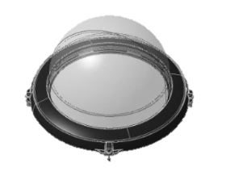
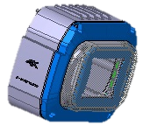
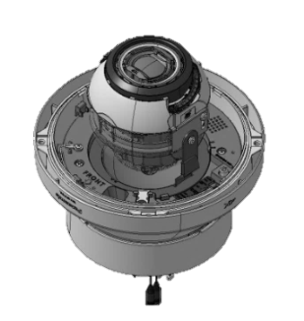
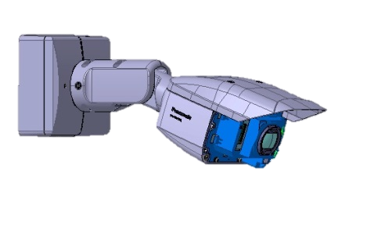
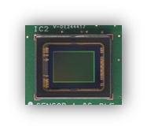
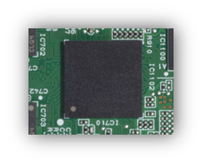
Base technology which support 4K camera
8
Panasonic 4K cover
4K dome cover using the proprietary technology of Panasonic delivers clear view as if not using the dome cover.
IP66-, NEMA-4X and IK10-rated robustness
Panasonic 4K optical 6x zoom lens
F1.6, large diameter, 4K resolution lens delivers clear view,
6x optical zoom for installation flexibility.
12-megapixel, 1/1.7-inch MOS sensor
High-sensitivity sensor with newly designed optical system captures clear details with up to 12 megapixel resolution.
Powerful 4K Engine
Equipped with a dual-core 1GHz processor, the new 4K Ultra Engine performs vast calculations per second including Wide Dynamic Range (WDR).
Notes:
As first introduction of 4K cameras, we will launch 2 new 360 degree cameras;
One is WV-SFV481, outdoor vandal model, and the other is SFN480, indoor dome model.
The 3 major points are
ULTRA High Resolution 9M pixel as 360 degree camera
ULTRA High Sensitivity
ULTRA Intelligent

Slide 9

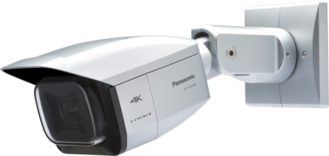
Specifications
9
 |  | WV-SFV781L | WV-SPV781L
Type |  | Outdoor Vandal resistant
Image sensor |  | 1/1.7 type MOS Sensor
Max. video resolution (pixel) |  | 12 megapixel, 4,000 x 3,000
Max. frame rate |  | 15 fps (12 mega pixel mode), 30 fps (8 mega pixel mode)
Day / Night |  | Yes (IR Cut filter Removal)
Minimum Illumination | Color | 0.3 lux
 | B/W | 0.04 lux / 0.1 lux with IR-LED
Angular Field of View *16:9 mode | Horizontal | 17° (Tele) - 96° (Wide) | 17° (Tele) - 97° (Wide)
 | Vertical | 9.3° (Tele) – 54° (Wide) | 9.4° (Tele) – 55° (Wide)
Audio |  | Two-way
SD memory card slot |  | 1 slot (SDXC/SDHC/SD)
Ambient Operating Temperature |  | -45°C ~ +50°C (-49°F ~ 122°F)
Dimension (excluding base bracket) |  | ø228 mm × 189 mm (H) | 131mm(W), 130mm(H), 380mm(D)
Notes:
As first introduction of 4K cameras, we will launch 2 new 360 degree cameras;
One is WV-SFV481, outdoor vandal model, and the other is SFN480, indoor dome model.
The 3 major points are
ULTRA High Resolution 9M pixel as 360 degree camera
ULTRA High Sensitivity
ULTRA Intelligent

